Slide 1
PLASMA PROTEINS

Slide 4
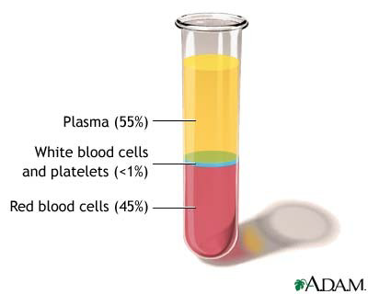
Components of Plasma
Blood plasma Consists of:
Water 90% and solid 10%
Plasma Proteins 6-8 %
Electrolytes 1%
Wastes (e.g. Urea)
Nutrients (e.g. Glucose, cholesterol and amino acids)
Hormones (e.g. Cortisol, thyroxin)
Enzymes
Blood gases (e.g. CO2, O2)

Slide 5
Plasma proteins
Plasma contains a complex mixture of thousands of simple proteins and conjugated protein that is known as plasma proteins.
They carry out a number of different functions.
Total protein (normal plasma): 6 to 8 g/100 ml.
The plasma proteins consist of :
albumin (3.5 to 5 g/dl),
globulins(2.5-3.5 g/dl)
fibrinogen (200-400 mg/dl)
The albumin : globulin(A:G Ratio) - 1.2:1 to 1.5:1.
Synthesis: liver except immunoglobulin

Slide 6
General characteristics of plasma proteins
They are synthesized in liver except immunoglobulin.
Almost all plasma proteins are glycoproteins.
Each plasma protein has a characteristic half life in the circulation.
Technique for separation of plasma proteins:
ELECTROPHOERESIS

Slide 7
Separations of Plasma protein
Ammonium sulphate will precipitate globulins at half saturation and albumin at full saturation.
Fibrinogen is precipitated by 10% and globulin by 22% concentration of sodium sulphate.
In clinical laboratory, total proteins in serum or plasma of patients are estimated by Biuret method.
Albumin by Bromocresol green (BCG) method. in which the dye is preferentially bound with albumin, and the colour intensity is measured calorimetrically.

Slide 8
ALBUMIN
constitutes the major part of plasma proteins. Makes up approximately 60% of total plasma protein.
one polypeptide chain with 585 amino acids and contain 17 disulfide bonds.
molecular weight - 69000 D. so it can easily come out through vascular compartment and can be present in CSF and interstitial fluid.

Slide 9
ALBUMIN
synthesized by hepatocytes. Liver produces -12 g of albumin per day.estimation of albumin is a liver function test. representing about 25% of total hepatic protein synthesis.
Half life of albumin is about 20 days.
Albumin has isoelectic pH of 4.7

Slide 10
Functions of Albumin

Slide 11
1.Colloid Osmotic Pressure of Plasma
The total osmolality of serum is 278-305 mosmol/kg
Exerted mainly by salts, which can pass easily from intravascular to extravascular space.
So, the osmotic pressure exerted by electrolytes inside and outside the vascular compartments will cancel each other.
Proteins cannot easily escape out of blood vessels, and so, proteins exert the effective osmotic pressure.
This effective osmotic pressure maintains blood volume.

Slide 12
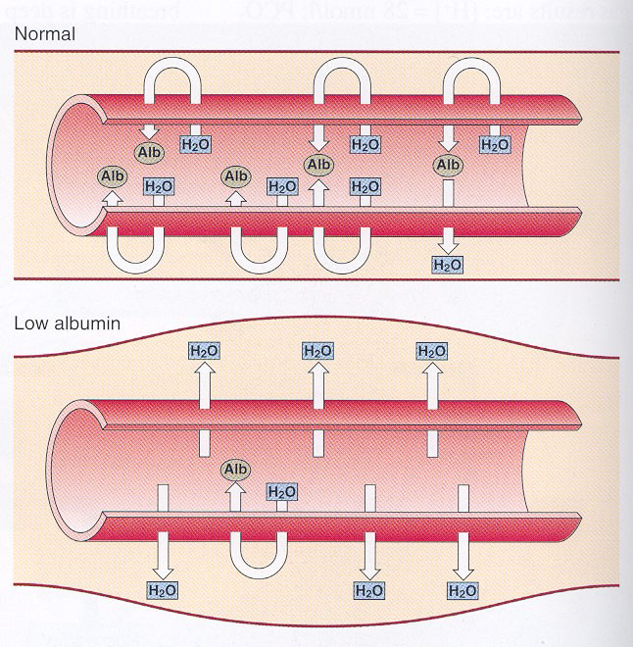
Colloid osmotic pressure
Low Albumin causes Edema

Slide 13
2.Transport Function
Albumin carries the hydrophobic substances in the blood.
Bilirubin
non-esterified fatty acids
Drugs : aspirin, salicylate, phenytoin,suifonamides
Hormones : thyroxine, steroid hormones
Metals: calcium, copper and heavy metals
Only the unbound fraction of drugs is biologically active.

Slide 14
3.Buffering Action
All proteins have buffering capacity.
Normal ph of blood – 7.36-7.42
Albumin has maximum buffering capacity because of its high concentration in blood.
Albumin has a total of 16 histidine residues which contribute to this buffering action.
4.Nutritional Function
All tissue cells can take up albumin by pinocytosis.
broken down to amino acid level.
considered as the transport form of essential amino acids from liver to extrahepatic cells.

Slide 15
5) Albumin is an important component of plasma antioxidant activity.
6)Albumin inhibits leukotriene and acid actin production, thus reducing the inflammatory response of platelets and neutrophils.

Slide 16
clinical Applications of Albumin

Slide 17
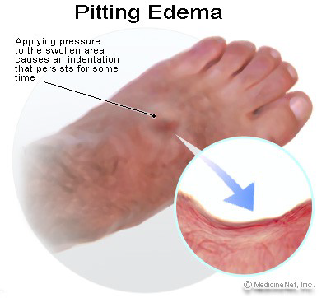
If protein concentration in serum is reduced, then return of water into blood vessels is diminished, leading to accumulation of water in tissues. This is called edema.
Chronic congestive cardiac failure: venous congestion will cause increased hydrostatic pressure & decreases return of water into capillaries & so pitting edema of feet may result
Edema is seen in conditions where albumin level in blood is less than 2 g/dl.

Slide 18
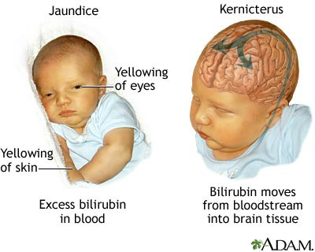
2)Albumin-fatty acid complex cannot cross blood-brain barrier and so fatty acids cannot be taken up by brain.
3)The bilirubin from albumin may be competitively replaced by aspirin and such other drugs.
In newborns, bilirubin is already high, and if such drugs are given, there is a probability that free bilirubin is deposited in brain leading to kernicterus and mental retardation.

Slide 20
4) Protein-Bound Calcium
Calcium level in blood is lowered in hypo-albuminemia.
But this does not lead to tetany because even though total calcium level in blood is lowered, ionised calcium level may be normal.
Calcium is lowered by 0.8 mg/dl for a fall of 1 g/dl of Albumin.
5) Drug interaction
Two drugs having same affinity for albumin when administered together, can compete for available binding sites with displacement of other drug

Slide 21
6)Therapeutic Use
Human albumin is therapeutically useful to treat burns, hemorrhage and shock.

Slide 22
Hypo-albuminemia
Normal level of Albumin is 3.5-5 g/dl
Lowered in:
Cirrhosis of liver: Synthesis is decreased.
Malnutrition: Availability of amino acids is reduced and so albumin synthesis is affected.
Nephrotic syndrome: Permeability of kidney glomerular membrane is defective, so that albumin is excreted in large quantities.

Slide 23
cirrhosis of liver

Slide 24
Nephrotic syndrome

Slide 25
Albuminuria: Presence of albumin in urine is called albuminuria. It is always pathological. Albumin is lost in urine in Nephrotic syndrome (Large quantities). In acute nephritis, and other inflammatory conditions of urinary tract (Small quantities). Detection of albumin in urine - heat and acetic acid test. In micro-albuminuria, small quantity of albumin (30- 300 mg/dl) is seen in urine.
Protein losing enteropathy: Large quantities of albumin is lost from intestinal tract.
Burns

Slide 26
Albumin-Globulin Ratio
The albumin : globulin(A:G Ratio) - 1.2:1 to 1.5:1.
In hypo-albuminemia, there is a compensatory increase in globulins which are synthesized by the reticulo-endothelial system.
In hyper gamma globulinemia
So, A/G ratio is altered or even reversed.

Slide 27
Hyper-gamma-globulinemias
Low Albumin Level : body tries to compensate by increasing the production of globulins from reticuloendothelial system.
Chronic Infections : Gamma globulins are increased, but the increase is smooth and wide based.
Multiple Myeloma : Multiple myeloma is a cancer that forms in a type of white blood cell called a plasma cell. Drastic increase in globulins are seen in para-proteinemias, when a sharp spike is noted in electrophoresis. This is termed as M-band.

Slide 28
Normal electrophoretic pattern and Globulin fraction

Slide 29
GLOBULIN FRACTION
α₁-anti trypsin
α₁- globulin
α₂- globulin
Ceruloplasmin
α₂-macroglobulins
β-globulin
C-reactive protein (CRP)
Low density lipoproteins
γ-globulin
Antibodies (Immunoglobulins)

Slide 30
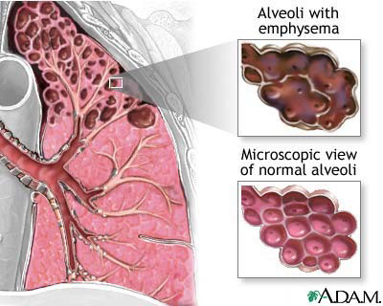
Alpha-1 Anti- trypsin (AAT)
alpha-anti-proteinase/ protease inhibitor
It inhibits all serine proteases such as plasmin, thrombin, trypsin, chymotrypsin, elastase and cathepsin.
Bacterial infections in lung attract macrophages which release elastase.
In the alpha1-AT deficiency, unopposed action of elastase will cause damage to lung tissue, leading to emphysema.

Slide 31
2. Ceruloplasmin (blue)
It is also called Ferroxidase, an enzyme which helps in the incorporation of iron into transferrin.
90% of copper content of plasma is bound with ceruloplasmin, and 10% with albumin.
Lowered levels of ceruloplasmin is seen in Wilson’s disease, malnutrition, nephrosis and cirrhosis.
Increased in all inflammatory conditions, collagen disorders and in malignancies.
an important anti-oxidant in plasma.

Slide 32
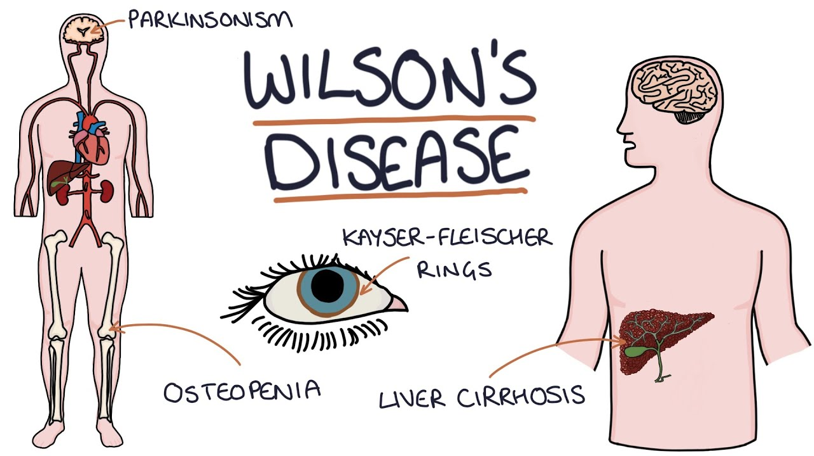
Wilson’s Disease:
The basic defect is a mutation in a gene encoding a copper binding ATPase in cells, which is required for excretion of copper from cells. So, copper is not excreted.
Osteolytic lesions (also known as osteoclastic lesions) are areas of damaged bone that can occur in people with malignancies, such as myeloma and breast cancer.

Slide 33
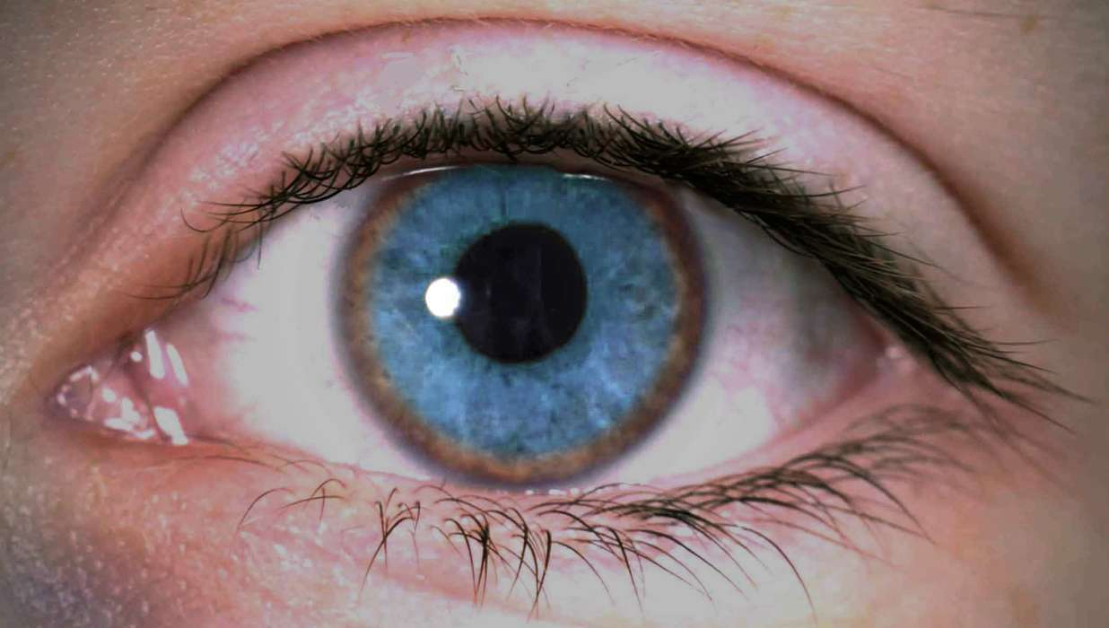
Increased copper content in hepatocyte inhibits the incorporation of copper to apo-ceruloplasmin. So, ceruloplasmin level in blood is decreased.
Copper deposits as green or golden pigmented ring around cornea; this is called Kayser-Fleischer ring.

Slide 34
3. Alpha-2-Macroglobulin
It inactivates all proteases, it is an important in vivo anti-coagulant.
It is the carrier of many growth factors such as platelet derived growth factor (PDGF).

Slide 35
4. C-Reactive Protein (CRP)
It is thus named because it reacts with C-polysaccharide of capsule of pneumococci.
It is a beta globulin.
It can stimulate complement activity and macrophage phagocytosis.
When inflammation subsides, CRP quickly falls, followed later by ESR
CRP level, especially high sensitivity C-reactive protein level in blood has a positive correlation in predicting the risk of coronary artery diseases

Slide 36
ACUTE PHASE PROTEINS
The level of certain proteins in blood may increase 50 to 1000 folds in various inflammatory and neoplastic conditions.
Such proteins are acute phase proteins.
C-Reactive Protein (CRP)
Ceruloplasmin
Alpha-1 Anti-trypsin (AAT)
Alpha-2-Macroglobulin

Slide 37
Negative Acute Phase Proteins
During an inflammatory response, some proteins are seen to be decreased in blood; those are called negative acute phase proteins.
used as a better index of protein turnover than albumin
Examples are
Albumin
Transthyretin (pre-albumin)
Retinol binding protein
Transferrin.

Slide 38
TRANSPORT PROTEINS
Bilirubin , free fatty acids, calcium
and drugs.
Albumin
Pre-albumin or Transthyretin
Thyroid hormones
Retinol Binding Protein
Vitamin A
Thyroxine Binding Globulin
Thyroxine and tri-iodo thyronine.
Transcortin
Cortisol and corticosterone
Haptoglobin
Hemoglobin
Transferrin
Iron
Hemopexin
Heme

Slide 39
clotting factors
The biochemical mechanism of clotting is a typical example of cascade activation.
The coagulation factors are present in circulation as inactive zymogen forms.
converted to their active forms only when the clotting process is initiated.
This prevents unnecessary intravascular coagulation. one molecule of preceding factor activates 1000 molecules of the next factor and so on.
Thus within seconds, millions or trillions of molecules of final factors are activated.

Slide 40
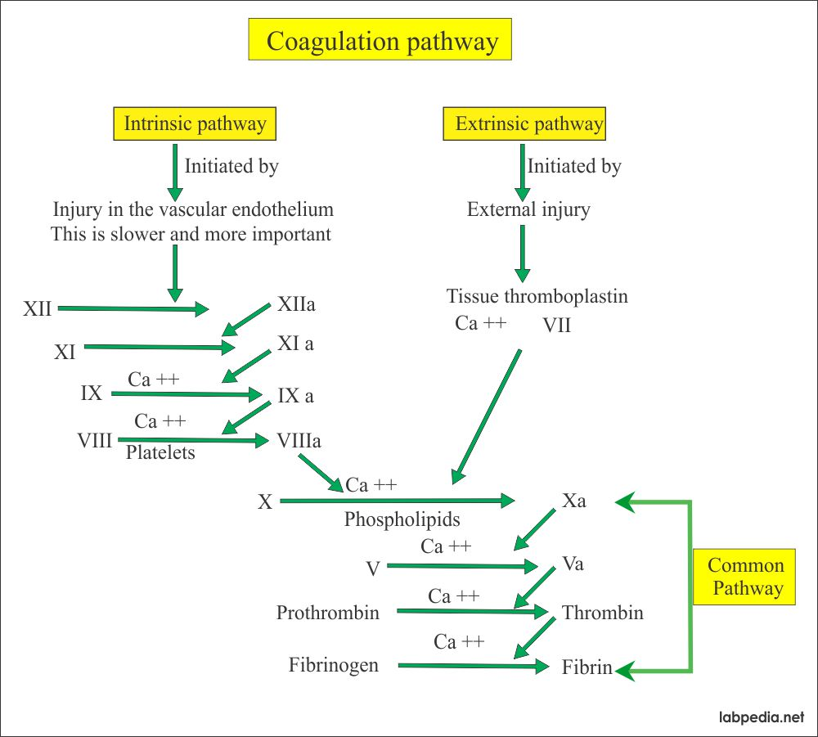

Slide 41
ELECTROPHORESIS
It is used regularly for separation of serum proteins.
Electrophoresis is the migration of charged solutes or particles of any size in a liquid medium under the influence of an electrical field.

Slide 42
ELECTROPHORESIS
In agar gel electrophoresis, normal serum is separated into 5 bands, which are given below:
Albumin : 55-65%
Alpha-1-globulin : 2-4%
Alpha-2-globulin : 6-12%
Beta-globulin : 8-12%
Gammaglobulin : 12-22%
Albumin has the maximum and Gammaglobulin (immunoglobulins) has the minimum mobility in the electrical field.

Slide 43
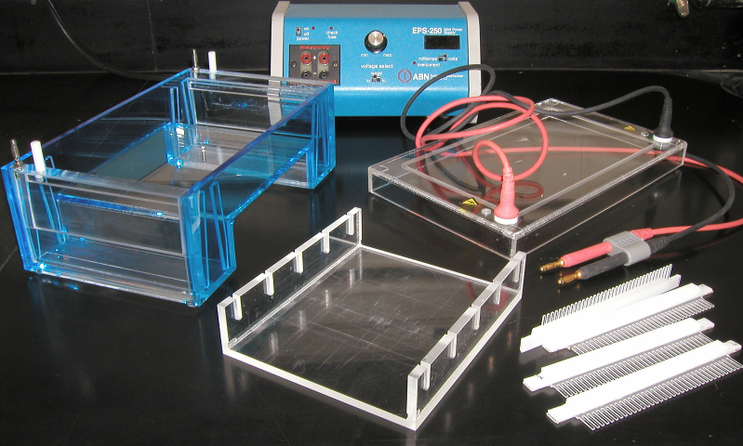

Slide 44
Agar Gel Electrophoresis

Slide 45
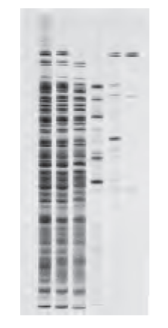
ELECTROPHORESIS

Slide 46
Electrical field

Slide 47
UV Light

Slide 48
ELECTROPHORESIS

Slide 49
Normal Electrophoretic pattern of serum proteins

Slide 50
Normal electrophoretic pattern of serum proteins

Slide 51
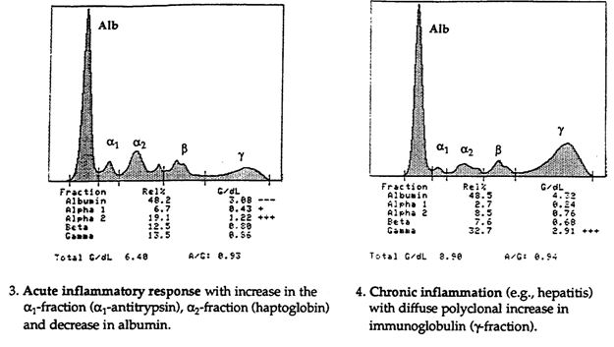
Abnormal Patterns in Clinical Diseases
Chronic infections: The gammaglobulins are increased, but the increase is smooth and widebased.

Slide 52
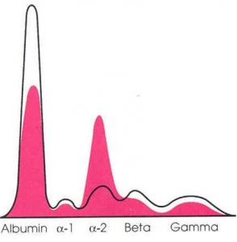
Nephrotic syndrome: All proteins except very big molecules are lost through urine, and so alpha-2 fraction (containing macroglobulin) will be very prominent.

Slide 53
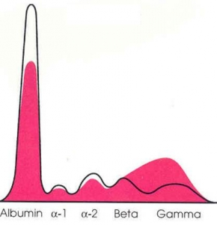
Cirrhosis of liver: Albumin synthesis by liver is decreased, with a compensatory excess synthesis of globulins by reticuloendothelial system. So, albumin band will be thin, with a wide beta fraction; sometimes beta and gamma fractions are fused.

Slide 55
Applications of electrophoresis
In the study of structure and function of proteins
In the separation of DNA fragments for DNA fingerprinting to investigate crime scenes
To analyze results of polymerase chain reaction
In paternity testing using DNA fingerprinting and DNA Sequencing
Medical Research
Agricultural testing
Separation of organic acid, alkaloids, carbohydrates, amino acids, alcohols, phenols, nucleic acids, insulin steroids and antibiotics.
In food industry

Slide 56
Applications of electrophoresis
9.It is employed in biochemical and clinical fields i.e. in the study of protein mixtures such as blood serum, haemoglobins and in the study of antigen- antibody interactions.
10.Electrophoresis in combination with autoradiography is used to study the binding of iron to serum proteins.
11.For testing purity of thyroid hormones by zone electrophoresis.
12.Paper chromato-electrophoresis is used to separate free Insulin from plasma proteins.
13.It is used for diagnosis of various diseases of kidney , liver and CVS.
14.It is also used for separation of Scopolamine and Ephedrine using buffer at PH 4.2.
15.Quantitative separation of all fractions of cellular entities, antibiotics, RBC, Enzymes etc is possible.

Slide 57
Clinical significance
Normal
Multiple myeloma (M band)
Chronic infection
Nephrotic syndrome
Cirrhosis of liver
Plasma showing fibrinogen (normal condition)

