Slide 1
Dr. Sapna Patel
MD Biochemistry
Govt. Medical College Bhavnagar

Slide 2
TYPES OF SPECIMENS
1)Whole blood
2) Serum
3) Plasma
4) Urine
5) Feces
6) Saliva
7) Other fluids( spinal, synovial, amniotic, pleural, pericardial, and ascitic)
8) Various types of solid tissue

Slide 3
BLOOD
1. Venipuncture
2. Skin Puncture
3. Arterial Puncture
4. Collection of Blood from Intravenous or Arterial Lines

Slide 4
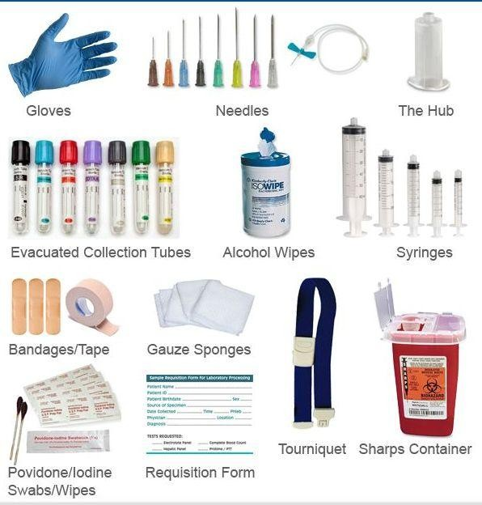
Phlebotomy

Slide 5
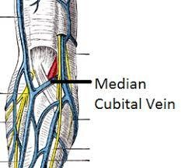
Median cubital vein is the best choice (why?)
good blood flow Most superficial

Slide 6
70% Alcohol
Circular motion and from the site to outward.

Slide 7
- Fasting blood Sample
Approximately 8 to12 hours fast before blood test.
-Drink only water
- Regular drug allow
- Postprandial blood sample
2 Hours after Regular major Meal

Slide 8
Lipid profile
Fasting required
Tri glyceride is high in non fasting sample
Why fasting is not required for cholesterol & thyroid profile ?

Slide 9
Method of blood collection
1)
With Syringe and non-vacuum vacutte
With vacuum Vaccutiner With Butterfly Needle Lancet
2)
3)
4)

Slide 10
1) With Syringe and non-vacuum vacuette
Advantage:
Cheaper
Not extra accessory requiry
Disadvantage:
Improper volume – especially when blood collection is require for cougulation profile
Haemolysis

Slide 11
2) With vacuum Vaccutiner
Advantages:-
Maintain proper volume of blood
Safe & Speedy
Reducing the risk of haemolysis
Blood can be collected in multiple tubes
Disadvantages:-
not suited for small veins.

Slide 12
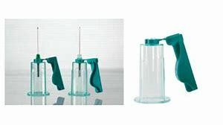
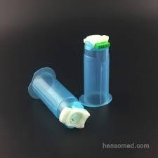
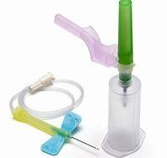

Slide 13
3) With Butterfly needle
Disadvantages.
1) The risk of hemolysis
2) It is difficult to collect large quantity of blood as well as in multiple vacuette
Advantages:
Useful in infants & children

Slide 15
Preanalytic Interference In Sample
Haemolysis
Reddish discoloration of serum/plasma due to rupture of RBCs.
Factor causing haemolysis
Sampling = Inject forcefully in vacutte
Store = Frozen = Due to high or low temp,
Vigorously shaking of blood - trasnporatation
Icteric
Yellowish discoloration of Serum due to high bilirubin.
Lipemic
Milky or Turbid appearance of Serum due to high Triglyceride

Slide 16
CSF
CSF collected in small amount
So, CSF is collected in Plain Tube (For glucose estimation )
Tube immediately transported to laboratory.
Tube is keep over ice packs but do not allow to frozen
Sample is as early as possible to analyse (half an hour)

Slide 17
Blood collection tubes:
Serum separating tubes (SST)
Plasma separating tubes (PST)

Slide 18
Plasma Separating Tubes (PST)
Top Color | Additives | Principle | Uses
Lavender | EDTA Dose= 1to2g/l of blood | -The strongest anti-coagulant -Ca⁺² chelating agent | Hematology Blood bank
Light Blue | Sodium Citrate 2g/l | Ca⁺² chelating agent | PT APTT:
Green | Sodium Heparin or Lithium Heparin | Heparin binds to Thrombin and inhibits the second step in the coagulation cascade (Prothrombin Thrombin) Heparin Fibrinogen Fibrin | Enzymes Hormones Electrolytes (Na⁺, K⁺, Mg⁺, Cl)

Slide 19
Serum Separating Tubes (SST)
Top Color | Additives | Principle | Uses
Gray | -Sodium Fluoride 2g/l -Potassium Oxalate | Glycolysis inhibitor Anti- Coagulant | Glucose tests
Top Tubes | Additives | Principle | Uses
Red | ------ Sometimes it has gel or silicon at the bottom of tube to reduce hemolysis | Enhancing the formation of blood clot | Serology -Antibodies -Hormones -Drugs Virology Chemistry Blood cross matching before blood transfusion

Slide 20
Order of Draw
1)
Blood culture tube
2)
Citrate tube
3)
Plain tube
4)
Heparin tube
5)
EDTA tube
6)
Fluoride tube

Slide 21
Why Blood culture tube collected first?
Avoid surface contamination by Hands,
Vacuette

Slide 22
Why plain tube is take after the citrate tube ???
Plain tube –Clot activated
This contaminate citrate tube
Low result of PT

Slide 23
Why Heparin tube is take after the plain tube???
Heparin contain Sodium or Potassium or Lithium salt.
So it contaminate plain tube with Sodium or Potassium or Lithium salt.
So result of Sodium or Potassium or Lithium is high if heparin tube is
collected before plain tube.

Slide 24
Why is EDTA tube take after the Heparin tube???
EDTA chelate calcium
In plain tube ca+ result is low
So Heparin and Plain tube collected
before EDTA.

Slide 25
Why Fluoride tube is take after the EDTA tube ???
Fluoride can contaminate EDTA tube if collected before EDTA
Fluoride can distorted Red Blood cell
Morphology.
So Peripheral smear can not be reliable.

Slide 26
What to see on and inside the vaccuette?

