Slide 1
PRINCIPLE OF COLORIMETER AND SPECTOPHOTOMETER AND VARIOUS TYPE OF ANALYSER USED IN CLINICAL BIOCHEMISTRY

Slide 2
COLORIMETER
What is colorimeter ?
Colorimetry.
Principle of colorimeter.
Beer's and Lambert's law.
Components of colorimeter.
Functions of components.
Advantages and Disadvantages of single cell photometry.

Slide 3
What is colorimeter ?
Colorimeter is a instrument used for the measurement of colored substance in solution.
Instrument is operative in the visible range of the magnetic spectrum.

Slide 4
COLORIMETRY
It is a most common analytical technique used in biochemical estimation in clinical laboratory.
It involves the quantitative estimation of colour.
A substrate must be estimated colorimetrically, must be coloured or it should be capable of forming chromogens (coloured complexes) through the addition of reagents.

Slide 5
Coloured substance absorb light in relation to their colour density.
The colour density will be proportional to the concentration of coloured substance.
The instruments used in this method are called colorimeter or photometer.

Slide 6
PRINCIPLE OF COLORIMETER
When a monochromatic light passes through a coloured solution, some specific wavelength of light is absorbed which is related to colour density.
The amount of light absorbed or transmitted by a colour solution is accordance with two law, i.e. Beer’s law and Lambert’s law.

Slide 7
COMPONENT OF COLORIMETER
Light source
Slit
monochromator(filter)
Cuvette
Photocell
Galvanometer

Slide 8
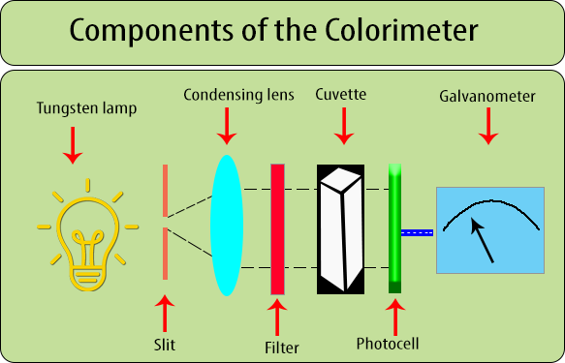

Slide 9
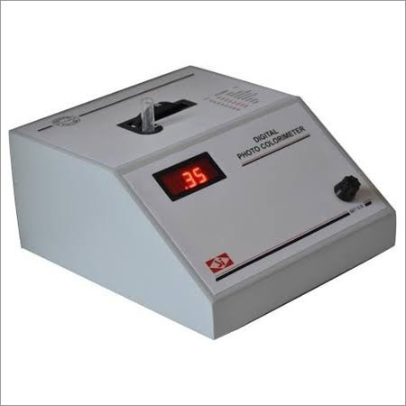

Slide 10
FUNCTION OF EACH COMPONANT
Light source
Two kinds of lamp:-
Halogen Deuterium :- for measurement in the ultraviolet range 200 – 900 nm.
Tungsten lamp:- for measurement in the visible 400
– 760 nm and near-infrared ranges.

Slide 11
MONOCHROMATOR(FILTER) :
Used for selecting the monochromatic light.
Filters will absorb light of unwanted wavelength and allow only monochromatic light to pass through.
Three type: 1.Prism 2.Grating
3. Glass

Slide 12
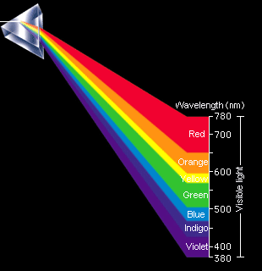
PRISM
When light travels from one medium to another medium , it is refracted and enters in the new medium at a different angle.

Slide 13
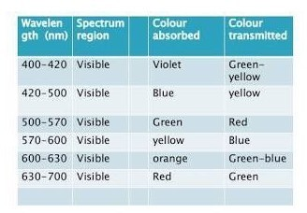
Prism wavelength spectrum

Slide 14
GLASS FILTER:-
Glass filters are selectively transmit particular range of wavelength.
light in

Slide 15
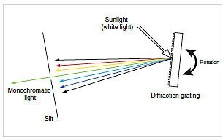
GRATINGS :
GRAPHITE
Light (Tungsten light) is reflected on graphite. This graft separate light in different wave length . By rotation of slit, desirable wave length of light come out from slit. And Beam of that wave length is generated.
Desired wavelength selected by the adjustment of an exit slit.

Slide 16
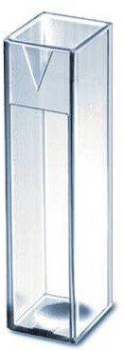
CUVETTE (Sample cell ):
path length is fixed to 1 cm.
Sample cell has 1 cm cdiameter.
A container that contains a sample is usually called cell.

Slide 17
THREE TYPES OF CELL:-
1.Glass
340nm wavelength of light absorbed in glass cell.
cheap

Slide 18
2. Quartz
It allows passage both type of light, ultraviolet & visible ranges.
So used for measurement of both ranges. costly.
3.Plastic cuvette
Shorter Life Span
Easily get Scratches
Low Cost

Slide 19
PHOTOCELL (PHOTODETECTOR)
These are the devices to measure the intensity of light by converting light energy in to electric energy.
They are made up of light sensitive material such as selenium.
GALVANOMETER
Readout device.
A galvanometer is used to detect and measure electrical current produced by the photodetector.

Slide 20
ADVANTAGE:-
It is very easy to operate.
DISADVANTAGES:-
Less sensitive.
Limited range of filters are available.
If the light source is not stable ,there is a possibility of errors due to a change from the initial light intensity during a measurement.
The manual operation are limited.

Slide 21
Spectrophotometer

Slide 22
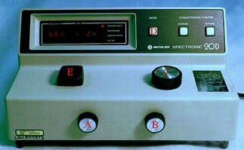

Slide 23
Principle
Beer's Law:-It states that the optical density of a solution is directly proportional to the concentration of the solution .
Lambert's law:-It states that the optical density of a coloured solution is directly proportional to the path of light.

Slide 24
According to Beer's & Lambert's law where, T=kcL,
T=transmittance
K=Constant characteristic of the solution C=concentration of the coloured solution L=Path of light through the coloured solution
O.D.=2 – log T%

Slide 25
Differences: Colorimeter & Spectrophotometer
Colorimeter
Limited for the visible portion of spectrum (visible light)
Cheap
Two digit reading after desimal point.
Less sensitive
Glass are used.
Spectrophotometer
Ultra violet & infrared region also visible e.g.340nm
Very costly
Four digits reading after desimal point .
More sensitive
Prism are used.

Slide 26
Glass cuvette or test tube is used for reading which absorb 340nm light.
Tungsten lamps are used.
Can’t use specific filter.
Can’t do kinetic method.
Quartz cuvette is used which does not absorb 340nm light.
Halogen lamps are used.
Can use specific filter.
Can do kinetic method.

Slide 27
Semi Auto Analyzer
●
Advantage :
●
●
●
Displaying the test results
Printing & memorizing these results Graphs of all linear & nonlinear reactions.
●
Disadvantage :
initial stage of Analysis are performed manually
●
●
●
●
Pipetting of reagent
Pipetting of specimen
Mixing & incubation.
●
This instrument require minimum 500 microliters of reagent for test. Manual L-J chart to draw
●

Slide 28
Fully Auto Analyzer
The auto analyzer perform all the function of semi auto analyzer.
Automatic dispensing of reagent (by reagent probe).
Automatic dispensing of samples . 3.Automatic mixing of reaction mixtures. 4.Incubating of reacting mixture .

Slide 29
Advantages
Many samples with different parameter can analyzed at time.
Good precision
Less reagent required.
Less sample required.
Less man power required .
Maintain the temperature For Sample, Reagent & for incubation period.
Can stored result in memory.
It have facility to accommodate various samples, standards, calibrations & Q.C. Sera.
Automated L-J Chart is visible
Programmable wash cycles between samples & tests for minimum carry over.
Auto dilution is also possible

