Slide 1
POLYSACCHARIDES

Slide 2
HOMOPOLYSACCHARIDES

Slide 3
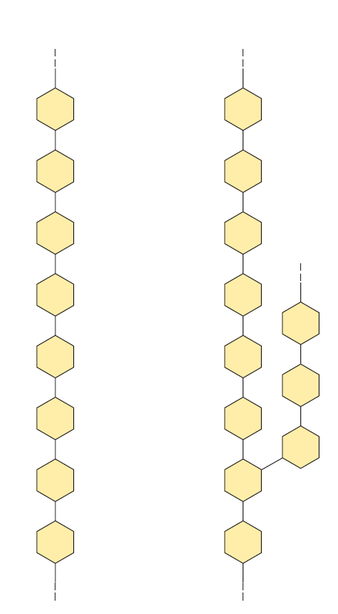
Homopolysaccharides
Composed of single kind of monosaccharides
Either linear or branched.
E.g. Starch, Glycogen,
Cellulose, Inulin,
Dextran, Chitin

Slide 4
Starch
Main carbohydrate in food.
Present in plants, not found in animals.
Sources : potatoes,topica,cereals (rice & wheat) etc.
Consists of amylose & amylopectin

Slide 5
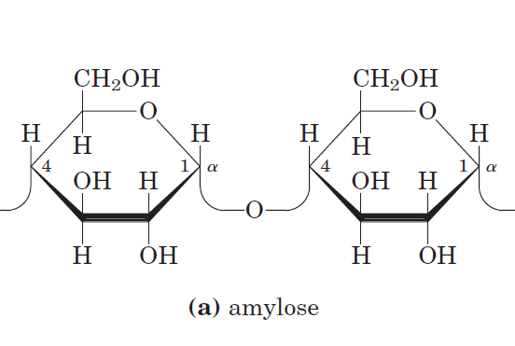

Slide 7
Hydrolysis of starch
Chemical method
Enzymatic method

Slide 8
1. Chemical method
When starch is hydrolysed with mild acid, smaller and smaller fragments are produced.
Starch – blue colour, Non reducing
Amylodextrin – violet colour, Non reducing
Erythrodextrin– red colour, Mild reducing
Achrodextrin – No colour, Reducing
Maltose – No colour, Powerful reducing

Slide 9
Starch will form a blue coloured complex with iodine; this colour disappears on heating and reappears when cooled.
This is a sensitive test for starch.
Starch is non-reducing because the free sugar groups are negligible in number.

Slide 10
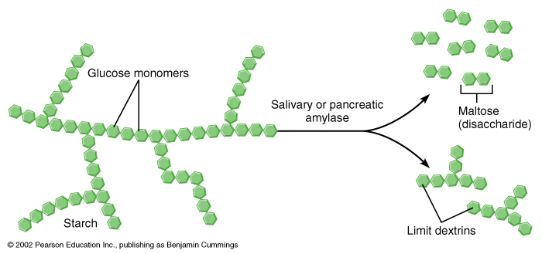
2. Enzymatic method
Salivary amylase and pancreatic amylase are α-amylases. β-amylase is of plant origin.
Acts on α-1,4 glycosidic bonds to produce limit dextrin and finally alpha-maltose.

Slide 11
Beta-amylases are of plant origin. It acts to release, maltose units from the ends of the branches of amylopectin.Maltose units are librated from end of branches of amylopectin,until the action of enzyme is blocked at 1,6-glycosidic linkage.The action stops at branching points, leaving a large molecule, called limit dextrin or residual dextrin.

Slide 12
Glycogen
Major storage form of carbohydrates in animals
Stored in muscle and liver.
Excess carbohydrates are deposited as glycogen.
Formed of α D-glucose units linked by α-1,4 glycosidic bonds with many branches at α-1,6 glycosidic bonds.
MW- 5million
Innermost core of glycogen contains a primary protein called Glycogenin.
Glycogen is more branched and more compact than amylopectin.

Slide 15
Cellulose
It is the supporting tissue of plants and major dietary fibre. It has a straight line structure, with no branching points.
It is made up of β D glucose units combined with beta-1,4 linkages.
Beta-1, 4 bridges are hydrolysed by the enzymes CELLOBIASE which is absent in animal & human digestive system, hence cannot be digested.
Cellulose constitutes 99% of cotton, 50 % of wood & is the most abundant organic material in nature.
MW-2-5 million

Slide 16
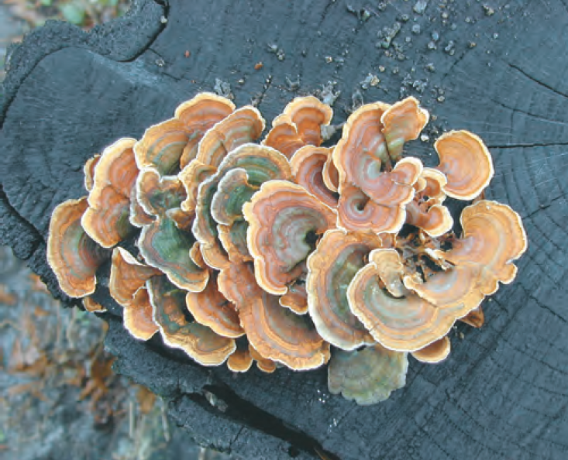
All wood fungi have the enzyme cellulase
which breaks the (1→4) glycosidic bonds in cellulose, such that wood is a source of metabolizable sugar (glucose) for the fungus.
The only vertebrates able to use cellulose as food are cattle and other ruminants (sheep, goats, camels, giraffes).
Cellulose breakdown by wood fungi

Slide 17
Inulin
It is a long chain homoglycan composed of β D-fructose units with repeating beta-1,2 linkages.
It is known as a fructosan.
It is the reserve carbohydrate present in various bulbs & tubers such as onion, garlic, dahlia.
It is clinically can be used to find renal clearance value & glomerular filtration rate but it act as a external agent.
Inulin - Homopolysaccharide
Insulin - Hormone

Slide 18
Dextrans
These are highly branched homopolymers of glucose units with 1-6, 1-4 & 1-3 linkages.
They are produced by microorganisms & molecular weight 1 million to 4 millions.
They will not easily go out of the vascular compartment
They are used for intravenous infusion as plasma volume expander for treatment of hypovolemic shock.
Dextrans-Homopolysaccharide
Dextrins- Partially digested product of starch
Dextrose-D glucose

Slide 19
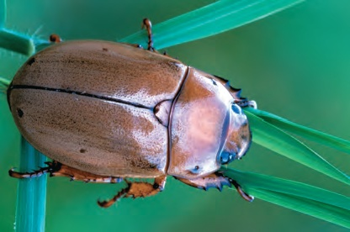
Chitin
It is present in exoskeletons of crustacea & insects.
It is composed of units N-acetyl-glucosamine with beta-1, 4 glycosidic linkages.

Slide 20
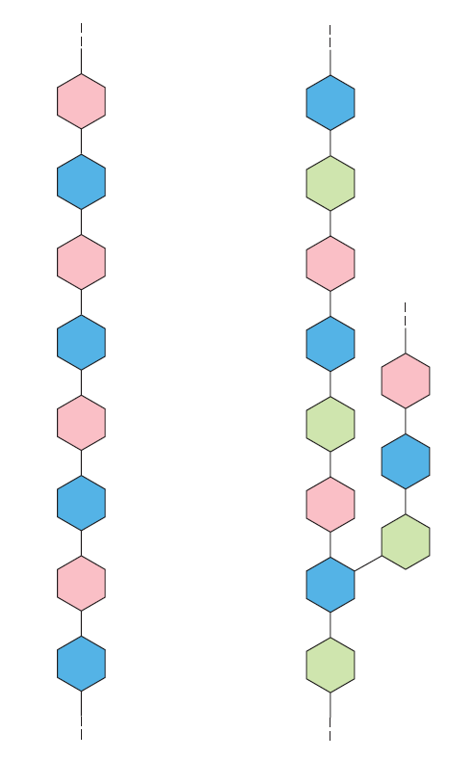
Heteropolysaccharides
Composed of different kind of monosaccharides
Either linear or branched.
E.g.hyaluronic acid-joint cavity
heparin-anti coagulant
chondrotin sulphate-Bone,
tendon, skin , cornea
dermatin sulphate-skin
keratin sulphate-cornea
Agar- culture meduim,
electrophoresis

Slide 21
HETEROGLYCANS
Agar
Hyaluronic acid
Heparin
Chondroitin sulphate
Keratan sulphate
Dermatan sulphate
Mucopolysaccharides

Slide 22
Agar
It is prepared from sea weeds.
It contains galactose, glucose & other sugars. Agarose is made up of galactose combined with 3, 6- anhydrogalactose units.
It is dissolved in water at 100˚C, which upon cooling sets into a gel.
Agar cannot be digested by bacteria hence used as a supporting agent to culture bacterial colonies.
It is used as a supporting medium for immunodiffusion & immunoeletrophoresis.
Agarose is made up from agar and is used as matrix for electrophoresis.

Slide 24
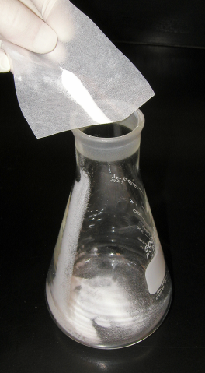
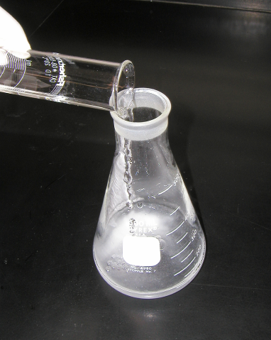
Step 1
Step 2

Slide 25
Step 3
Step 4

Slide 26
Electrophoresis
Gel

Slide 27
MUCOPOLYSACCHARIDES
or
GLYCOSEAMINOGLYCANS (GAGs)

Slide 29
Introduction
Most mammalian cells are located in tissues where they are surrounded by a complex extracellular matrix (ECM) often referred to as “connective tissue.”
The extracellular space in animal tissues is filled with a gel-like material, the extracellular matrix, also called ground substance.

Slide 30
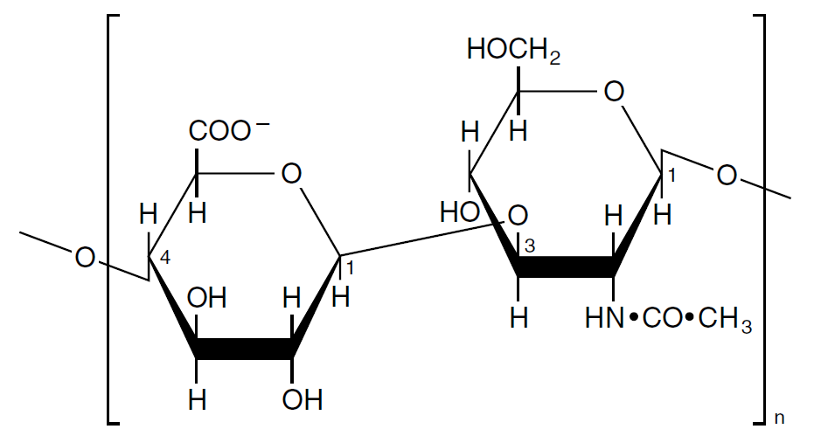
STRUCTURE
They are long unbranched heteropolysaccharide chains composed of diasacchaeride repeat
(acid sugar-amino sugar)n
Except-Hyluronic acid
[Acidic sugar - Amino sugar ]_{n}

Slide 31
Important functional characteristic
Because presence of these charged groups in GAGs, they attract water molecules & so they produce viscous solutions.
"slippery" consistency of mucous secretions and synovial fluid.

Slide 32
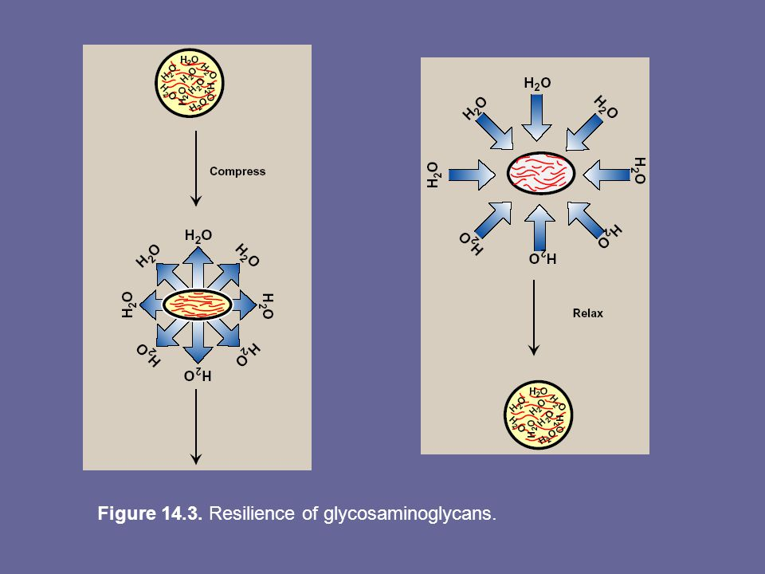
Resilience oF GAGs

Slide 33
Mucopolysaccharides
Hyaluronic acid
Chondroitin sulphate
Keratan sulphate
Dermatan sulphate
Heparin
Heparan sulphate

Slide 35
CARBOHYDRATE | COMPOSITION | LINKAGE
MALTOSE | GLU+GLU | α 1→ 4 GLYCOSIDIC
ISOMALTOSE | GLU+GLU | α 1→ 6 GLYCOSIDIC
LACTOSE | GALACTOSE+GLUCOSE | β 1→ 4 GLYCOSIDIC
LACTULOSE | GALACTOSE+FRUCTOSE
SUCROSE | GLUCOSE+FRUCTOSE | α 1→β 2 GLYCOSIDIC
TREHALOSE | GLUCOSE+GLUCOSE | α 1→ 1 GLYCOSIDIC
GLUCOGEN | α D GLUCOSE | α 1→ 4 , α 1→6
STARCH | α D GLUCOSE | α 1→ 4 , α 1→6
CELLULOSE | β D GLUCOSE | β 1→ 4 GLYCOSIDIC
CHITIN | N-acetyl glucosamine | β 1→ 4 GLYCOSIDIC
INULIN | D - FRUCTOSE | β 1→ 2 GLYCOSIDIC
DEXTRAN | α D GLUCOSE | α 1→ 4 , α 1→6, α 1→3

Slide 36
Thanks

