Slide 1
AMINO ACIDS Structure & Properties Dr. Sapna Patel Senior resident Biochemistry dept. GMC Bhavnagar

Slide 2
Amino Acid Structure
Carboxylic group
-
COO
Amino group
α
+
H N
H
3
R group
H = Glycine
CH₃ = Alanine

Slide 3
Amino Acid Structure
Amino acids are compounds that contain an amino group and a carboxylic acid group.
Although about 300 aminoacids occur in nature, only 20 of them are seen in human body.
Most of the amino acids (except proline) are alpha aminoacids, which means that the amino group is attached to the same carbon atom to which the carboxyl group is attached.

Slide 4
CLASSIFICATION OF AMINOACIDS
1. Based on structure
2. Based on side chain
3. Based on metabolism
4. Based on nutritional requirements

Slide 5
CLASSIFICATION OF AMINOACIDS
1.Based on structure :
A. Aliphatic amino acids:
a. Mono amino mono carboxylic acids
b. Mono amino dicarboxylic acids
c. Dibasic monocarboxylic acids
B. Aromatic amino acids
C. Heterocyclic amino acids
D. Imino acid
E. Derived Amino acids

Slide 6
1.Based on structure:-
A. Aliphatic amino acids:
a. Mono amino mono carboxylic acids:
1. Simple amino acids: glycine, alanine
2. Branched chain amino acids: Valine, Leucine, Isoleucine
3. Hydroxy amino acids: Serine, Threonine
4. Sulphur-containing amino acids: Cysteine, Methionine
5. Amino acids with amide group: Asparagine, Glutamine
b.Mono amino dicarboxylic acids: Aspartic acid, Glutamic acid
c. Di basic mono carboxylic acids: Lysine, Arginine

Slide 7
CLASSIFICATION OF AMINOACIDS
1.Based on structure:-
A. Aliphatic amino acids:
a.Mono amino mono carboxylic acids:
simple amino acids:
Glycine-G
Alanine-A

Slide 8
Simple Amino Acids

Slide 9
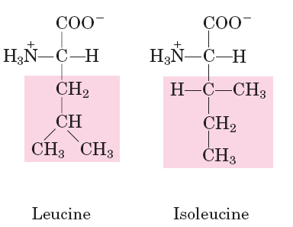
Branched chain Amino Acids
Val;V
Leu; L
Ile;I

Slide 10
Hydroxy Amino Acids
Ser; S Thr; T

Slide 11
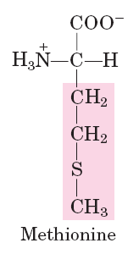
Sulphur Containing Amino Acids
Cys;C Met; M

Slide 12
Amide Containing Amino Acids
Asn;N Gln; Q

Slide 13
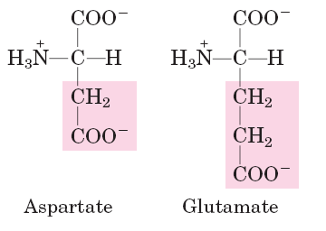
b.Mono amino dicarboxylic acids:
Aspartic acid
Glutamic acid
Asp; D Gln;E

Slide 14
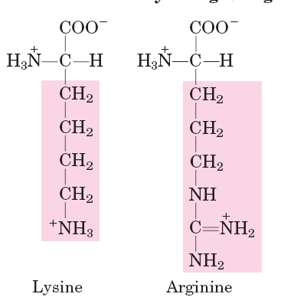
c. Di basic mono carboxylic acids:
Lysine
Arginine
Lys;K; epsilon amino gp Arg;R;Guanidium gp

Slide 15
B.Aromatic amino acids:
Phe;F; Benzene gp Tyr;Y; Phenol gp

Slide 16
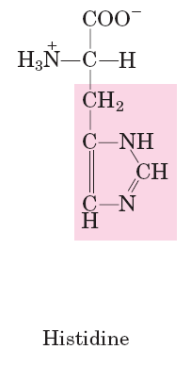
C.Heterocyclic amino acids:
Trp;W; Indole gp His;H;Imidazole gp

Slide 17
D.Imino acid:
Pro; P (Pyrrolidine gp)
Proline

Slide 18
E.Derived amino acids:
1.Found in proteins
2.Not found in proteins:(non protein amino acids)
3.Non –alpha amino acids

Slide 19
E.Derived amino acids:
Found in proteins:
Modified amino acids, e.g.
1.hydroxy lysine and hydroxy proline are important components of collagen.
2.by methylation and acetylation: In ribosomal proteins and in histones, amino acids are methylated and acetylated.

Slide 20
Derived amino acids
Gamma carboxylation of glutamic acid residues of proteins is important for clotting process.(Gamma carboxyglutamate)
1. Factor 2,7,9,10(clotting process)
2. Protein C,S
3.Nephrocalcin
4. Osteocalcin
5. Matrix GLA Protein

Slide 23
Not found in proteins (non protein amino acids):
Some derived amino acids are seen free in cells, e.g. Ornithine, citrulline, homocysteine.
produced during the metabolism of amino acids
e.g. Ornithine, citrulline,Arginino succinate-Urea cycle.
Thyroxine- derived from tyrosine.
Homocysteine, Homoserin- metabolism of S containing AA

Slide 24
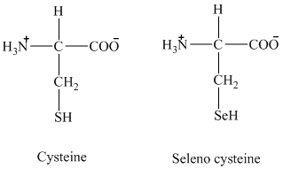
Newly added amino acids

Slide 25
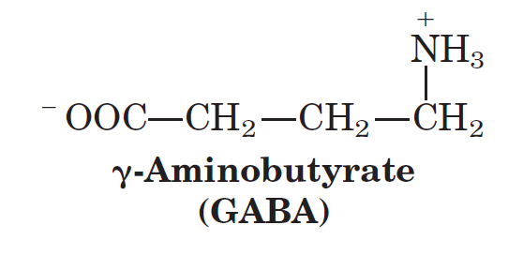
Non –alpha amino acids:
1.Gamma amino butyric acid (GABA) is derived from glutamic acid.
2.Beta alanine , where amino group is in beta position, is a constituent of pantothenic acid and co-enzyme A.
3.β aminoisobutyrate
4.γ aminoisobutyrate

Slide 26
2.Based on side chain:
A. Amino acids having nonpolar side chains
B. Amino acids having uncharged or nonionic polar side chains
C. Amino acids having charged or ionic polar side chains

Slide 27
2.Based on side chain:
A. Amino acids having nonpolar side chains:
Alanine, proline, phenylalanine and tryptophan.
These groups are hydro-phobic and lipophilic.
The parts of proteins made up of these amino acids will be hydrophobic in nature.

Slide 28
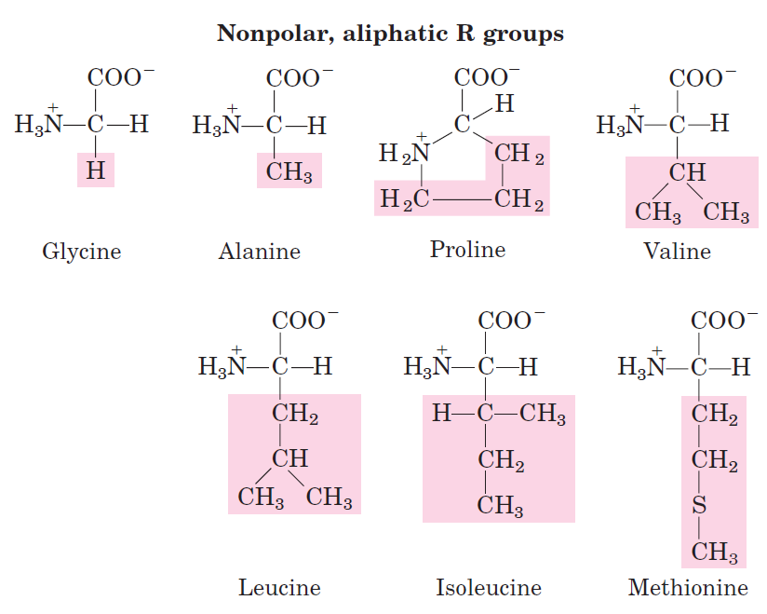
2.Based on side chain:
Notes:
A. Having nonpolar side chains:
These includes
alanine,proline, valine, leucine, isoleucine, methionine, phenylalanine and tryptophan.
These groups are hydrophobic and lipophilic.
so the parts of proteins made up of these amino acids will be hydrophobic in nature.

Slide 29
B. Amino acids having uncharged or nonionic polar side chains:
Glycine, serine, threonine, cysteine, tyrosine, glutamine and aspargine belong to this group.
These amino acids are hydrophilic in nature.

Slide 30
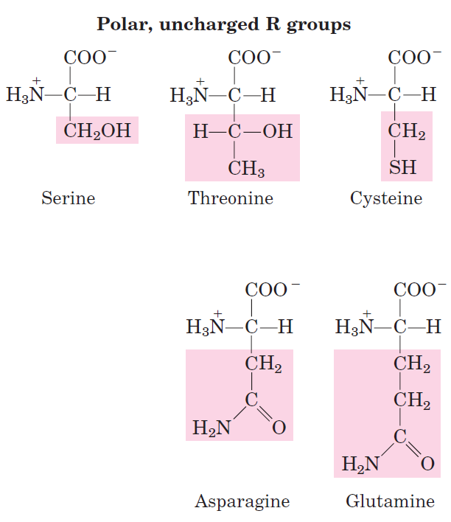
Notes:
B.Having uncharged or nonionic polar side chains:
Serine, threonine, cysteine, tyrosine,
glutamine and aspargine
These amino acids are hydrophilic in nature.

Slide 31
C. Amino acids having charged or ionic polar side chains:
a.Acidic amino acids: They have a negative charge on the R group: Aspartic acid and Glutamic acid.
b.Basic amino acids: Having positive charge on the R group: lysine, arginine and histidine.

Slide 32
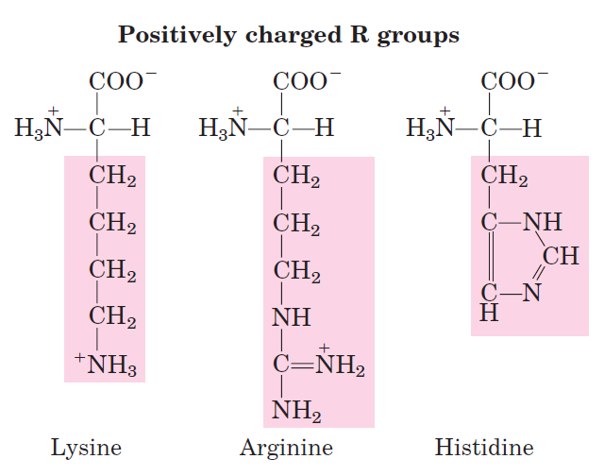
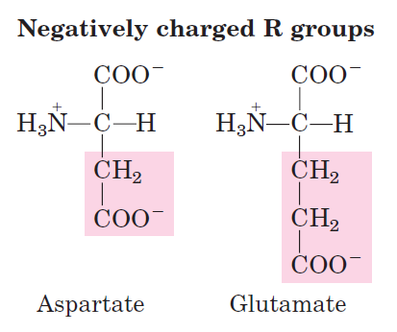

Slide 33
3.Based on metabolism:
Purely ketogenic: Leucine is purely ketogenic : converted to ketone bodies.
Ketogenic and Glucogenic: A part of the carbon skeleton of these amino acids enters the glucogenic pathway and a part enters ketogenic pathway. eg.Lysine, isoleucine, phenylalanine, tyrosine,Tryptophan
Purely glucogenic: All the remaining 14 amino
acids are purely glucogenic as they enter only
into the glucogenic pathway.

Slide 34
4. Based on nutritional requirements
1. Essential or indispensable
2. Semi-essential or partially essential
3. Non-essential or Dispensable
4. Conditionally essential

Slide 35
4. Based on nutritional requirements:
Essential or indispensable:
Their carbon skeleton cannot be synthesized by human beings
preformed amino acids are to be taken in food for normal growth.
Met-methionine, threonine, tryptophan
V - valine
I- Isoleucine
L- leucine
L- lysine
Fly- phenylalanine

Slide 36
Semi-essential:
Histidine and arginine are semi-indispensable amino acids.
Growing children require them in food.
Not essential for the adult requirement.

Slide 37
Non-essential or Dispensable:
The remaining 10 amino acids are non-essential,
their carbon skeleton can be synthesized by the body.
They are also required for normal protein synthesis.
Non essential amino acids: Alanine,Asparagine, Aspartic acid, Cysteine, Glutamine, Glutamic acid, Glycine, Proline, Serine, Tyrosine

Slide 38
Conditionally essential: the person may lack the ability to synthesise non –essential amino acids
-during chronic illness
-Problems with digestion
-physiological stress
Supplementation is required at this time of need
Arginine, Glycine, Cysteine, Tyrosine, Proline, Glutamine, Taurine.

Slide 39
PROTEIN: STRUCTURE

Slide 40
INTRODUCTION
Proteins are of paramount importance for biological systems.
Out of the total dry body weight,3/4th are made up of proteins.
All the major structural & functional aspects of the body are carried out by protein molecules.
Abnormality in protein structure will lead to molecular diseases with profound alterations in metabolic functions.

Slide 41
Protein contains Carbon, Hydrogen, Oxygen, Nitrogen as the major components while sulphur and Phosphorus are minor constituents.
The nitrogen content of an ordinary proteins is 16% by weight.
All proteins are polymers of amino acids which are linked by peptide bonds.
Alpha carboxyl group of one amino acid reacts with alpha amino group of other amino acid to form a peptide bond or CO-NH bridge.
Proteins are made by polymerisation of amino acids through peptide bonds.

Slide 42
Formation of Peptide Bonds by Dehydration
1
2
NH2
COOH
NH2
COOH
Dehydration
-H₂O
O
1
2
NH2
C N
COOH
H
Notes:
胺基酸 像樂高玩具或積木一樣，可以一個一個頭尾接起來，組成一個巨分子蛋白質。連接的方法非常簡單，前一個胺基酸 (1) 的羧基與後一個胺基酸 (2) 的胺基，經脫水反應即可。所生成的雙胜 (1-2) 都還有一個胺基及羧基，可以繼續連接下去。如此兩個胺基酸間所產生的新鍵，稱為 胜肽鍵 (peptide bond)，如上圖中的 C-N。許多胜肽鍵組成了蛋白質的骨架，蛋白質是生物的重要分子，因此胜肽鍵也可以說是組合了生命的基本骨架。在試管中也可以把兩個胺基酸連結在一起，使用脫水劑 carbodiimide，進行如上的操作。

Slide 43
Two amino acids are combined to form Dipeptide, three make Tripeptide, four make Tetrapeptide.
Few amino acids together will make an Oligopeptide,10 -50 amino acids make Polypeptide.
Finally a big polypeptide chains containing >50 amino acids are called Proteins.
Evan though there are 20 amino acids, by changing the sequence of combination of these amino acids, nature produces enormous number of markedly different proteins.

Slide 44
STRUCTURE(Organisation of Proteins)
Proteins have different levels of organisation;
Primary Structure
Secondary Structure
Tertiary Structure
Quaternary Structure

Slide 46
1.PRIMARY STRUCTURE
Sequence of amino acids in proteins
Primary structure denotes the number and sequence of amino acids in the protein.
Higher levels of organization are decided by this structure.

Slide 47
Each polypeptide chain has a unique amino acid sequence decided by the genes.
The primary structure is maintained by the covalent bonds of the peptide linkages.
One should be very clear by the term “sequence” see e.g.
Gly-Ala-Val(1)
Gly-Val-Ala(2)
Both the tripeptides shown above contain the same amino acids; but their sequence is altered.

Slide 48
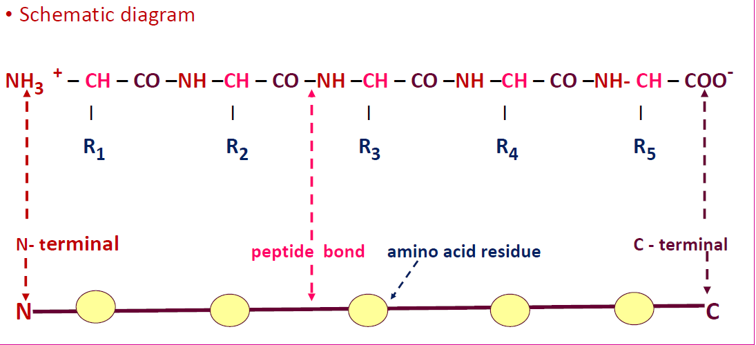
Numbering of amino acids in proteins

Slide 49
Numbering of amino acids in proteins
In a polypeptide chain, at one end there will be one free α-amino group called the Amino terminal (N-terminal) end and the amino acid contributing the α-amino group is named as the first amino acid.
The other end of the polypeptide chain is the Carboxy terminal end (C-terminal) where there is a free α-carboxyl group which is contributed by the last amino acid.

Slide 50
Branched and Circular proteins
Branching points in the linear polypeptide chains may be produced by interchain Disulphide bridges.
The covalent disulphide bonds between different polypeptide chains in the same protein (interchain) or portions of the same polypeptide chain (intrachain) are also part of the primary structure.

Slide 51
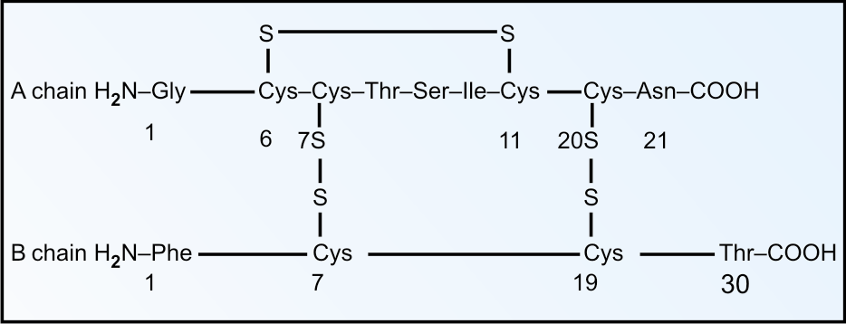
Structure of Insulin
Intrachain Disulphide Bond
Interchain Disulphide Bond

Slide 52
Primary structure of Insulin
This was first isolated by Banting and Best.
This was originally described by (sequenced)Sanger in 1955 who received nobel prize in 1958.
Insulin has 2 polypeptide chains. The A chain (Glycine chain) has 21 A.A. and B(phenylalanine) has 30 A.A.They are held together by 2 interchain disulphide bonds.

Slide 53
Primary Structure of Insulin

Slide 54
7th cysteine of A chain and 7th cystein of B chain are connected. Similaraly A chain 20th cysteine and B chain 19th cysteine are connected.
There is another intrachain disulphide bond between 6th and 11th cysteine recidues of A chain.
The species variation is restricted to amino acids in position 8,9 and 10 in A chain and in C-terminal of B chain.
The porcine insulin and human insulin are structurally similar except the terminal amino acid in B chain(Thr→Ala).

Slide 55
Bovine insulin may produce antibodies in humans by repeated injections.
But de-alaninated porcine insulin, bearing no antigenic difference from human insulin will not produce antibodies in diabetic patients even after a long term use.
Nowadays human insulin is being produced by recombinant DNA technology.

Slide 56
Pro-insulin
Beta cells of pancreas synthesise insulin as a prohormone.
Pro-insulin is a single polypeptide chain with 86 amino acids.
Biologically active insulin (2 chains) is formed by removal of the central portion of the pro-insulin before release.
The C-peptide (connecting peptide) is also released into the circulation.

Slide 58
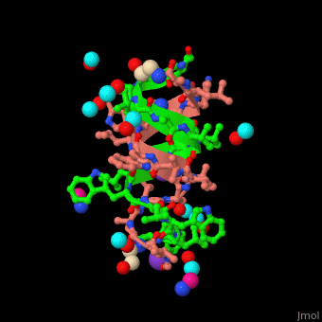
Very rarely protein may be in a circular form,e.g.Gramicidin.
It is used as a antibiotics.

Slide 59
Primary structure determines biological activity:-
A protein with a specific primary structure, when put in solution, will automatically form its natural 3-dimensional shape. So the higher levels of organisation are dependent on the primary structure.
Even a single amino acid change (mutation) in the linear sequence may have profound biological effects on the function.
For example, in HbA (normal Hb), the 6th amino acid in the beta chain is glutamic acid; it is changed to valine in HbS(sickle cell anemia).

Slide 60
SECONDARY STRUCTURE
The term “secondary structure” denotes the configurational relationship between residues which are about 3-4 amino acids apart in the linear sequence.
The structure is preserved by non-covalent forces or bonds.

Slide 61
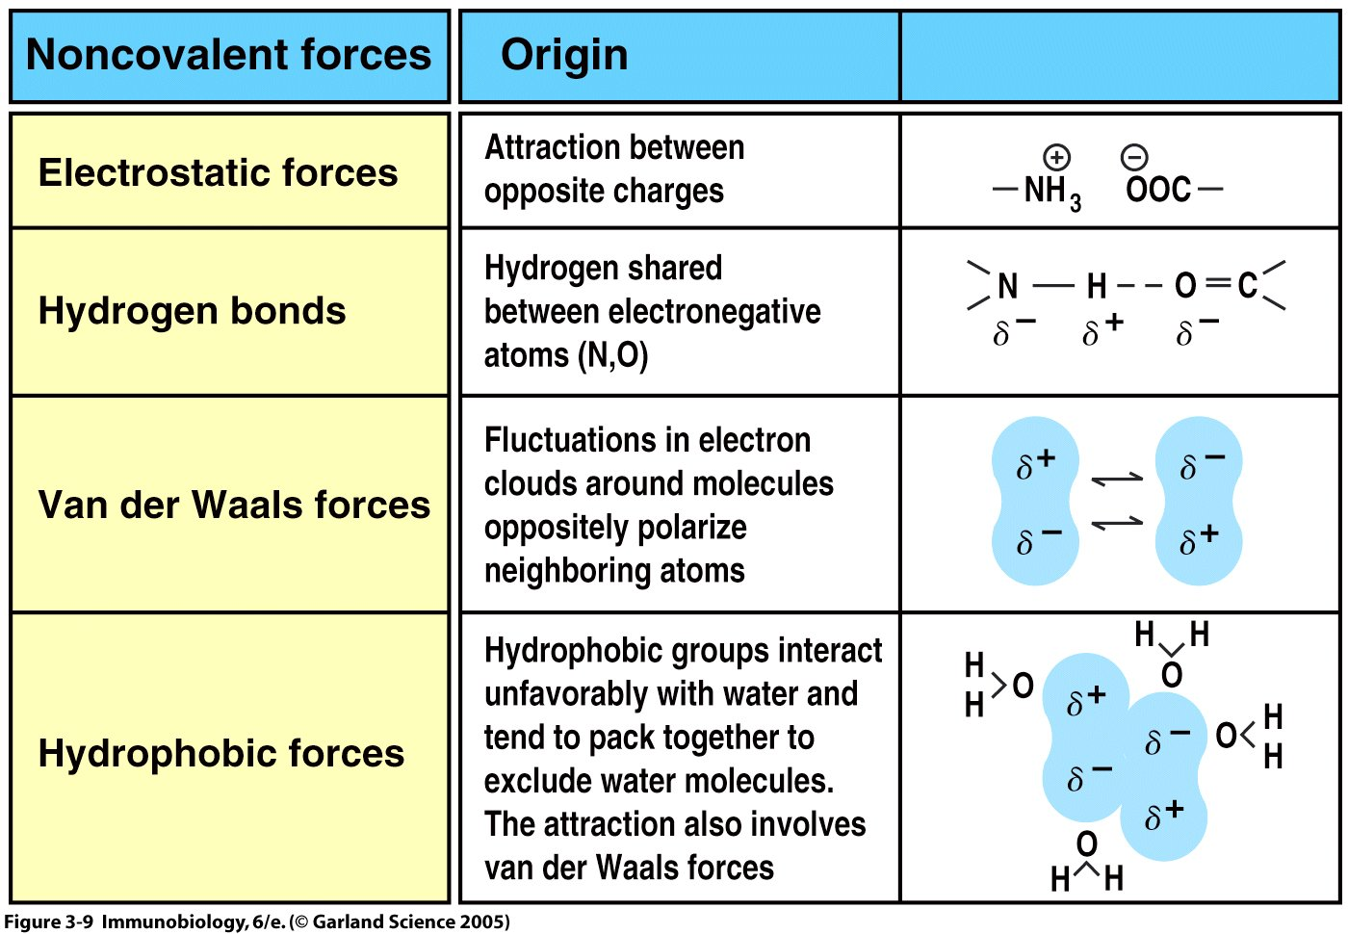

Slide 62
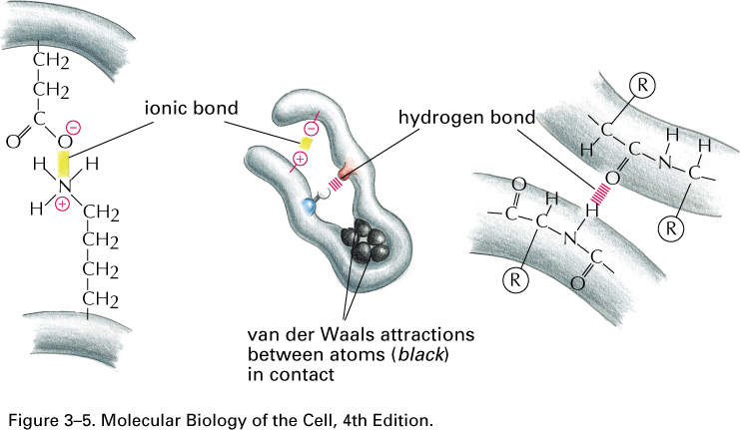
2-A Alpha helix
Pauling and Corey described the α-helix and β-pleated sheet structures of polypeptide chains in 1951.
α-helix is the most common and stable conformation for a polypeptide chain.
It is a spiral structure. The polypeptide bonds form the backbone and the side chains of amino acids extend outward.
It is stabilized by hydrogen bonds between NH and C=O groups of the main chain.

Slide 63
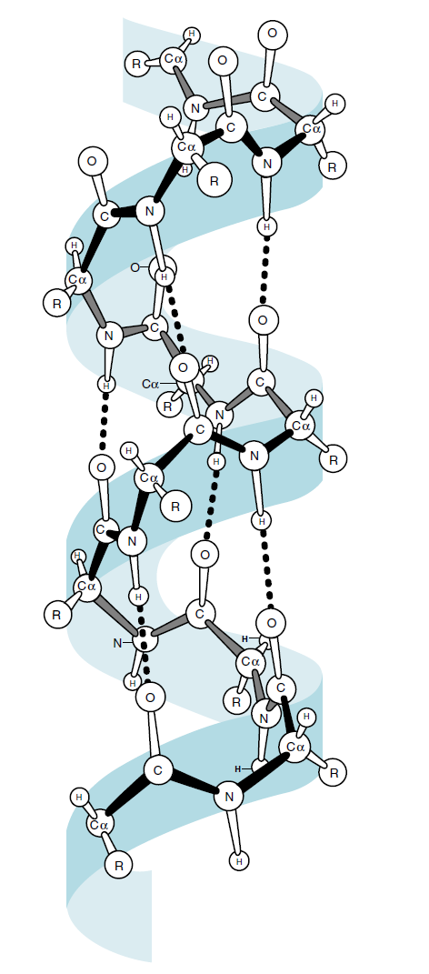
2-A Alpha helix
Most common
Most stable conformation.
It is a spiral structure.
The polypeptide bonds form the backbone and side chain of amino acids extended outwards. It is stabilized by hydrogen bonds
Each turn is formed by 3.6 residues.
Distance between each a. a. residue is 1.5Å

Slide 65
2-B Beta-pleated sheet
The polypeptide chains are fully extended so hydrophobic part is fully exposed.
The distance between adjacent a.a. is 3.5Å.
It is stabilized by hydrogen bonds.
Adjacent strands in a sheet can run in the same direction (parallel) or in opposite direction (anti parallel beta sheet).
Beta pleated sheet is the major structural motif in proteins like silk Fibroin(antiparallel), Flavodoxin(parallel)and Carbonic anhydrase(both).

Slide 66
β- pleated sheet

Slide 68
TERTIARY STRUCTURE
Secondary structure denotes the configurational relationship between residues which are about 3-4 amino acids apart, while tertiary structure denotes three dimensional structure of the whole protein .
It defines the steric relationship of amino acids which are far apart from each other in the linear sequence, but are close in the three dimensional aspect.

Slide 69
It is maintained by non-covalent interactions such as hydrophobic bonds, electrostatic bonds, van der Waals forces.
The tertiary structure aquired by the native protein is always thermodynamically stable.
Domain is section of protein sufficient to perform a particular chemical or physical task.
it is the term used to denote a compact globular functional unit of a protein.

Slide 70
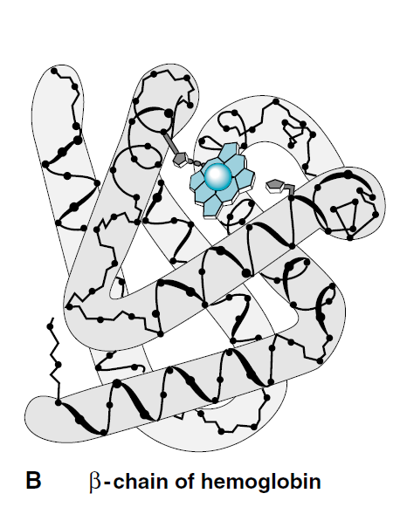
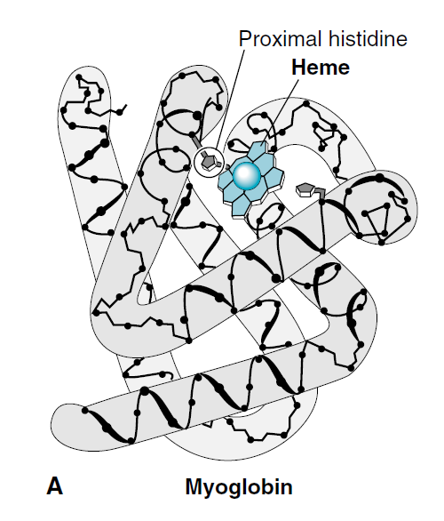

Slide 71
QUATERNARY STRUCTURE
Certain polypeptides will aggregate to form one functional protein known as quaternary structure.
The protein will lose its function when the subunits are dissociated.
It is stabilised by hydrogen bonds,electrostatic bonds,hydrophobic bonds and van der Waals forces.

Slide 72
Depending on the number of the monomers, the protein may be termed as dimer(2),tetramer(4),etc. Each polypeptide chain is termed as Subunit or Monomer.
For example,2 alpha chains and 2 beta chains form the Hemoglobin molecule.similarly,2 heavy chains and 2 light chains form one molecule of Immunoglobulin G.
Creatine kinase is dimer, Lactate dehydrogenase is a tetramer.

Slide 73
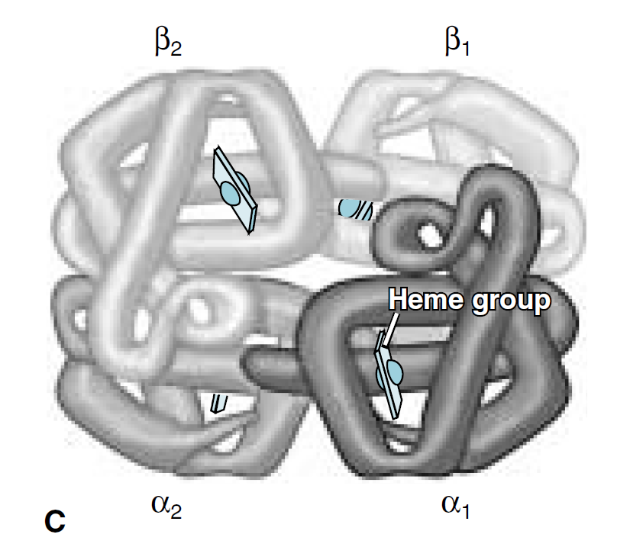
Hemoglobin
2 alpha and
2 beta chains

Slide 75
Hierarchical nature of protein structure
Primary structure (Amino acid sequence)
↓
Secondary structure （α-helix, β-sheet）
↓
Tertiary structure （Three-dimensional structure formed by assembly of secondary structures）
↓
Quaternary structure （Structure formed by more than one polypeptide chains）

Slide 76
CLASSIFICATION OF PROTEINS
BASED ON FUNCTIONS
Catalytic proteins, e.g. enzymes
Structural proteins, e.g. collagen, elastin
Contractile proteins, e.g. actin, myosin
Transport proteins, e.g. hemoglobin, myoglobin, albumin, transferrin.
Regulatory proteins or hormones, e.g. ACTH, insulin, growth hormone.
Genetic proteins, e.g. histones
Protective e.g. Igs, interferon, clotting factors

Slide 77
B.BASED ON COMPOSITION AND SOLUBILITY
B-1 Simple proteins (contain only amino acids)
1. Albumins: soluble in water and coagulated by heat. Human serum albumin has a molecular weight of 69,000.Other examples are lactalbumine of milk and egg albumin.
2. Globulins: Insoluble in pure water, but soluble in dilute salt solutions and coagulated by heat. e.g. egg globulin, serum globulins, legumins of peas.
3. Protamines: Soluble in water, dilute acids and alkalies. Not coagulated by heat.

Slide 78
Protamines contain large number of arginine and lysine residues, so are strongly basic & can combine with other acidic proteins.
E.g. protamine zinc insulinate is a common commercial preparation of insulin.
4. Prolamines: Soluble in 70-80% alcohol, but insoluble in pure water. They are rich in proline but lack in lysine. E.g. zein from corn, gliadin of wheat, hordein of barley.
5. Lectins: Precipitated by 30-60% ammonium sulphate. They have high affinity to sugar groups.

Slide 79
Phytohemaglutinin(PHA), a lectin from Phaseolus vulgaris(red kidney bean)agglutinates all RBCs and WBCs.
6. Scleroproteins: Insoluble in water, salt solutions and organic solvents, and soluble only in hot strong acids. They form supporting tissues. E.g. collagen of bone, cartilage and tendon; keratin of hair , horn, nail and hoof.

Slide 80
B-2 Conjugated proteins (protein + non protein part, called prosthetic group)
Glycoproteins: These are proteins combined with carbohydrates.
Hydroxyl group of serine or threonine and amide groups of asparagine and glutamine form linkages with carbohydrate residues.
Blood group antigens and many serum proteins are glycoproteins.
When the carbohydrate content is >10% of the molecule, the viscosity is increased correspondingly. These are known as Mucoproteins or proteoglycans.

Slide 81
Lipoproteins: Proteins loosely combined with lipid components.They occur in blood and on cell membranes.
Nucleoproteins: proteins attached to nucleic acids,e.g.histones.The DNA carries negative charges which combines with positively charged proteins.
Chromoproteins: Proteins with coloured prosthetic groups. Hemoglobin (heme, red); flavoprotein (riboflavin, yellow);Visual purple(Vit A, purple).

Slide 82
Phosphoproteins: these contains phosphorus. e.g.Casein of milk and vitellin of egg yolk.
Metalloproteins: They contains metal ions.e.g. Hemoglobin(iron), cytochrome(iron), tyrosinase(copper) and carbonic anhydrase (zinc).
B-3 Derived proteins
They are degradation products of the native proteins.
Progressive hydrolysis of protein results in smaller and smaller chains: protein→ peptones→ peptides→ amino acids.

Slide 83
C.BASED ON THE SHAPE
C-1. Globular proteins:
Spherical or oval in shape.
Easily soluble e.g. albumins, globulins and Protamines
C-2. Fibrous proteins:
Elongated or needle shape.
Solubility is minimum.
Resist digestion
e.g. collagen, elastin and keratins

Slide 84
D.BASED ON NUTRITIONAL VALUE
D-1.Nutritionally rich proteins:
Also called as complete proteins or first class proteins.
Contains all the essential amino acids in required proportion.
On supplying these proteins in diet, children will grow satisfactorily.e.g. casein of milk.
D-2. Incomplete proteins:
They lack one essential amino acid.
Cannot promote body growth in children but able to sustain body weight in adults.

Slide 85
Proteins from pulses are deficient in methionine, while proteins of cereals lack in lysine.
If both of them are combined in the diet , adequate growth may be obtained.
D-3. Poor proteins:
They lack in many essential amino acids and the diet based on these proteins will not even sustain the original body weight.
Zein from corn lacks tryptophan and lysine.

Slide 86
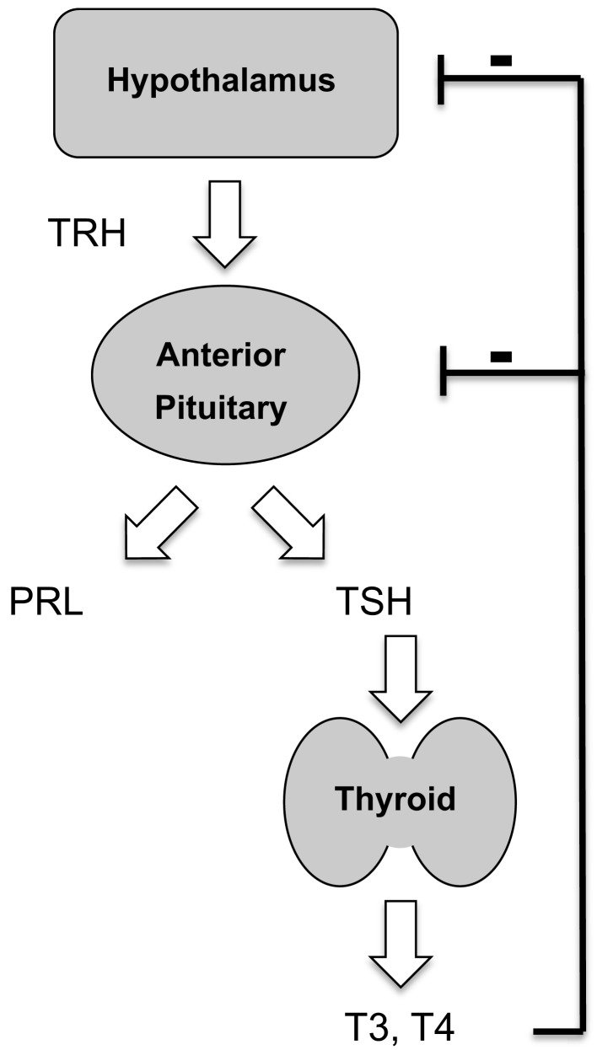
Biologically Important Peptides
When 10 or less number of amino acids are joined together, it is called an oligopeptide. Some of them are biologically active.
1)Thyrotropin releasing hormone
(TRH)
It is a tripeptide with the
sequence of Glu-His-Pro
but the Glu and Pro are
modified.

Slide 87
2. Glutathione It is a tripeptide. It is a gamma- glutamyl – cysteinyl -glycine. It is involved in erythrocyte membrane integrity and is important in keeping enzymes in active state.

Slide 88
3)Angiotensin I and II I has 10 amino acids and II has 8 amino acids. They can cause hypertension.

Slide 89
2. Glutathione It is a tripeptide. It is a gamma- glutamyl – cysteinyl -glycine. It is involved in erythrocyte membrane integrity and is important in keeping enzymes in active state.
Are nanopeptides , with 9 amino acids.

Slide 90
6)Gramicidin S
An antibiotic produced by Bacillus brevis, contains 10 amino acids.
Its shape is circular and contains D-phenyl alanine (usual proteins contain only L-amino acids).

Slide 91
STRUCTURE-FUNCTION RELATIONSHIP
The functions of proteins are maintained because of their ability to recognize and interact with a variety of molecules.
The three dimensional structural conformation provides and maintains the functional characteristics.
The three dimensional structure, in turn, is dependent on the primary structure, so any difference in the primary structure may produce a protein which cannot serve its function.

Slide 92
To illustrate the structure-function relationship, the following three proteins are considered;
1.ENZYMES
The first step in enzymatic catalysis is the binding of the enzyme to the substrate.
This in turn depends on the structural conformation of the active site of the enzyme, which is precisely oriented for substrate binding.

Slide 93
Lock and Key Model
+ +
E + S ES complex E + P
P
S
S
P

Slide 94
2. TRNSPORT PROTEIN
Hemoglobin, the transporter of oxygen is a tetrameric protein (α₂β₂), with each monomer having a heme unit.
Binding of oxygen to one heme facilitates oxygen binding by other subunits.
Binding of H+ and CO2 promotes release of O2 from hemoglobin, this allosteric interaction is physiologically important and termed as Bohr effect.
Even a single amino acid substitution alters the structure and thereby the function for e.g. sickle cell anemia (HbS).

Slide 95
The transport of oxygen in blood Hemoglobin
Hb + 4O₂ → Hb(O₂)₄
Over 95% of O₂ is carried in this way
Red blood cell (erythrocyte)

Slide 96
3.STRUCTURAL PROTEINS
Collagen is the most abundant protein in mammals and is the main fibrous component of skin, bone, tendon, cartilage and teeth.
Collagen forms a super helical cable where the 3 polypeptide chains are wound around itself.
In collagen, every 3rd residue is glycine, that only fit into the triple stranded helix.
The quarter staggered triple helical structure of collagen is responsible for its tensile strength.

Slide 97
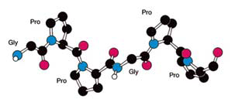

Slide 98
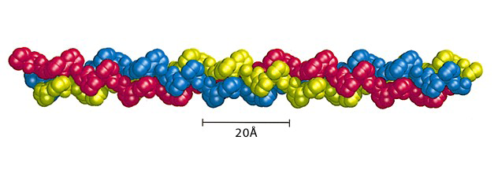
COLLAGEN

Slide 99
