Slide 1
Automation
Clinical Biochemistry

Slide 2
Automation In Clinical Chemistry
The analytic process can be divided into three major phases— preanalytic, analytic, and postanalytic—corresponding to sample processing, chemical analysis, and data management, respectively.
Substantial improvements have occurred in all three areas during the past decade.
The analytic phase is the most automated, and more research and development efforts are focusing on increasing automation of the preanalytic and postanalytic processes.

Slide 3
AUTOMATION
The term automation is applied to described the process whereby an analytical instrument performs many tests with only minimal involvement of an analyst.
“ The replacement of human manipulative effort and facilities in the performance of a given process by mechanical and instrumental devices that are regulated by feedback of information so that an apparatus is self-monitoring or self-adjusting.”
Use of laboratory instruments and specimen processing equipment to perform clinical laboratory assays with only minimal involvement of technologist .

Slide 4
Advantages of Autoanalyzers
Large number of samples can be tested in a short time.
Variety of tests can be performed by using various methods such as end point and rate of reaction.
By using techniques such as ELISA, Turbidimetry , Chemiluminescence, nephlometry etc. it is possible to determine concentrations of hormones, drugs, tumor markers and various types of antibodies and proteins.
4. Most of the methods performed on automation are accurate, precise, sensitive and specific.

Slide 5
5. Although the various types of Autoanalyzers are expensive, they prove to be cost effective because the amount of reagent and specimens required can be as low as 300 and 5 microlitres respectively.
6. Automation allows laboratories to process much larger workload without a comparable increase in number of staff members.
7. Internal and external quality control programmes can be easily be implemented efficiently and effectively.
8. In case of fully autoanalyzer, the staff members do not come in contact with specimen and reagent so it is safe for working.

Slide 9
Patient identification

Slide 10
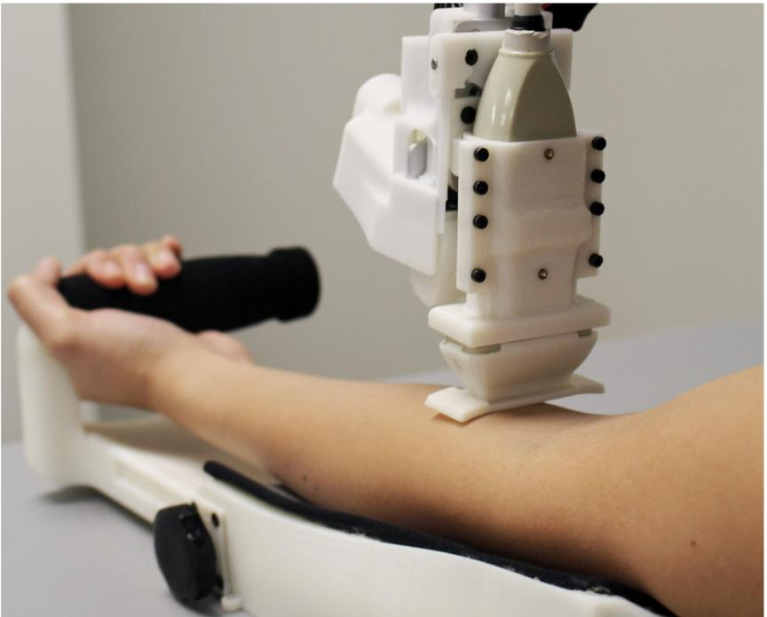

Slide 16
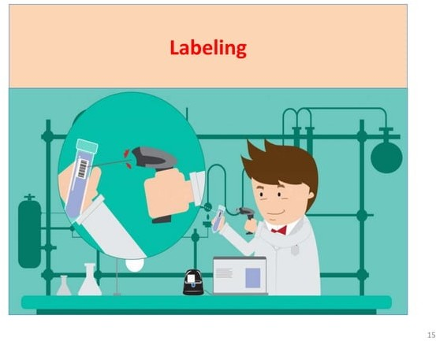

Slide 27
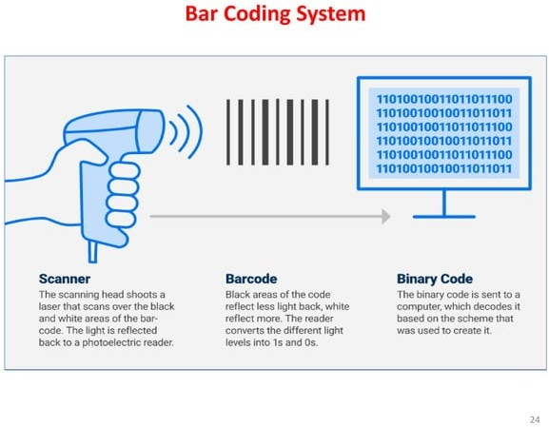

Slide 83
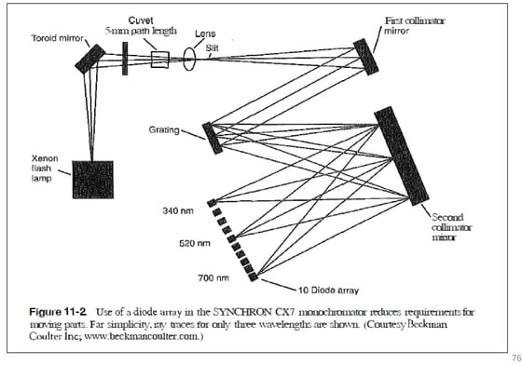

Slide 89
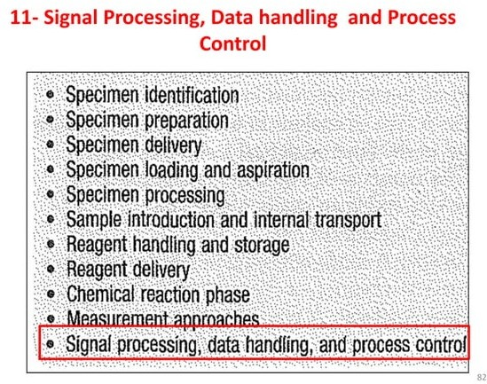

Slide 97
“Let us Thank All the Brains
Behind Automation “
For Making Our job
Easy and Pleasurable and
our life Peaceful ……

