Slide 1
Phenylketonuria
Dr.KR Gopalakrishnan
3rd year PG resident, Batch-2022,
Department of Biochemistry,
GMC Bhavnagar

Slide 2
Case presentation
A 5 year boy presented with Delayed developmental milestone.
On Examination, it is found that boy has blue eyes, blond hair, unusual mousy body odour.
Paediatrician started following as treatment
Synthetic sapropterin dihydrochloride (kuvan) and
Phenylalanine ammonia lyase
Lab investigation shows following abnormalities.
Blood phenylalanine- 15mg/dl
Urinary ferric chloride test - Positive
Guthrie's test from Blood Sample - Positive

Slide 3
Objectives
Biochemical basis of Clinical manifestations, diagnosis and treatment of PKU
Role of Phenylalanine ammonia Lyase in PKU
Role of sapropterin dihydrochloride in PKU
How to differentiate from segawa syndrome?

Slide 4
Phenylketonuria
Enzyme defect- Phenylalanine Hydroxylase
Phenylalanine Hydroxylase gene deletion or mutation
Present on chromosome 12
13 Exon
Autosomal recessive
Type 1 | Phenylalanine hydroxylase deficiency
Type 2, 3 | Dihydrobiopterin deficiency
Type 4 ,5 | Deficiency in enzyme synthesizing biopterin

Slide 5
Role of Phenylalanine hydroxylase
Type 1
Type 4,5
Type 2,3

Slide 6
Biochemical defect in PKU

Slide 7
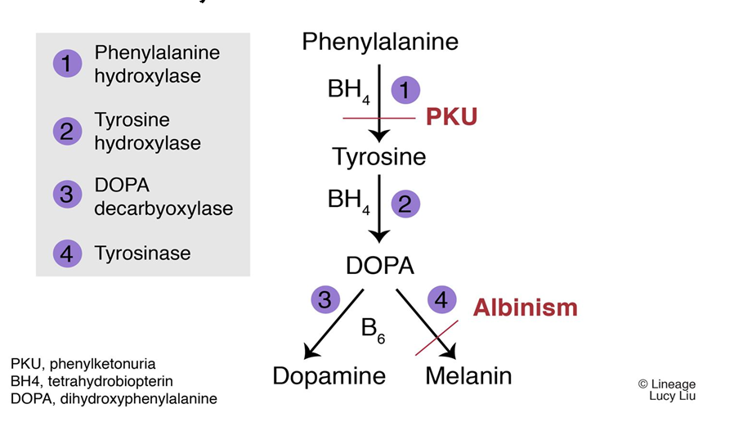
Role of Phenylalanine & Tyrosine

Slide 8
Clinical Manifestations
Mental retardation
Agitation, hyperactivity, tremors and convulsions
Hypopigmentation
Mousy body odour.

Slide 9
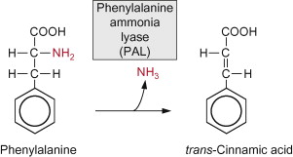
Role of Phenylalanine ammonia Lyase in PKU

Slide 10
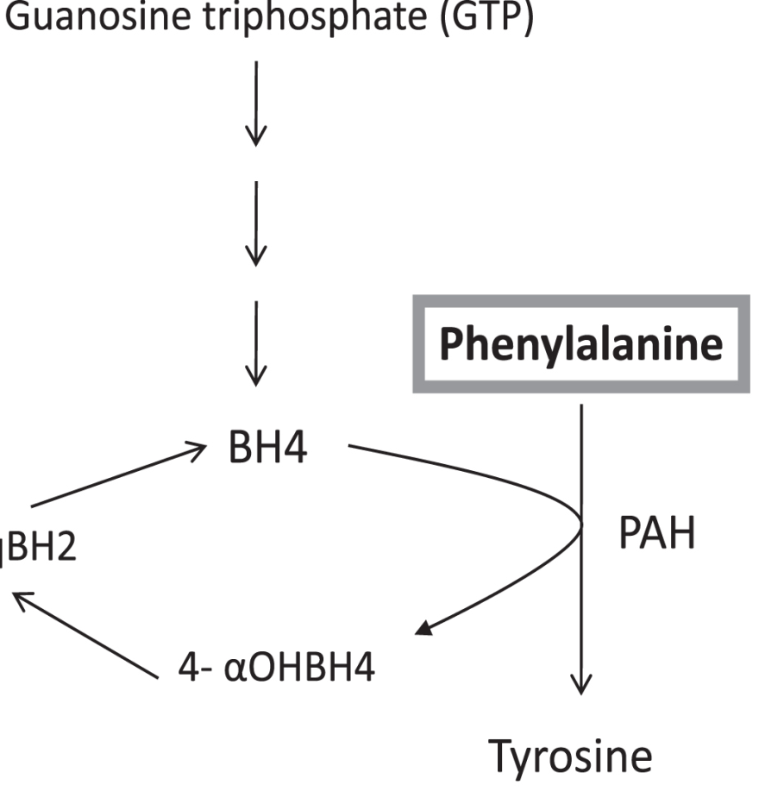
Role of sapropterin dihydrochloride for differentiation of PKU from segawa syndrome
GTP Cyclohydrolase
If Phenylalanine level decrease -After BH4 = PKU
if Dopamine Synthesis Normalize -After BH4 = Sagawa Syndrome

Slide 11
Laboratory Diagnosis
Blood phenylalanine: Normal level is 2-6 mg/dl.
Guthrie test: screening test

Slide 12
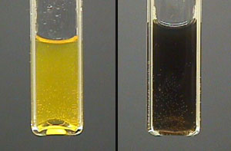
Laboratory Diagnosis
Ferric chloride test: Urine contains phenyl ketones about 500-3000 mg/day.
transient blue-green colour is a positive test.

Slide 13
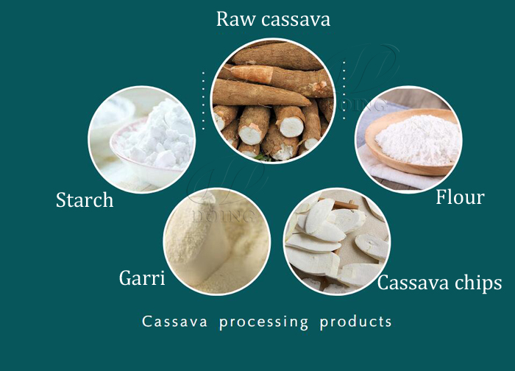
Treatment
Early detection is very important. About 5 units of IQ are lost for each 10 week delay in starting the treatment.
diet containing low phenylalanine (Cassava based)

Slide 14
THANK YOU

Slide 15
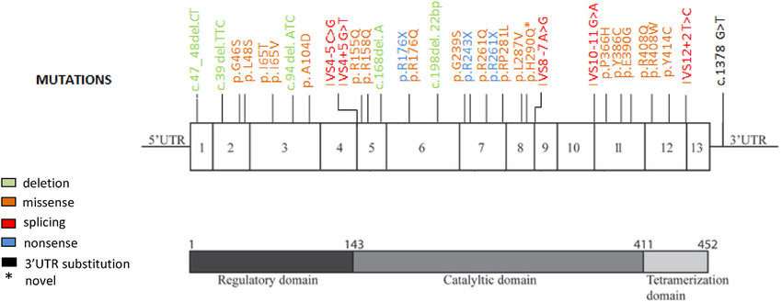
Genetic basis for Phenylketonuria

