Slide 1
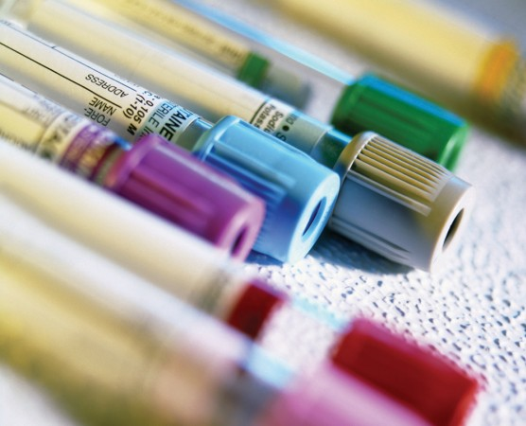
SAMPLE REJECTION CRITERIA IN CLINICAL BIOCHEMISTRY
Dr. Sapna Patel
MD Biochemistry

Slide 2
A properly completed request must contain following information
Patients name, gender and age.
Registration number [MRD]
Type of sample
Collection date and time
Ward/ OPD
Diagnosis
Doctors Signature/ Name
Proper Parameter
Receiving Date & Time

Slide 3
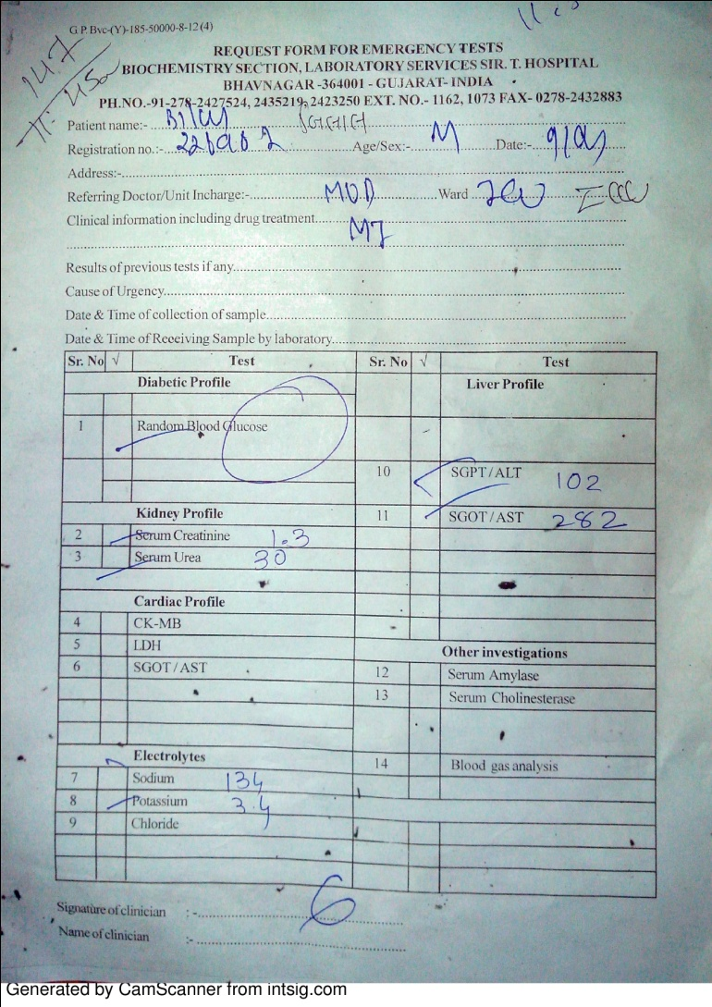
Requisition Form
ROUTINE
EMERGENCY

Slide 4
Specimen rejection criteria
Specimen improperly labeled or unlabeled
Specimen improperly collected or preserved
Specimen submitted without properly completed request form
contaminated form
Improperly volume & leakage sample
Absurd blood sample -: High electrolyte level
Hemolyzed sample (show tubes)

Slide 5
HbA1C

Slide 6
Fasting Blood Sugar
Post Prandial blood sugar
Random Blood sugar
Oral glucose tolerance test

Slide 7
Diabetic Profile | 1 | Fasting Blood Sugar | Liver Function Test | 26 | S.Bilirubin Total: Direct: Indirect:
 | 2 | Post Prandial blood sugar |  | 27 | S.SGPT/ALT
 | 3 | Random Blood sugar |  | 28 | S.SGOT/AST
 | 4 | Oral glucose tolerance test |  | 29 | S.ALP
Kidney Function Test | 6 | S.Creatinine |  | 31 | S.Albumin
 | 7 | S.Urea |  | 32 | S.Globulin
 | 8 | BUN |  | 33 | A:G ratio
 | 9 | S.Cystatin C | Other Thyroid Function Test | 34 | S.Amylase
Lipid Profile | 10 | S.Cholesterol
 | 11 | S.Triglycerides |  | 36 | S.Uric acid
 | 12 | S.HDL |  | 37 | S.Cholinesterase
 | 13 | S.LDL |  | 38 | S.Hs-CRP
 | 14 | S.VLDL |  | 39 | S.Lipoprotein (a)
 | 15 | HDL:LDL ratio |  | 40 | CA 125
Electrolytes | 16 | Sodium
 |  |  |  | 41 | S.Alpha-1-Antitrypsin
 |  |  |  | T3, T4, TSH
 | 17 | Potassium
 | 18 | Chloride
 | 19 | Ionised Calcium
 | 20 | Lithium
Cardiac Function Test | 21 | S.CK-MB
 | 22 | S. LDH
 | 23 | S.SGOT/AST

Slide 8
 |  |  | Liver Function Test | 26 | S.Bilirubin Total: Direct: Indirect:
 |  |  |  | 27 | S.SGPT/ALT
 |  |  |  | 28 | S.SGOT/AST
 |  |  |  | 29 | S.ALP
 |  |  |  | 30 | S.Total Protein
Kidney Function Test | 6 | S.Creatinine |  | 31 | S.Albumin
 | 7 | S.Urea |  | 32 | S.Globulin
 | 8 | BUN |  | 33 | A:G ratio
 | 9 | S.Cystatin C | Other | 34 | S.Amylase
Lipid Profile | 10 | S.Cholesterol |  | 35 | Micro protein (CSF)
 | 11 | S.Triglycerides |  | 36 | S.Uric acid
 | 12 | S.HDL |  | 37 | S.Cholinesterase
 | 13 | S.LDL |  | 38 | S.Hs-CRP
 | 14 | S.VLDL |  | 39 | S.Lipoprotein (a)
 | 15 | HDL:LDL ratio |  | 40 | Fluid: Sugar & Protein
Electrolytes | 16 | Sodium |  | 41 | Urine Micro albumin
 | 17 | Potassium |  | 42 | 24 hrs Urinary Protein
 | 18 | Chloride |  | 43 | Serum Osmolality
 | 19 | Ionised Calcium |  | 44 | Urine Osmolality
 | 20 | Lithium |  | 45 | Urinary Sodium
Cardiac Function Test | 21 | S.CK-MB |  | 46 | Urinary Potassium
 | 22 | S. LDH |  | 47 | Urinary Calcium
 | 23 | S.SGOT/AST |  | 48 | S.CA-125
ABG Analysis | 24 | Arterial Blood Gas Analysis |  | 49 | S.Alpha-1-Antitrypsin
 | 25 | Venous Blood Gas Analysis | Thyroid Function Test | 50 | T3, T4, TSH

Slide 9
Wrong sample collection
Sample submitted in the improper vaccutainer cannot be accepted.
Sample collected from wrong site i.e. no clot formation after centrifugation.
The submitting physician or nursing staff will be asked to recollect the sample from correct site and in the proper container.

Slide 10
Improperly written requisition form
A properly completed requisition form must be submitted.
Routine requisition form should be sent in day time from 8 am to 8pm.And emergency request form should be send in night from 8 pm to 8am.
In case of emergency in day time Routine requisition form should be sent with tick over “URGENCY”.

Slide 11
Sr. No. | Parameter | Signed by
1 | S. Cholinesterase | Professors Only
2 | S. hs-CRP
3 | S. CA-125
4 | S. Alpha-1-Antitrypsin
5 | Total T3, T4, TSH, Free T3&T4
6 | S. Ferritin
7 | S. GGT
8 | S. Apo A and Apo B
9 | S. Prostate Specific Antigen
10 | S. Adonosine Deaminase
11 | S. Insulin
12 | S. Cystatin C
13 | S. Lactate
14 | S. Lipid Profile | Assistant Professor and above
15 | S. Electrolytes
16 | S. CK-MB
17 | S. LDH
18 | HbA1c
19 | Arterial Blood Gas Analysis
20 | Venous Blood Gas Analysis
Sr. No. | Parameter | Signed by
 | S. Cholinesterase | Professors Only
 | S. hs-CRP
 | S. CA-125
 | S. Alpha-1-Antitrypsin
 | Total T3, T4, TSH, Free T3&T4
 | S. Ferritin
 | S. GGT
 | S. Apo A and Apo B
 | S. Prostate Specific Antigen
 | S. Adonosine Deaminase
 | S. Insulin
 | S. Cystatin C
 | S. Lactate
 | S. Lipid Profile | Assistant Professor and above
 | S. Electrolytes
 | S. CK-MB
 | S. LDH
 | HbA1c
 | Arterial Blood Gas Analysis
 | Venous Blood Gas Analysis
Sr. No. | Parameter | Signed by
 | S. Cholinesterase | Professors Only
 | S. hs-CRP
 | S. CA-125
 | S. Alpha-1-Antitrypsin
 | Total T3, T4, TSH, Free T3&T4
 | S. Ferritin
 | S. GGT
 | S. Apo A and Apo B
 | S. Prostate Specific Antigen
 | S. Adonosine Deaminase
 | S. Insulin
 | S. Cystatin C
 | S. Lactate
 | S. Lipid Profile | Assistant Professor and above
 | S. Electrolytes
 | S. CK-MB
 | S. LDH
 | HbA1c
 | Arterial Blood Gas Analysis
 | Venous Blood Gas Analysis

Slide 12
Improperly labeled vaccutainer
Patients Sample should be labeled with following information like
Patient̓̓s name
Registration number
Date
Ward/ OPD
The submitting physician or nursing staff will be expected to submit a fresh properly labeled blood sample. For critical specimens (i.e. CSF, Body Fluids etc), the person must personally identify the sample .

Slide 13
Mismatch between requisition form and vaccutainer labeling

Slide 14
HEMOLYSED / DILUTED/ LIPEMIC SAMPLE

Slide 15
HEMOLYSED SAMPLE

Slide 16
LIPEMIC SAMPLE

Slide 17
DILUTED SAMPLE

Slide 18
INAPROPIATE SAMPLE VOLUME
Blood sample volume is not sufficient for requirement of test protocol.
Sample volume to be checked at the time of receiving th sample.
Optimal sample volume should be 2 to 2.5 ml for routine parameters testing.
In case of inadequate sample, sample not sufficient [SNS] or insufficient sample remarks to be given in reports.

Slide 19
Leaking containers cannot be accepted
The submitting physician or nursing staff will be asked to submit a fresh sample in a proper container, with a new request form if soiled.
Critical specimens, i.e., CSF or body fluids cannot be rejected. Wearing gloves, lab personnel should clean the outside of the container with 10% bleach solution.

Slide 20
Soiled requisition forms
If samples received with requisition form soiled or wet with fixative, blood or any other fluid
The submitting physician or nursing staff will be notified, and requested to prepare a clean requisition form and sign an incident form.
In this case, sample should not be rejected only new TRF form to be requested.

Slide 21
Samples having highly suspicious lab results
The submitting physician or nursing staff will be asked to recollect and submit the sample to the lab. This is to confirm the abnormal results.
The lab will not report suspicious results until the results have been confirmed by re-draw.
The concerned resident may be consulted to address any concerns.

Slide 22
Other conditions for non-acceptance
Insufficient quantity of sample, containers received "empty", improper storage (i.e. incorrect fixative, no fixative, not on ice, etc.).
These specimens will not be accepted until the submitting physician or nursing staff is notified.

