Slide 1
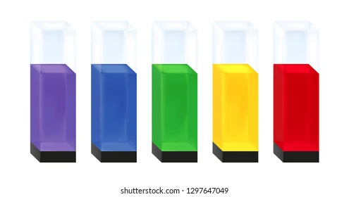
Spectrophotometer
STANBIO ONLINE PG CRASH COURSE 2024
11 September
Dr Sumitra G,
Professor of Biochemistry,
PSG Institute of Medical Sciences and Research, Coimbatore.

Slide 2
Outline
Principle
Components
Applications
Advantages & Limitations
Performance characteristics

Slide 3
Photometry
Photometry is defined as the measurement of light
Spectrophotometry is defined as the measurement of the intensity of light at selected wavelengths

Slide 4
Principle

Slide 5
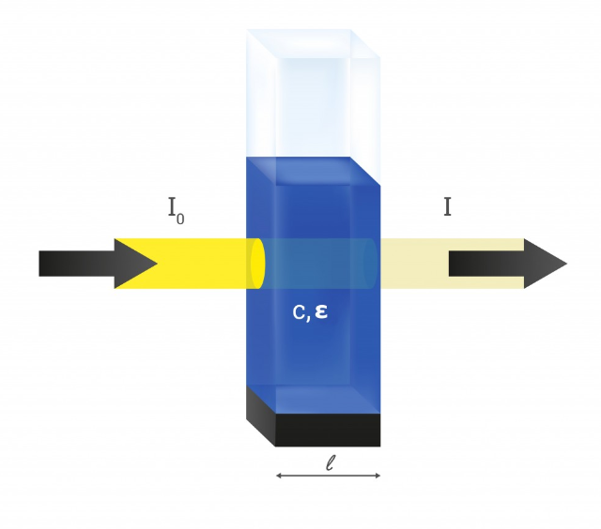
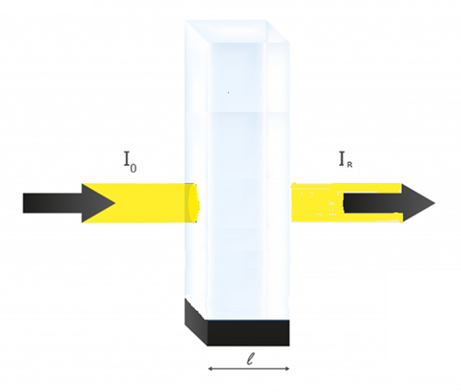
Beer Lambert’s law
T= I
I₀

Slide 6
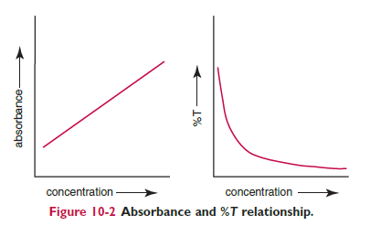
Absorbance
T% | A
100 | 0
10 | 1
1 | 2
0.1 | 3
0.01 | 4
0.001 | 5
Absorbance = log10 1/T
= log10 100/%T
= 2- log10 (%T)

Slide 7
Concentration and absorbance
A = a b c
A= Absorbance a = Constant – Molar absorptivity b = path length in cm c = Concentration of the solute in mol/L

Slide 8
Assumptions/ Limitations
Beer’s law is followed only if the following conditions are met:
Incident radiation on the substance of interest is monochromatic.
The solvent absorption is insignificant compared with the solute absorbance.
The solute concentration is within given limits.
An optical interferant is not present.
A chemical reaction does not occur between the molecule of interest and another solute or solvent molecule.

Slide 9
Why can’t molar absorptivity be used instead of calibration for all assays?

Slide 10
Instrumentation

Slide 11
Components

Slide 12
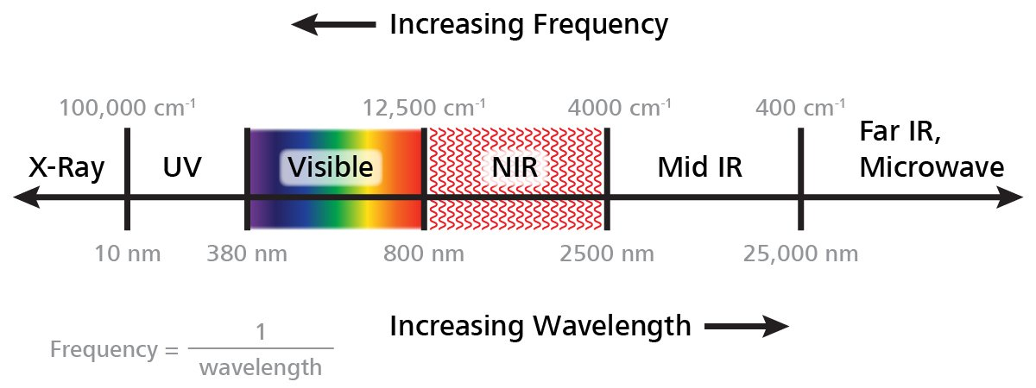
Types of spectrophotometers
UV-VIS Spectrophotometer
IR Spectrophotometer

Slide 13
Light source
The goal is to have a light source that provides high-intensity light uniformly across the spectrum of interest
bright across a wide wavelength range
stable over time
long service life
low cost
Incandescent
Gas discharge
LED
LASER

Slide 14
Incandescent lamps
A filament is heated to high temperature using electric current – emits light
Continuous spectrum of light
Examples
Quartz-halogen lamp – Tungsten - Vis and near IR
Nernst glower - oxides like zirconium oxide (ZrO₂) and yttrium oxide (Y₂O₃) - IR
Globar Silicon carbide (SiC) - IR
Nichrome lights -alloy of nickel and chromium - IR
Notes:
Emit light due to thermal excitation. Relation between temperature and spectrum

Slide 15
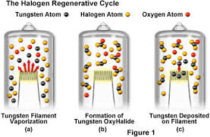
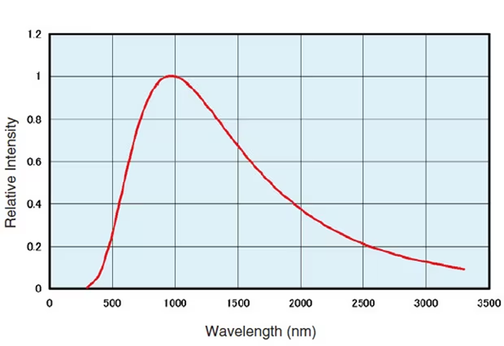
Quartz halogen lamp

Slide 16
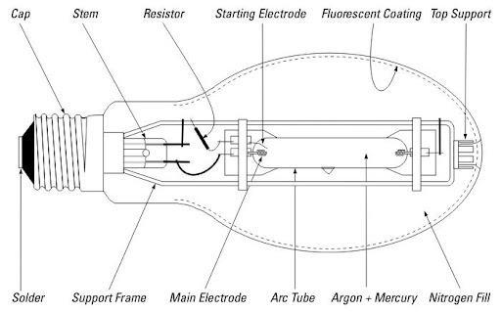
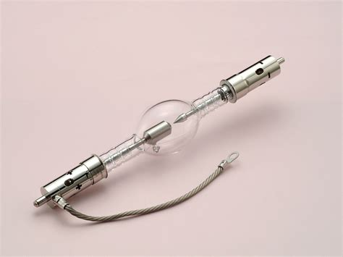
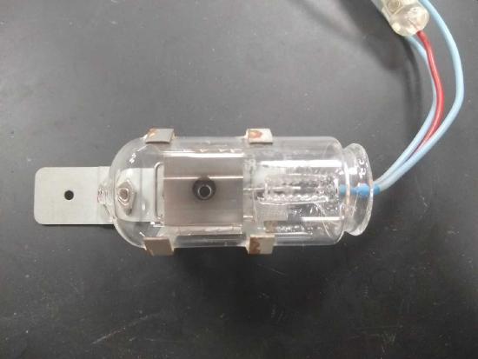
Gas discharge- Arc lamps
Arc lamps generate light through an electric arc formed between two electrodes in a gas or vapor.
The high temperatures in the arc cause the gas to emit light.
continuous spectrum – UV, Vis and near IR
Xenon arc lamps, Deuterium arc lamps

Slide 17
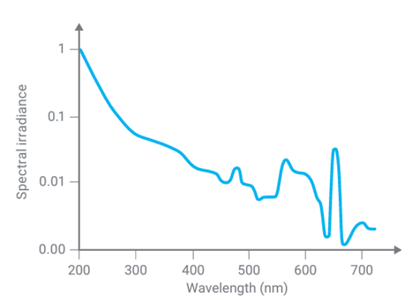
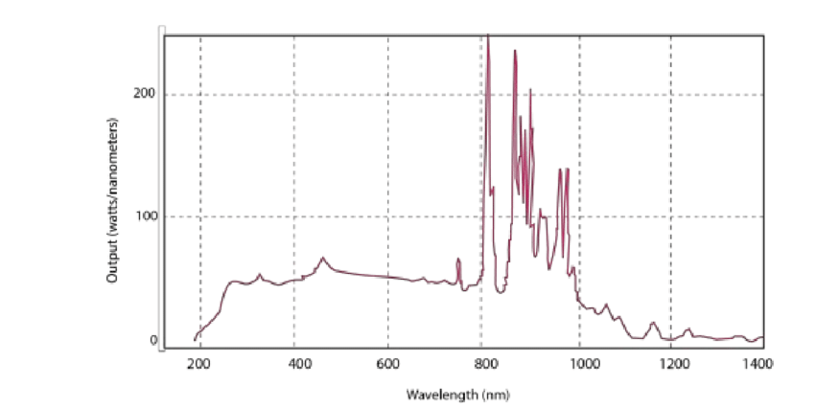
Xenon arc lamp
Deuterium lamp

Slide 18
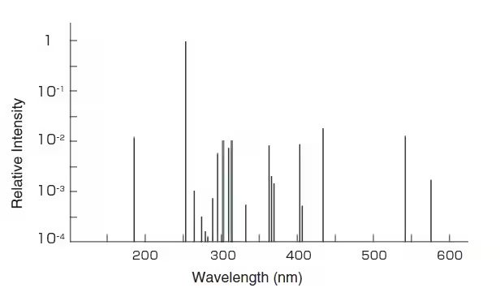
Gas discharge- vapour lamps
Low pressure mercury vapour lamp
When an electric current passes through the gas, it excites the atoms, causing them to emit light.

Slide 19
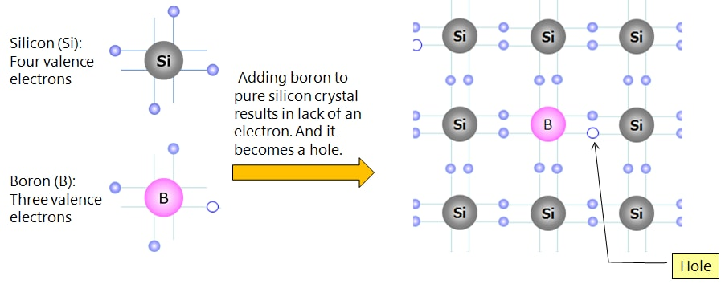
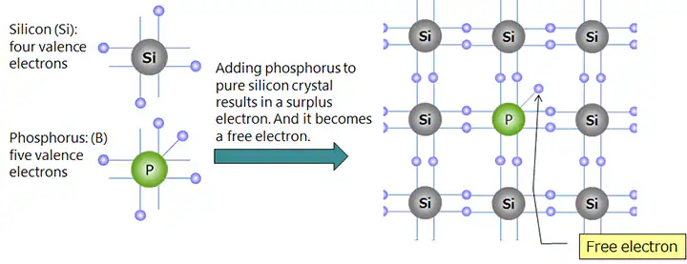
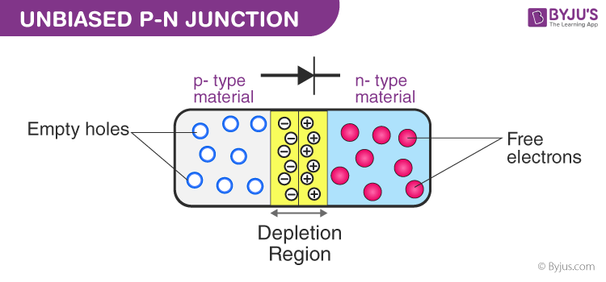
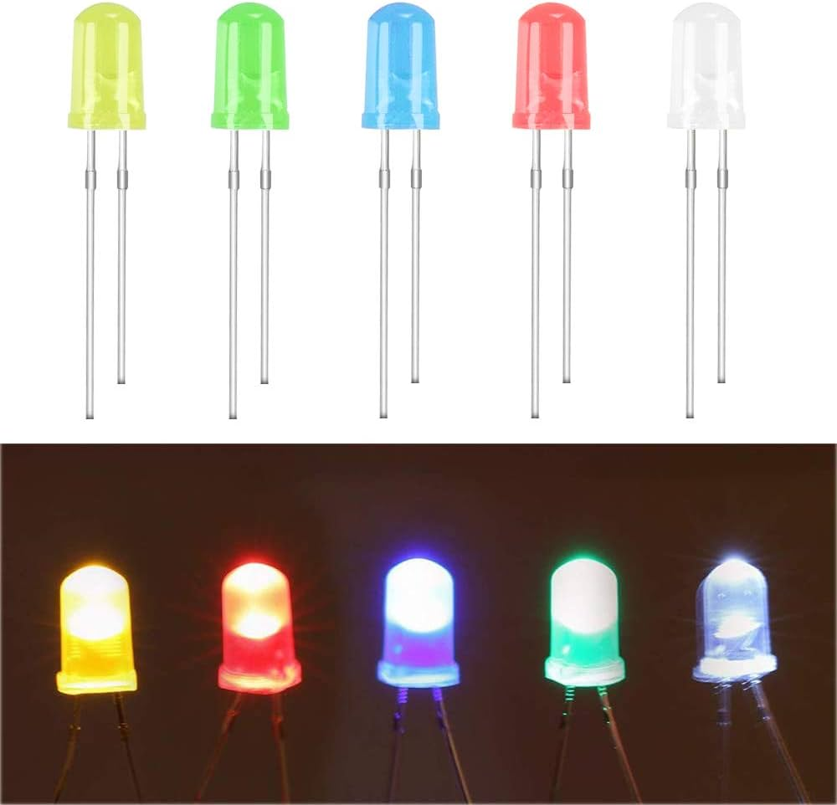
Light Emitting Diodes

Slide 20
LEDs

Slide 21
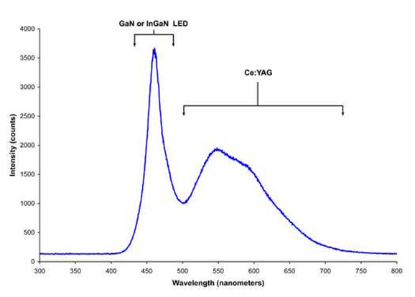
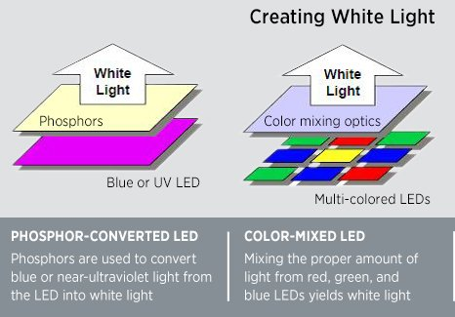
LEDs

Slide 22
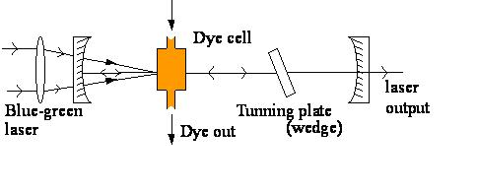
LASERS
Monochromatic light
Narrow beam width
Versatile pulse widths
Continuous wave dye laser – Argon laser with fluorescent dyes

Slide 23
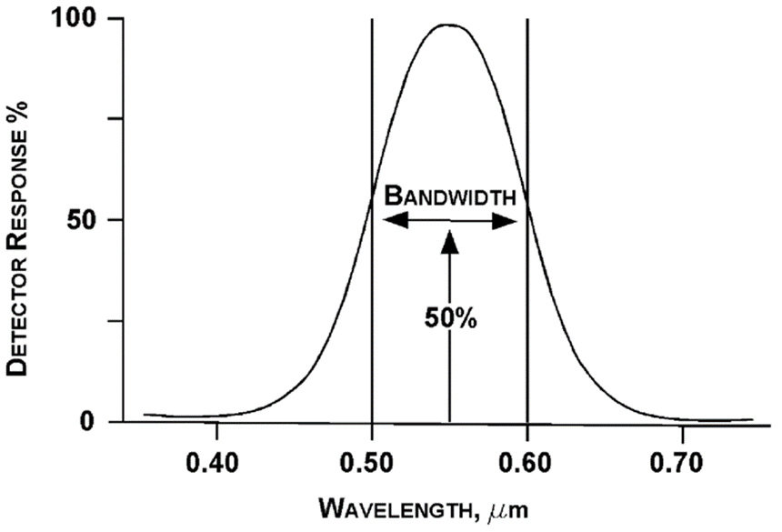
Wavelength selector
Required for isolating desired wavelengths – Fixed or scanning.
Filters – Interference filters, absorption filters
Dispersive elements – Prisms, Diffraction gratings
Purity of the exiting light is described as spectral bandwidth

Slide 24
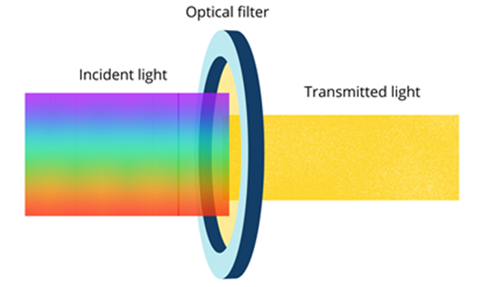
Absorption filter
Absorption filters work by absorbing specific wavelengths of light and allowing the rest to pass through. Made of colored glass or plastic materials that absorb certain parts of the spectrum.
Advantages:
Durable and easy to use.
Cost-effective for broad applications.
Disadvantages:
Lower spectral resolution.
Not suitable for precise wavelength selection.

Slide 25
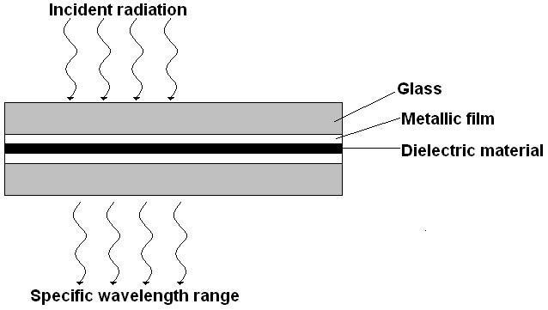
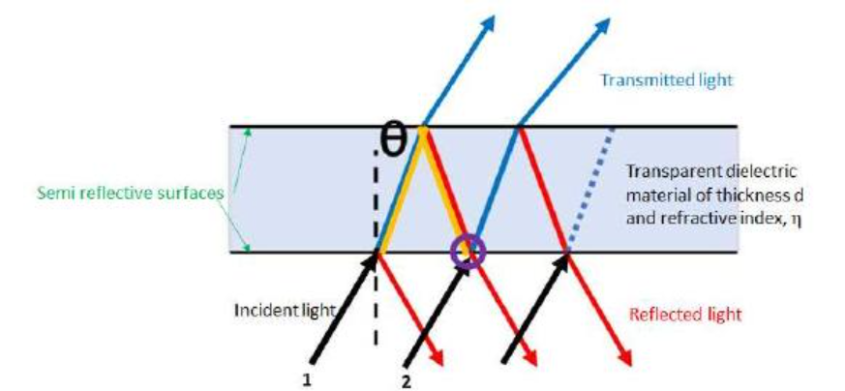
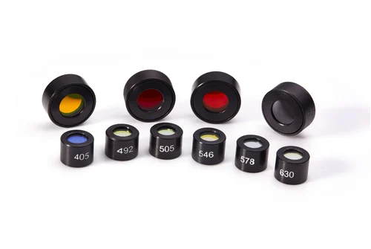
Interference filter

Slide 26
Interference filter
Use the phenomenon of constructive and destructive interference to transmit light within a narrow wavelength range. Made by stacking thin layers of dielectric materials and metal coatings. Provide high spectral resolution with very narrow bandwidth.
Advantages:
High precision and narrow bandwidth.
Ideal for applications requiring specific wavelength isolation, such as fluorescence spectroscopy and monochromatic light.
Disadvantages:
More expensive than absorption filters.
Low peak transmittance value

Slide 27
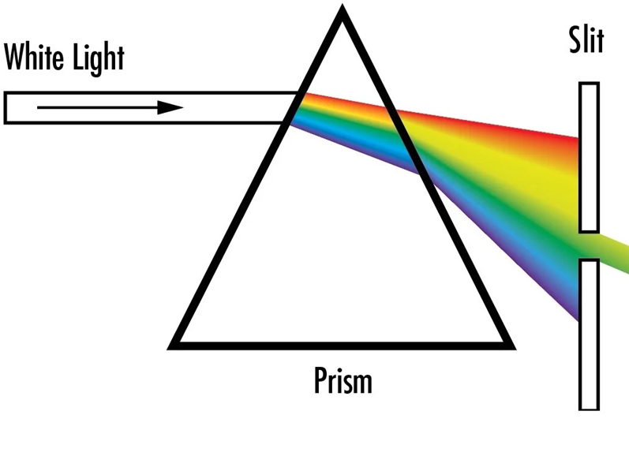
Prism
Principle:
Prisms disperse light by refraction; different wavelengths bend at different angles due to varying refractive indices.
Commonly made from glass, quartz, or fluorite (for visible and UV light), and calcite (for infrared).
Advantages:
Durable and suitable for broad-spectrum use.
Disadvantages:
Non-linear dispersion; shorter wavelengths (UV) are refracted more than longer wavelengths (IR).

Slide 28
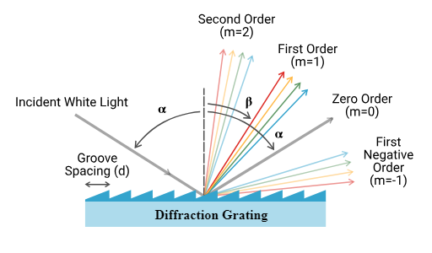
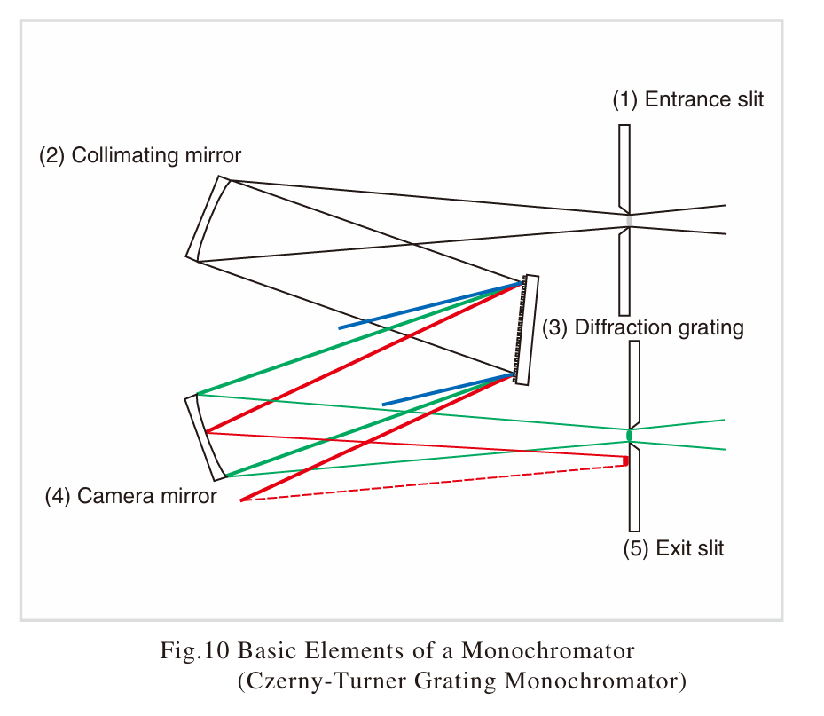
Diffraction Gratings

Slide 29
Diffraction Gratings
Disperse light through interference; light waves are diffracted at different angles based on the wavelength.
Composed of closely spaced grooves or lines.
Advantages:
High resolution and precise wavelength selection.
Suitable for UV, visible, and IR spectral ranges.
Disadvantages:
Higher-order diffraction can cause overlapping and needs filtering.

Slide 30
Cuvettes
Round
Square
Rectangle
Glass
Plastic
Quartz

Slide 31
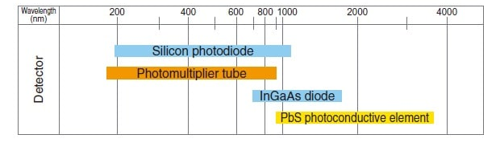
Photodetectors
Goal of photodetector
Responsive to low radiant energy
Cover broad wavelength
High signal to noise ratio

Slide 32
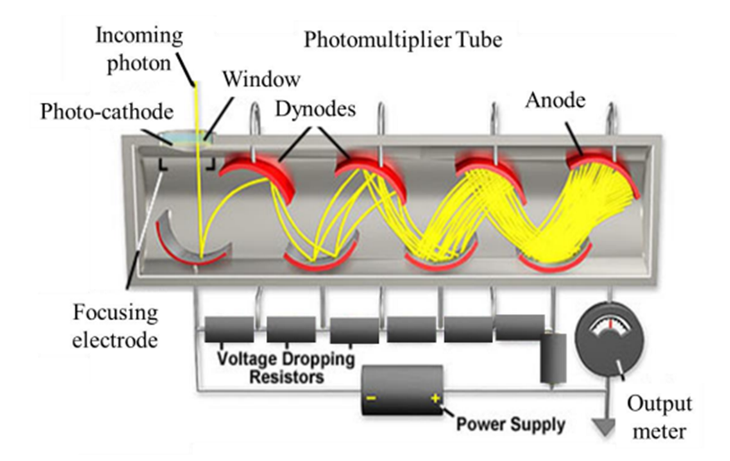
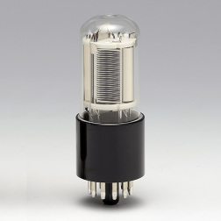
Photomultiplier tube

Slide 33
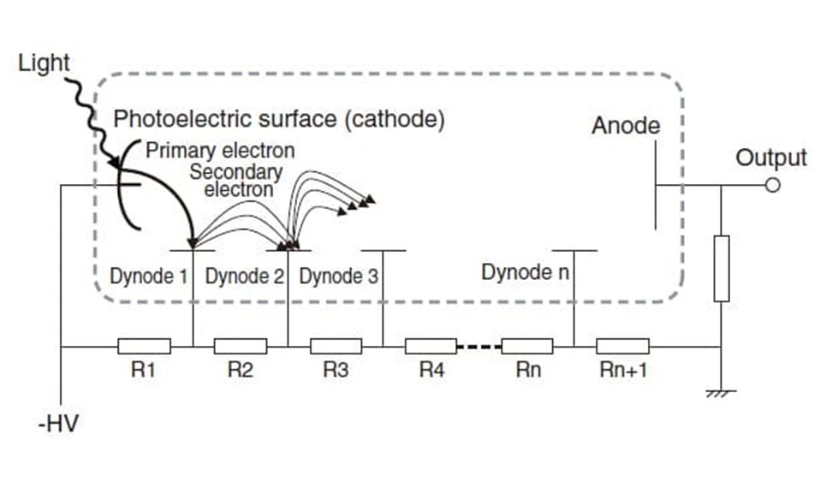

Slide 34
PMT
Advantages:
High Sensitivity
Fast Response Time
Wide Spectral Range
Long operational lifespan
Disadvantage
Very sensitive to stray light

Slide 35
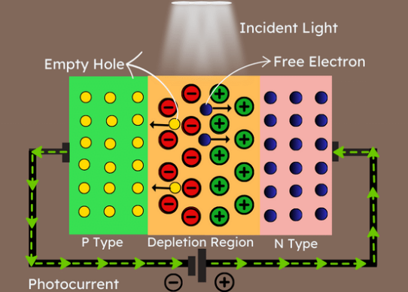
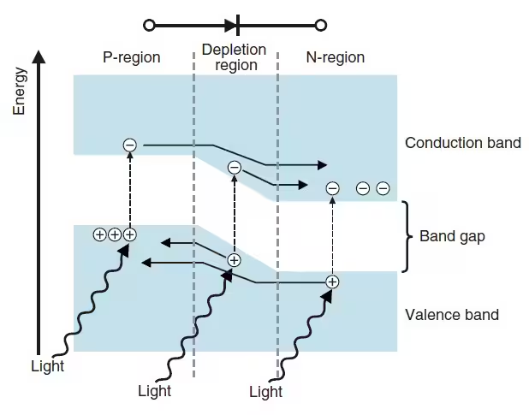
Photodiode

Slide 36
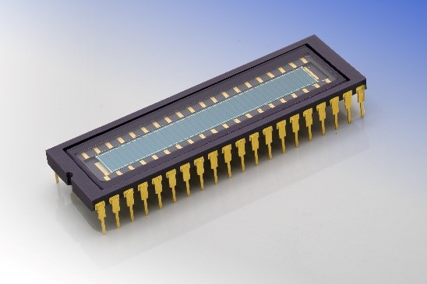
Photodiode array
Advantages
Parallel Detection
Sensitivity
Fast Response Time
Disadvantage
Not suited for measuring when light intensity is low

Slide 37
Charge-Coupled Device
Consists of an array of light-sensitive elements (pixels) that transfer charge to an output device
High Sensitivity
High Resolution
Uniform Response
Disadvantage: Readout Speed low

Slide 38
Process flow in CCD
Light to charge conversion
Charge accumulation – potential well
Charge transfer
Charge to voltage conversion
Amplification

Slide 39
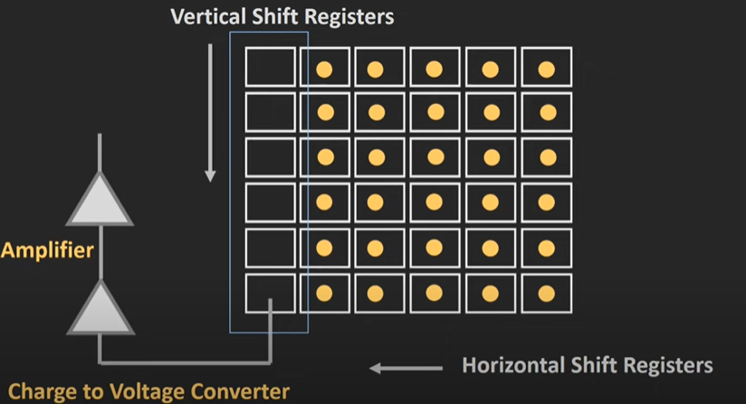

Slide 40
CMOS
Photon Detection: Light is converted into charge.
Charge Accumulation: Electrons are collected and stored.
Signal Amplification: The charge signal is amplified within each pixel.
Charge-to-Voltage Conversion: Charge is converted into a voltage signal.
Analog-to-Digital Conversion: The voltage signal is digitized.
Readout: Digital signals from each pixel are read out.
More compact, faster readout speed, low cost but higher noise level compared to CCDs

Slide 41
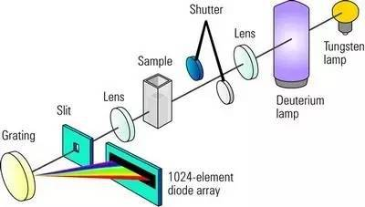

Slide 42
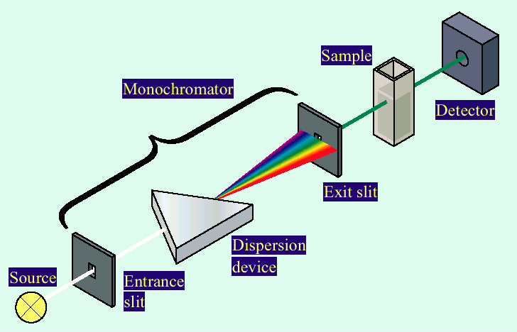

Slide 43
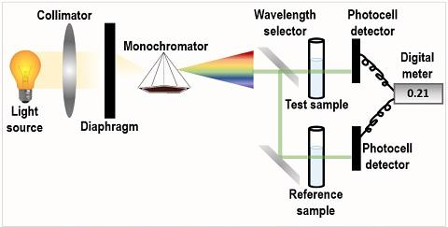

Slide 44
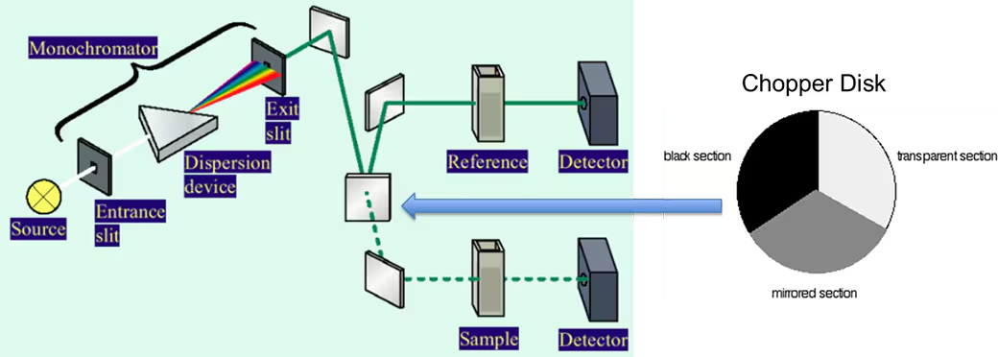

Slide 45
Applications

Slide 46
Applications
Identifying a substance
Quantifying a Molecule
Study enzyme kinetics
Study confirmational changes
Measure purity of proteins and Nucleic acid
Nucleic acid and proteins melting temperature
Colour measurement

Slide 47
Clinical laboratory – measurement of analytes, drugs concentrations in biological fluids
Molecular biology – Study the quantity, purity and structural changes in DNA
Pharmaceutical industry – verify purity, analyse concentration and quality control
Environmental testing – water and soil quality
Food and beverage industry – food content analysis, colour measurement
Forensic – Identification of substances
Spectrophotometer is an integral part of other instruments like HPLC, ELISA readers, ABG systems for co-oximetry

Slide 48
Advantages and Limitations

Slide 49
Advantages
High Sensitivity: Capable of detecting very low concentrations of analytes.
Non-Destructive: Does not alter or destroy the sample during analysis.
Wide Applicability: Can be used for a variety of compounds in different industries (e.g., chemistry, biology, environmental science).
Quantitative and Qualitative: Allows both the identification and quantification of substances.
Fast and Simple: Provides quick results with straightforward procedures.
Automation Capability: Easily integrated into automated systems for high-throughput analysis (e.g., in clinical labs, HPLC detectors, or ELISA readers).

Slide 50
Limitations
Stray Light: Causes errors at high absorbance values, leading to inaccurate readings.
Sample Preparation: Requires careful preparation; poor handling can affect accuracy.
Turbidity: Suspended particles can scatter light, causing measurement errors.
Beer's Law Deviations: Nonlinear results at high concentrations due to molecular interactions.
Limited Wavelength Range: A single spectrophotometer may not cover all required wavelengths (UV, visible, or IR).
Non-Specific Detection: Overlapping absorbance spectra can make it difficult to differentiate components in mixtures.
Environmental Sensitivity: Temperature, light, and vibrations can introduce noise or variability.

Slide 51
Performance characteristics

Slide 52
Performance characteristics
Wavelength accuracy
Spectral bandwidth
Straylight
Linearity
Photometric accuracy
Testing frequency- no regulations regarding - testing frequency monthly testing is preferred and frequency can be increased in high sample throughput environment

Slide 53
Wavelength accuracy
The wavelength accuracy test is used to ensure that the wavelength axis of the UV-Vis spectrum is accurate (correct and within acceptable limits) across the intended operational range.
This is assessed by using either a sample or a glass filter containing a series of very sharp peaks or by measuring the emission from a lamp.
Deuterium lamp
Mercury emission source
Glass and liquid filters such as holmium oxide, didymium

Slide 54
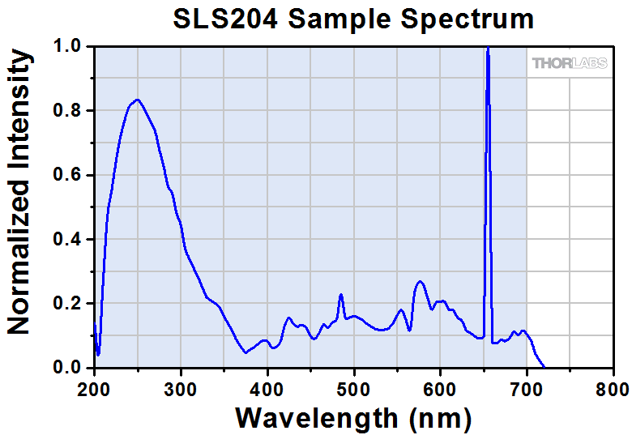
Wavelength accuracy using lamp emissions
Deuterium lamp emission: 656.1 nm emission line

Slide 55
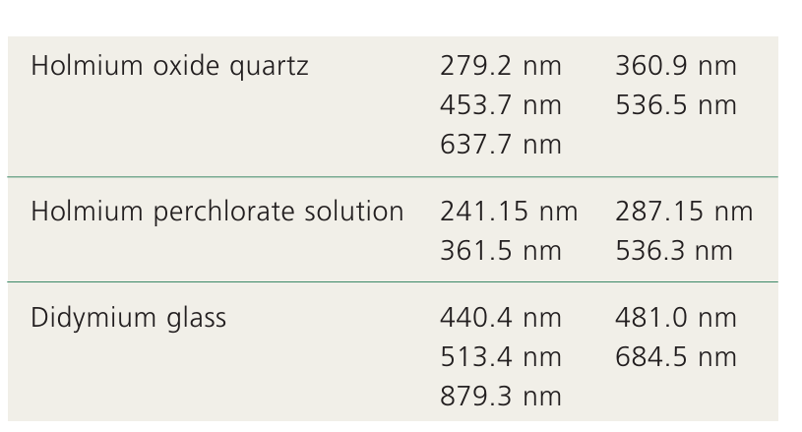
Wavelength accuracy using glass and liquid filters
Notes:
Samarium perchlorate UV-VIS and Rare earth sulphate UV

Slide 56
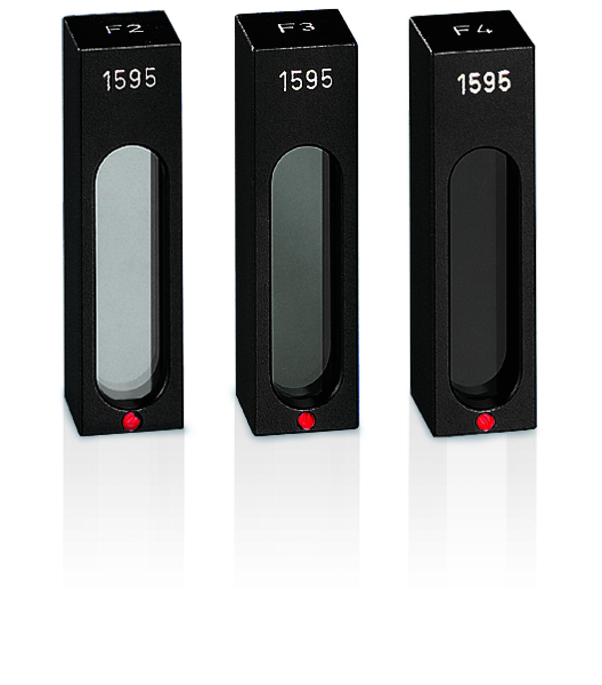
Photometric Accuracy
These tests are used to ensure that a UV-Vis spectrophotometer yields reliable quantitative measurements.
Neutral density glass filters
Potassium dichromate solution
Nicotinic acid solution

Slide 57
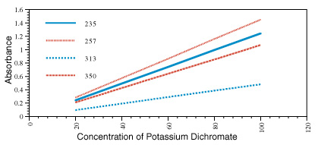
Photometric linearity
Photometric linearity affects how accurately an instrument measures absorbance with increasing optical density or concentration.

Slide 58
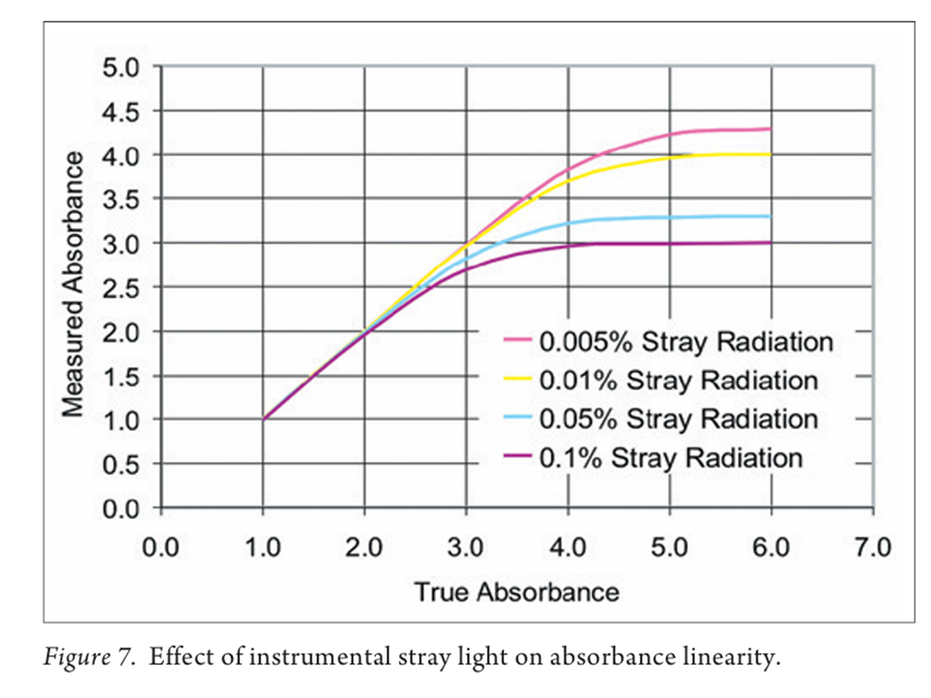
Stray light
Stray light can be defined as the amount of unwanted wavelengths that are present in the sample beam.
Scattering or diffraction by monochromator, other components of spectrophotometer or sample itself
Light leaks
Fluorescence of the sample
The best achievable stray light value will be around 0.01%T

Slide 59
Stray light measurement
50 g/L sodium nitrite for 340 nm and 370 nm
10 g/L sodium iodide for 220 nm

Slide 60
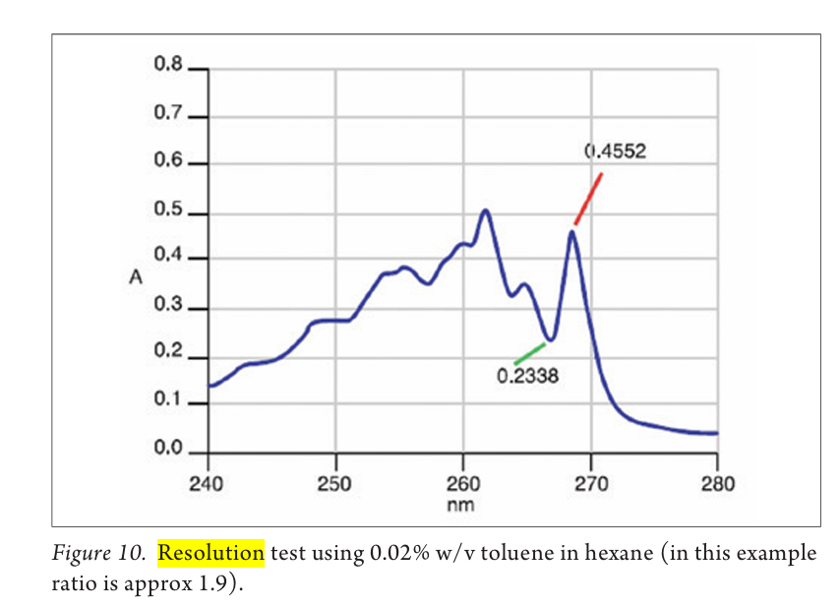
Spectral resolution
The resolution of a UV-Vis spectrophotometer is the narrowest spectral bandwidth that the instrument can achieve.
Toluene in Hexane solution

Slide 61
Other performance characteristics
Noise: Noise refers to random fluctuations in the signal that are inherent in any measurement system. It is usually a combination of electrical noise from the detector, thermal noise, and fluctuations in the light source.
Baseline flatness
Absorbance stability (drift)
Reproducibility

Slide 62
Questions?

