Slide 1
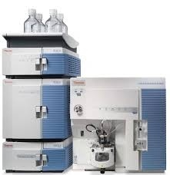
MASS SPECTROMETER AND TMS
Dr. G. CHITRA SIVA SANKARI .M D.,D.L.O., SENIOR ASSISTANT PROFESSOR , INSTITUTE OF BIOCHEMISTRY
MADRAS MEDICAL COLLEGE& RGGGH,CHENNAI

Slide 2
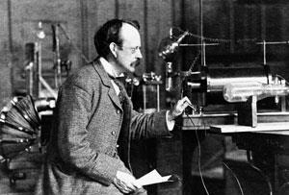
SYNOPSIS
MASS SPECTROMETER
DEFINITION
PRINCIPLE
INSTRUMENTATION
IONIZATION TECHNIQUES
MASS ANALYZER AND ITS TYPES
APPLICATIONS
ADVANTAGES AND DISADVANTAGES

Slide 3
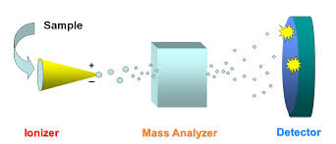
MASS SPECTROMETRY
Valuable analytical technique used in Quantitative and Qualitative analysis of molecules.
Molecules in the test sample are converted to gaseous ions that are subsequently separated in a MASS SPECTROMETER according to their mass to charge(m/z) ratio and detected.

Slide 4
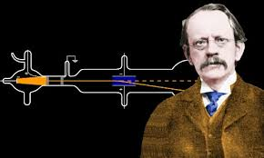
MASS SPECTROMETER
Analytical instrument
1. first ionizes a target molecule
2.then separates
3.then measures the mass of a
molecule or its fragments.

Slide 5
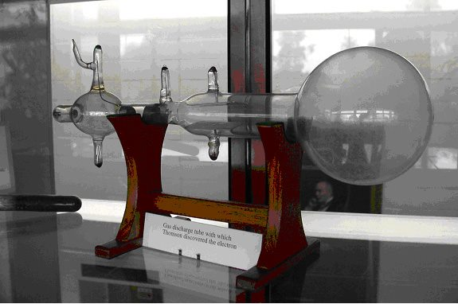
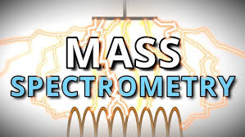
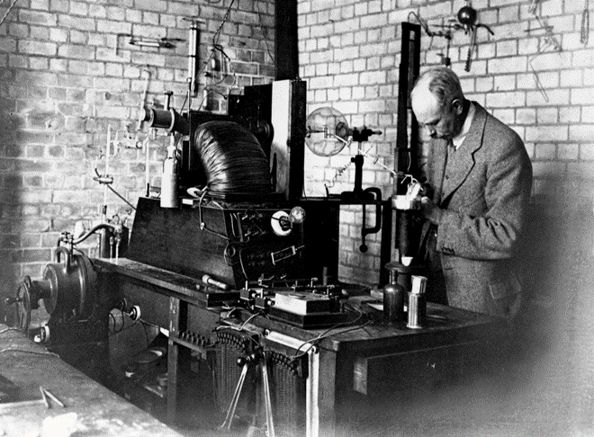
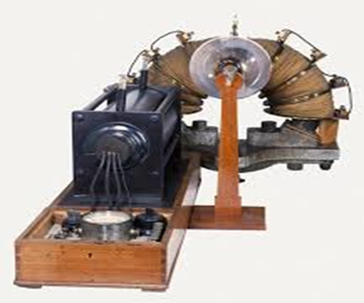
PARABOLA SPECTROGRAPH

Slide 6
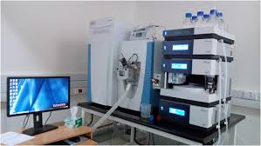

Slide 7
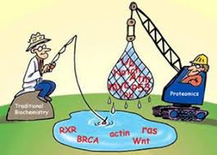
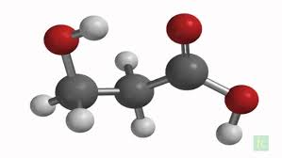
To determine the mass of molecules in a sample
To study the isotopes of molecules in a sample
To quantify the molecules in a sample
To elucidate the chemical structure of molecules
SAMPLES:
chemical and biological samples
WHERE
in pharmaceutical industries, proteomics, forensic studies and chromatographic techniques

Slide 8
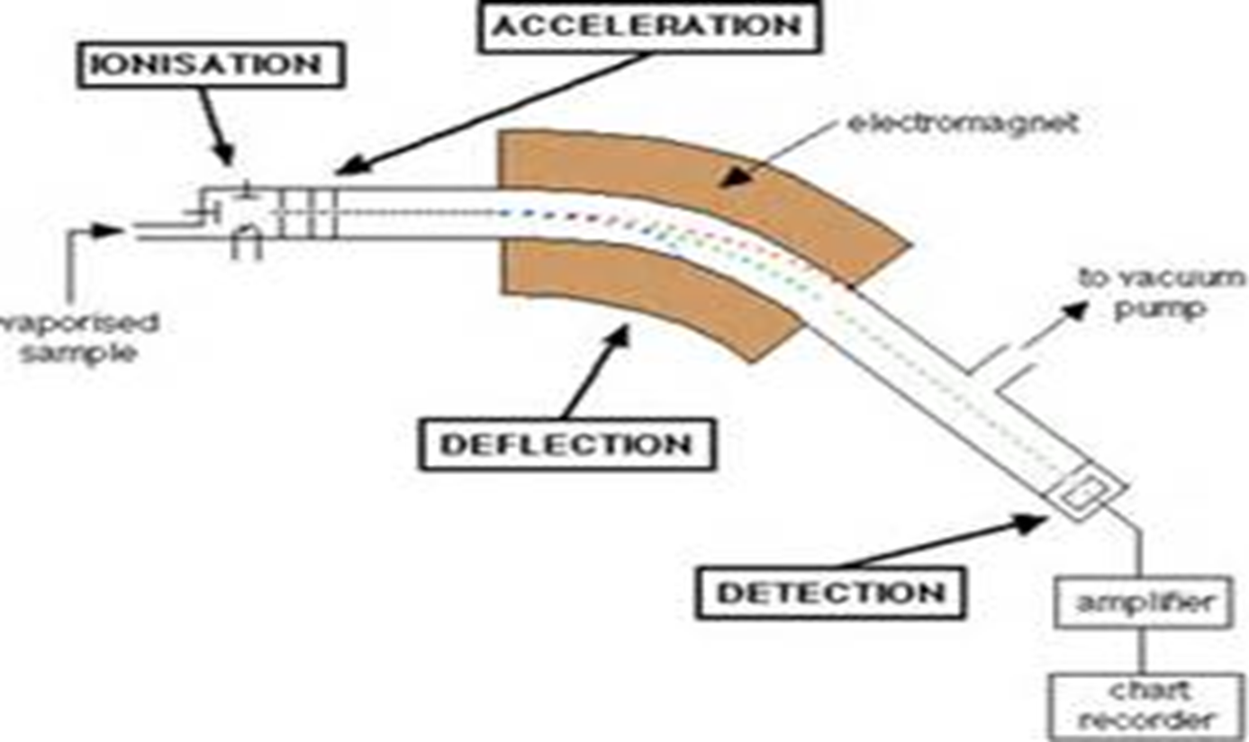
BASIC PRINCIPLE OF SPECTROMETER
Production of ions in the gas phase.
Acceleration of the ions to a particular velocity in an electric field.
separation of ions in the mass analyzer.
detection of each species of a particular m/z ratio.

Slide 9
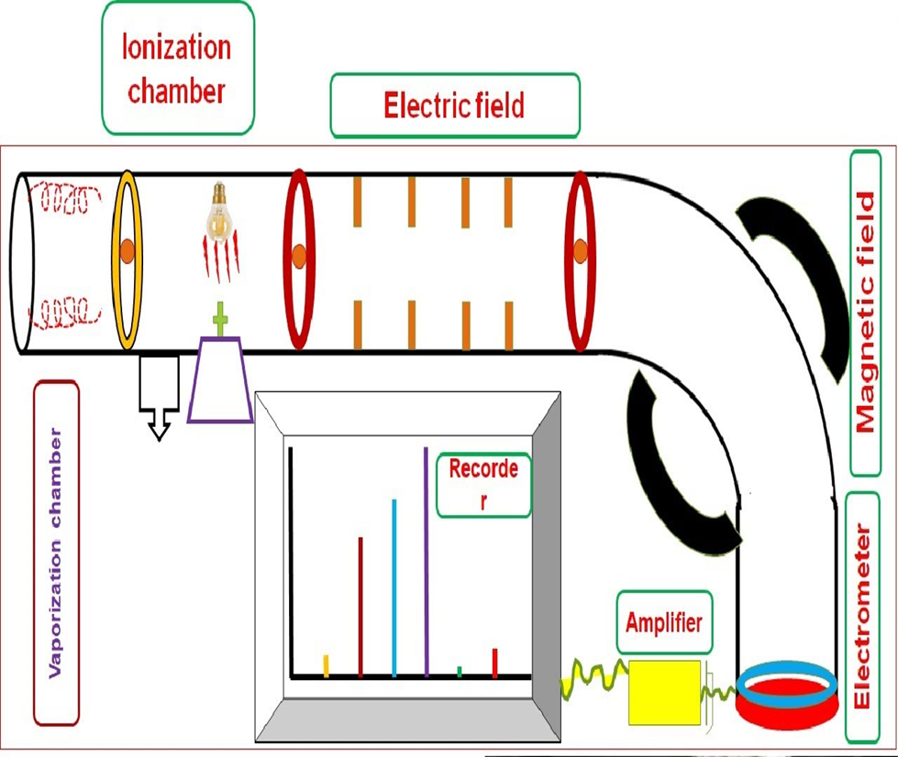
OVERVIEW
Sample molecules are
VAPOURIZED
IONIZED
ACCELERATED
SEPERATED AND DETECTED based on mass to charge ratio.(VIA-SD)

Slide 10
INSTRUMENTATION

Slide 11
COMPONENTS OF A MASS SPECTROMETER
1)Sample inlet
2)Vaporization chamber
3)Ionization chamber
4)Acceleration chamber
5)Mass analyser/filter
6)Detector
7)Computer
CONDITION:High vacuum system

Slide 12
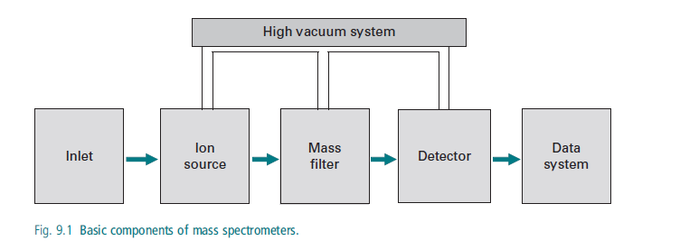

Slide 13
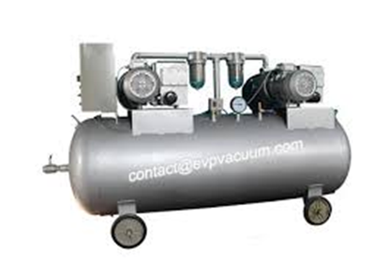
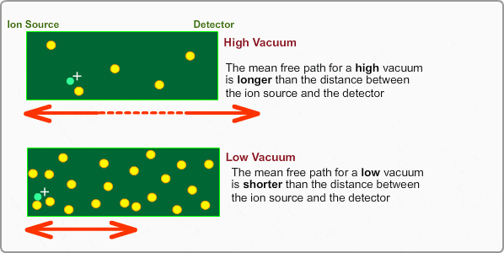
WHY HIGH VACUUM IS MAINTAINED?
All mass spectrometers operate at very low pressure and high vacuum.
- reduces the chance of ions colliding with other molecules in mass analyser. If such collisions occur, the instrument would suffer from reduced resolution and sensitivity.
-To allow ions to reach the detector without colliding with other gaseous molecules or atoms Any collision can cause the ions to react,neutralize,scatter or fragment.
Except ion trap mass analyser,high vacuum of 10⁻³ to 10⁻⁹ torr is needed.
Turbomolecular pumps, Diffusion pumps and rotatory vane pumps are used.

Slide 14
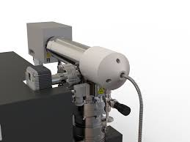
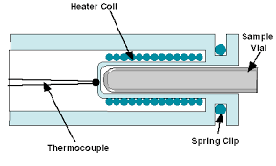
INLET SYSTEM
Sample is injected into the inlet system
Solid samples-with lower vapour pressure directly inserted into ionization chamber and volatilization is controlled by heating the probe.
Liquids-are handled by hypodermic needles, injection through a silicon capillary tube.
Gases samples-are leaked into the ionisation chamber directly by the help of mercury manometer.

Slide 15
VAPORIZATION CHAMBER
Any sample solid or liquid are converted into gaseous form using a heating coil.

Slide 16
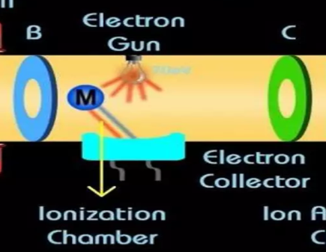
IONIZATION CHAMBER
1)All mass spectrometry techniques requires an ionization step in which an ion is produced from a neutral atom or a molecule.
2)Ions may undergo fragmentation in a mass spectrometer.
3)If ionization source is
Soft-it produces little fragmentation. An unfragmented ion of a original molecule is called a molecular ion.
Hard-it produces extensive fragmentation,
Ions formed by the fragmentation of molecular ions - fragment ions.
Base peak may be one of the fragment ions.Base peak in a mass spectrum is assigned a relative abundance of 100%.

Slide 17
MASS SPECTRUM

Slide 18
Relative abundance of each ion plotted as a function of it’s m/z ratio
Z=1, m/z=m
Molecular ion – Unfragmented ions of original molecule.
Base peak – Ion with highest abundance in mass spectrum assigned relative value of 100%

Slide 19
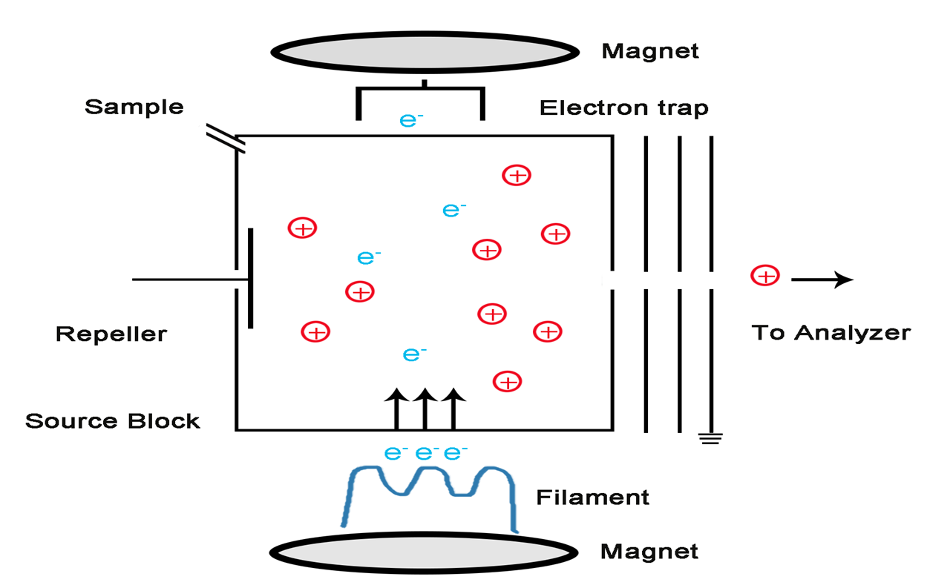
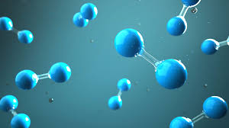
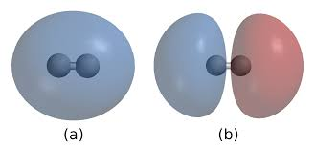
IONIZATION CHAMBER
Electrons are produced by heated tungsten filament and collected by electron collector.
Energy of the electron is 70 eV
At 70 eV,wavelength of the electron is 0.14nm which is equal to the diameter of chemical bond in organic molecules.
The electrons collide with the molecules and produces ions(mostly cations+)or fragments of molecules.
A positively charged electrode is placed in the side which pushes the ions into acceleration chamber.
Based on the phase of sample,ionization technique changes.

Slide 20
IONIZATION TECHNIQUES
1)For gas phase molecules entering into analyzer from GC:
EI( electron ionization)
CI(chemical ionization)
2)For liquid phase molecules entering into analyzer from HPLC:
ESI(electro spray ionization)
SSI(sonic spray ionization)
APCI(atmospheric pressure chemical ionization)
APPI(atmospheric pressure photo ionization)
3)Other ionization techniques
ICP(inductively coupled plasma)
MALDI(matrix assisted laser desorption/ ionization)
AP-MALDI(Atmospheric pressure-MALDI)
FAB(Fast atom bombardment).

Slide 21
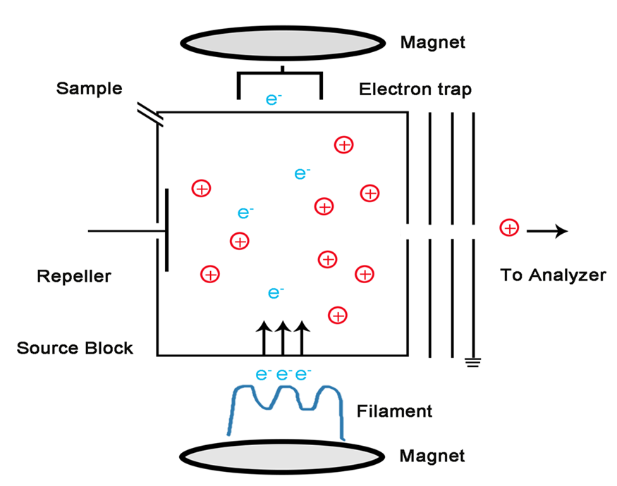
ELECTRON IMPACT IONIZATION
Hard ionization tech used in drug testing programs.
A beam of electrons emitted from a heated filament(cathode) pass through gas phase sample and collides with neutral analyte molecules to produce positively charged ion or a fragment ion
Positive ions are collected in focusing plate and passed into mass analyser.
electrons with 70eV –fragment ions.

Slide 22
CHEMICAL IONIZATION
Soft ionization technique for determination of molecular mass.
Here,interaction of sample with large amount of reagent gas occurs.
a proton is transfered from gas phase analyte by a reagent gas molecule
commonly used reagent gases are methane,ammonia and isobutane.
Electrons entering the source will preferentially ionize reagent gas
Resulting collision with reagent gas molecules-ionization plasma.
Positive and negative ions will be formed by reaction with this plasma

Slide 23
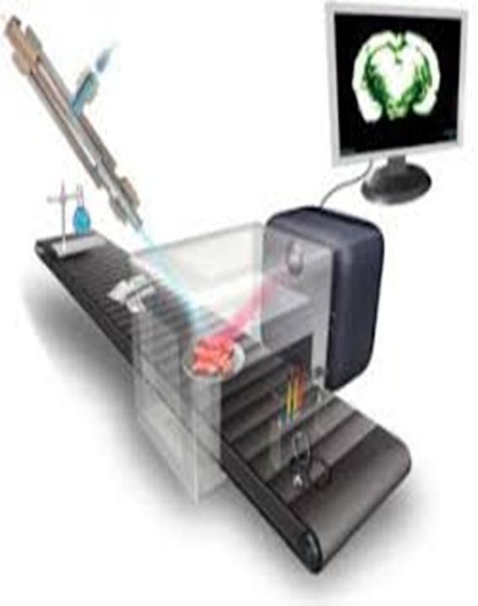
SONIC SPRAY IONIZATION
Ionizes polar and thermally unstable compounds.
Coaxial nitrogen –used to create spray and ion production.
Sonic velocity causes fine charged droplets.
Heating/high voltage not required.
Optimizes ionization

Slide 24
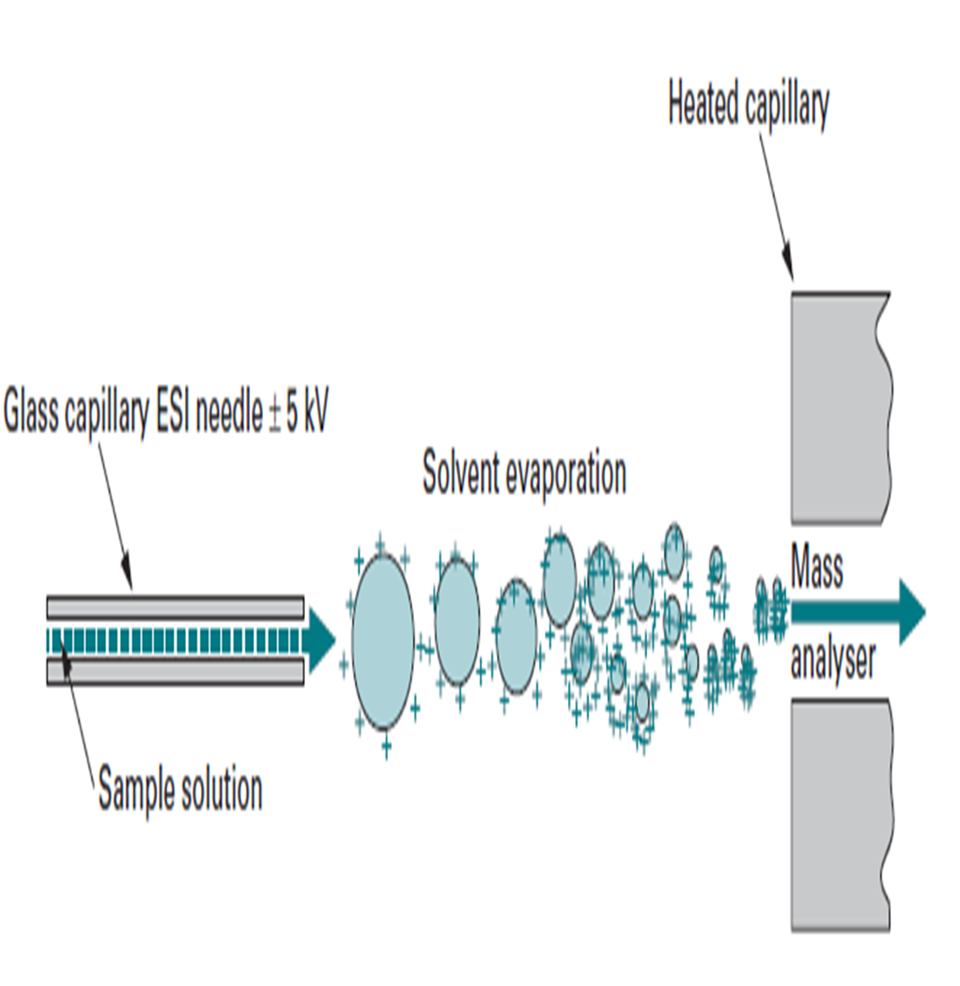
ELECTROSPRAY IONISATION
Ionizes polar compounds
soft ionization tech for the prodn of multiple charged ions from proteins and peptides.
Production of ions by spraying a solution of analyte into an electric field.
Used for analysis of large intact biomolecules-proteins and DNA.

Slide 26
ATMOSPHERIC PRESSURE CHEMICAL IONISATION
Soft ionisation technique that ionises polar compounds.
Method similar to chemical ionisation and ESI
Corona discharge needle is used to ionise the analyte in the atmospheric pressure region.
Since the ion current is concentrated into a single mass spectral peak,APCI is used in TMS.
ATMOSPHERIC PRESSURE PHOTO IONISATION
Method similar to APCI.
Ultraviolet photon flux is used instead of corona discharge needle to generate ions.
Photon source:Krypton discharge lamp.
Photon energy:10eV

Slide 27
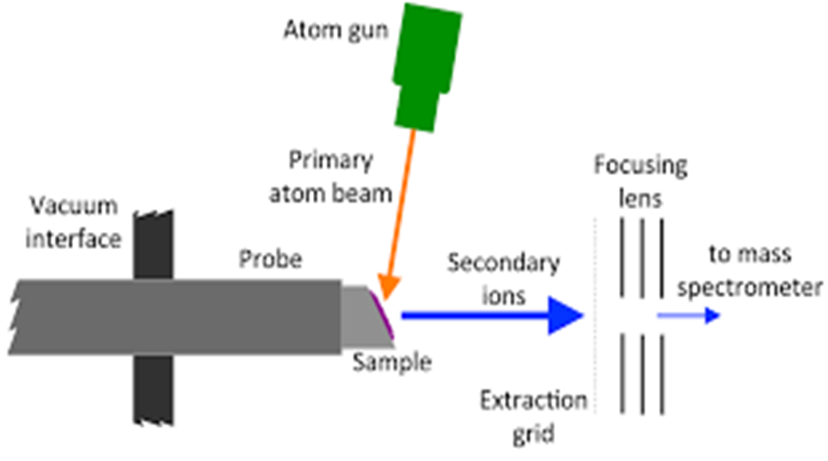
FAST ATOM BOMBARDMENT
Soft ionization technique in which an atom beam impinges the sample(liquid analyte)mixed with glycerol .
Ions are formed with low internal energy and little fragmentation.
High vacuum is required.
Used in TMS for diagnosis of AcylCarnitine Deficiency in new born blood spot.

Slide 28
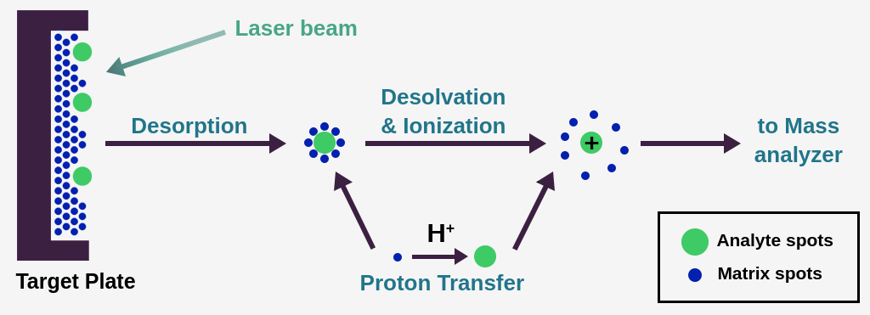
MATRIX ASSISTED LASER DESORPTION IONIZATION(MALDI)
Soft Ionization method.
Analyte dissolved in solution of matrix(small mol.wt.,UV-absorbing compound)
Solution placed on target, desorbed & ionized in MS
Under vacuum,laser beam vapourize small amount of matrix and analyte into ions that is directed into mass analyzer
TWO TYPES:1)AP-MALDI
2)SELDI
Advantages:speed, multiple sample wells,fragmentation
Disadvantages:poor fragmentation of singly charged ions

Slide 29
ACCELERATION CHAMBER
Also called velocity selector for focusing ions into analyzer
Ions are accelerated so that they all have the same kinetic energy.
Positive ions pass through 3 slits with voltage in decreasing order(10k to 0 volts)
middle slit carries intermediate and final slit is at 0 volts.
Then ions enter into mass analyser.

Slide 30
MASS ANALYZER
Different ions are deflected by the magnetic field by different amounts.
The amount of deflection depends on
Mass of the ion-lighter ions are deflected more than heavier ones.
Charge on the ion-ions with 2 or more positive charges are deflected more than ones with only one positive charge
These 2 factors are combined into the mass/charge (m/z) ratio

Slide 31
MASS SPECTROMETER

Slide 32
TYPES OF MASS ANALYSERS
BEAM TYPE
TRAPPING TYPE
1)Ions makes one pass through the instrument and strike the detector where they are destructively detected.
2)Entire process takes microseconds to milliseconds.
Ions are held in a spatially confined region of space acted upon by a combination of magnetic or RF electrical field.
Entire process takes seconds to minutes.

Slide 33
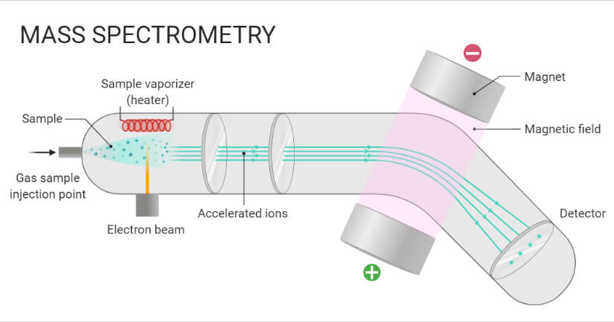
BEAM TYPE MASS ANALYZER

Slide 34
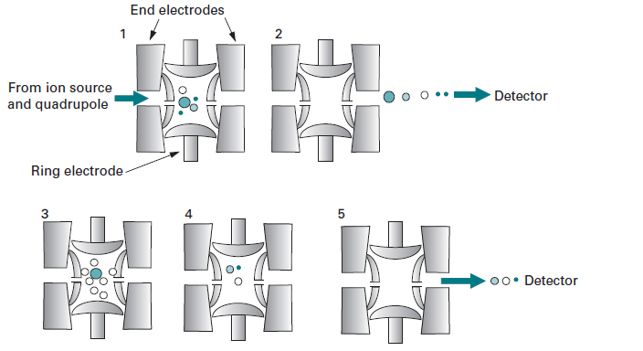
TRAPPING TYPE MASS ANALYZER

Slide 35
TYPES OF MASS ANALYSERS
BEAM TYPE
QUADRUPOLE MS
MAGNETIC SECTOR MS
TRAPPING TYPE
QUADRUPOLE ION TRAP MS
OTHERS
GAS CHROMATOGRAPHY MS
TIME OF FLIGHT MS
LINEAR ION TRAP MS
ION CYCLOTRON RESONANCE MS
ORBITRAP MS
LIQUID CHROMATOGRAPHY MS
TANDEM MASS SPECTROMETER.
MALDI-TOF MASS SPECTROMETER.

Slide 36
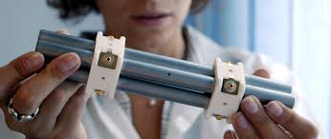
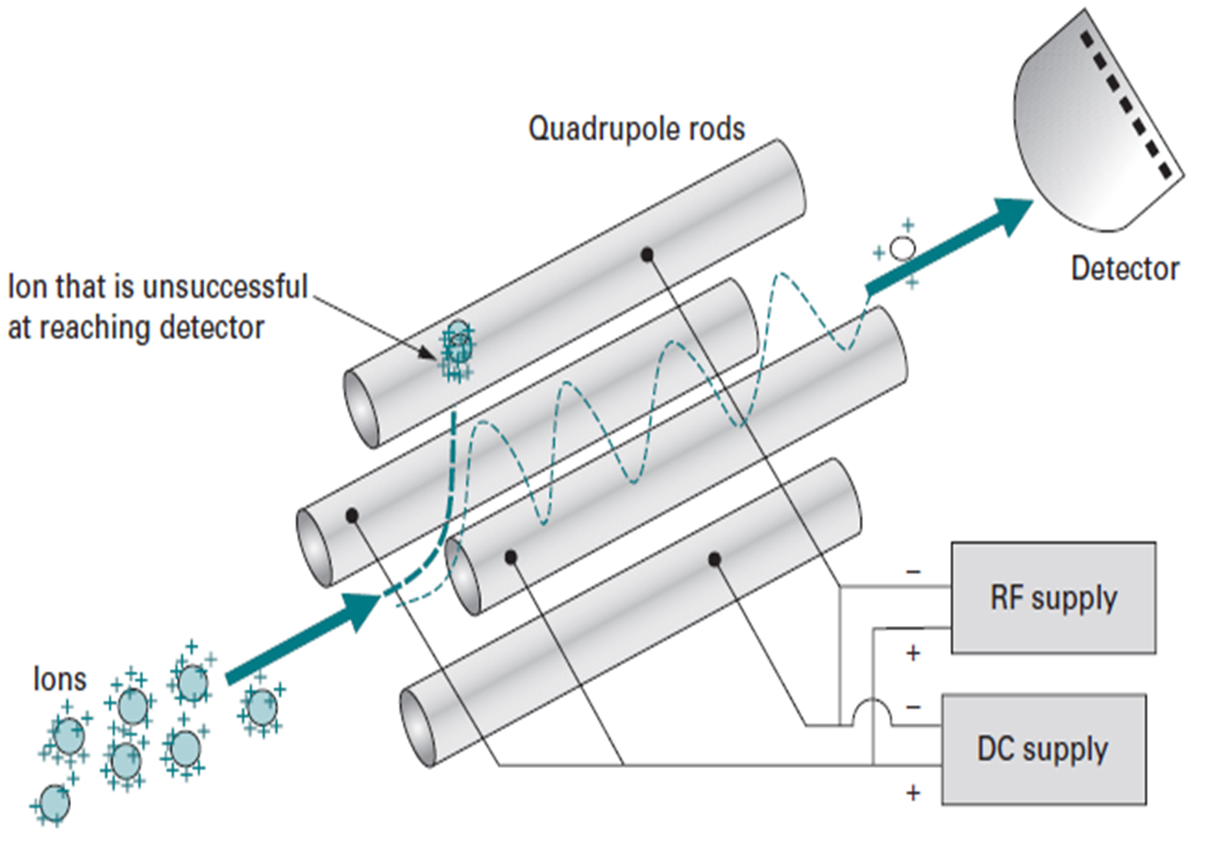
BEAM TYPE QUADRUPOLE MASS SPECTROMETER
Consist of four parallel cylindrical rods.
A DC voltage and a superimposed RF voltage are applied to each rod.
Electric field causes ions to move towards detector.
Ions of particular m/z ratio Pass down the analyzer.

Slide 37
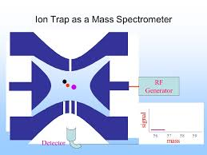
TRAPPING TYPE MASS ANALYZER
ION TRAP
QUADRUPOLE ION TRAP: Relies on RF field to provide ion trap.
LINEAR ION TRAP:Relies on RF field for ion trap.
IonCyclotron Resonance:Relies on magnetic and electrostatic field for ion trap.
ORBITRAP: Relies on electrostatic field for ion trap.

Slide 38
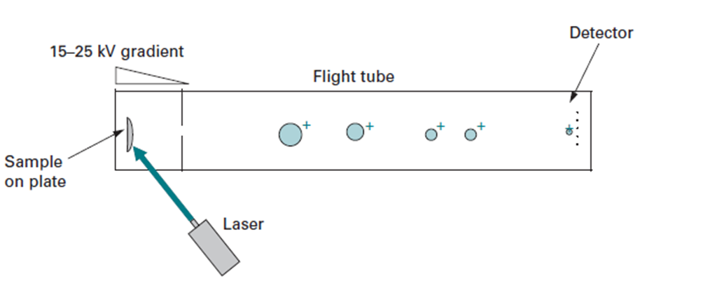
TIME OF FLIGHT MASS SPECTROMETER
:Principle
lighter ion travels faster than a heavier ion provided both have the same kinetic energy.
Advantages:
Unlimited m/z range
High speed
High mass accuracy
High resolution
High sensitivity
Reliable cost
Coupled to MALDI-TOF for protein detection

Slide 39
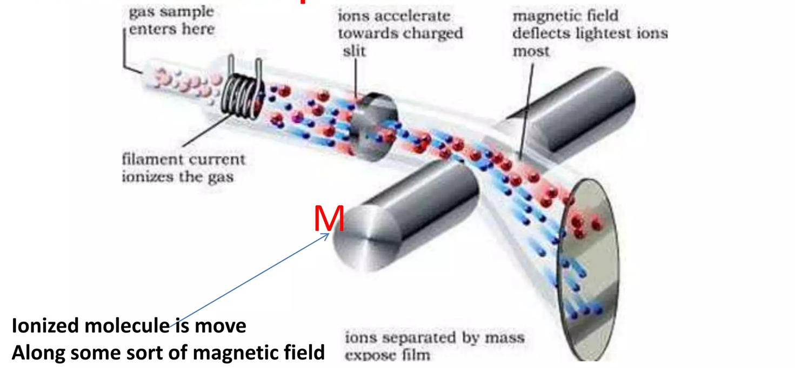
DETECTORS
Detect the time and radius of the curve of ions path.
Based on the radius of the curvature, mass of the molecule can be calculated.
Low mass ion deflected high=path length is long=reach the detector late.
High mass ion deflected Low=path length is short=reach the detector fast.
M=r x q x B / V
r=radius of curvature
q=charge of the ion
B=magnetic field
V=velocity of the ion
Faraday cup.
Electron multiplier.
Photo multiplier.
Micro channel plate

Slide 40
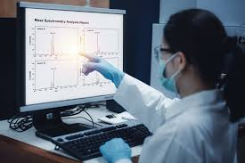
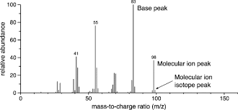
COMPUTER (RESULTS)
Signals from the detector are amplified and recorded in a computer as a stick diagram.
The result is shown in graph, m/z against relative abundance(intensity of the signal)
The highest value in m/z axis is molecular ion peak.
Due to molecules in intact form
The highest peak in relative abundance axis is base peak
Due to stable fragment ion
Small peaks nearby represent isotopes.

Slide 41
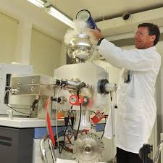
APPLICATIONS OF MS
Determination of molecular mass of peptides, proteins and oligo nucleotides
Eluciditation of structure of molecular and biological molecules
Monitoring gases in patients breath during surgery.
Identification of drug abuse and its metabolites in blood,urine and saliva
Analysis of aerosol particles.
Determination of pesticide residues in food.

Slide 42
ADVANTAGES
DISADVANTAGES
1)Less sample is required
2) fast, precise and reliable
3)Doth quantitative and qualitative analysis can be done
4)It does not involve absorbtion or emission of light.
5)A beam of high energy electrons breaks the molecules apart.
1.Sample destruction occurs
2. expensive
3.Some samples need prior separation of molecules by chromatography tech
So combined as GC-MS,LC-MS
4.Often fails to distinguish between optical and geometrical isomers
5.scope is limited in identifying hydrocarbons that produces similar fragment ions.

Slide 43
recap

Slide 44
TANDEM MASS SPECTROMETER
SYNOPSIS
DEFINITION
PRINCIPLE
INSTRUMENTATION
ION ACTIVATION METHODS
MS/MS EXPERIMENTS
TYPES OF TMS ANALYSERS
APPLICATIONS

Slide 45
TANDEM MASS SPECTROMETER (MS/MS)
DEFINITION
Uses 2 MASS SPECTROMETERS in a single instrument.
ONE MASS SPECTROMETER purifies the analyte ion from the mixture using a magnetic field.
the other MASS SPECTROMETER analyses fragments of the analyte ion for identification and quantification induced by collision with an inert gases like argon or helium.

Slide 46
PRINCIPLE OF TMS
combines 2 mass spectrometers MS1andMS2.
first mass spectrometer - select a single(precursor)mass that is characteristics of a given analyte in a mixture.
The mass selected ions pass through a region where they are activated in a way that causes them to fall a part to produce fragment(product)ions. This is usually done by colliding the ions with a neutral gas in a process called collisional activation(CA)or collision induced dissociation(CID).The second mass spectrometer is used to separate fragments ions according to mass.The resulting MS/MS spectrum consist only of product ions from the selected precursor.chemical back ground and other mixture components are absent.

Slide 47
INSTRUMENTATION OF TMS

Slide 48
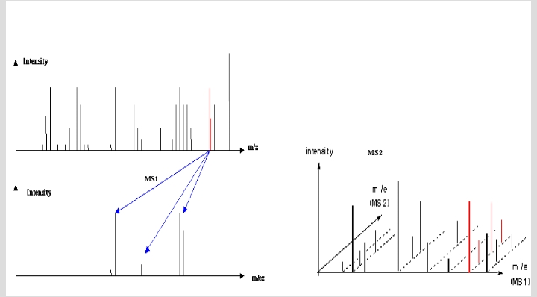

Slide 49
ION ACTIVATION METHODS
Mainly done to increase the internal energy of ions so that chemical bonds will break and fragment ions will be formed.

Slide 50
MS/MS EXPERIMENTS
Consider a precursor ion as, M1+ that decomposes to produce a product ion,M2+,and a neutral loss,N
M1+ M2+ + N
1)PRECURSOR ION SCAN
2)PRODUCT ION SCAN
3)CONSTANT NEUTRAL LOSS SCAN
4)SELECTED REACTION MONITORING.
5)MULTIPLE REACTION MONITORING.

Slide 51
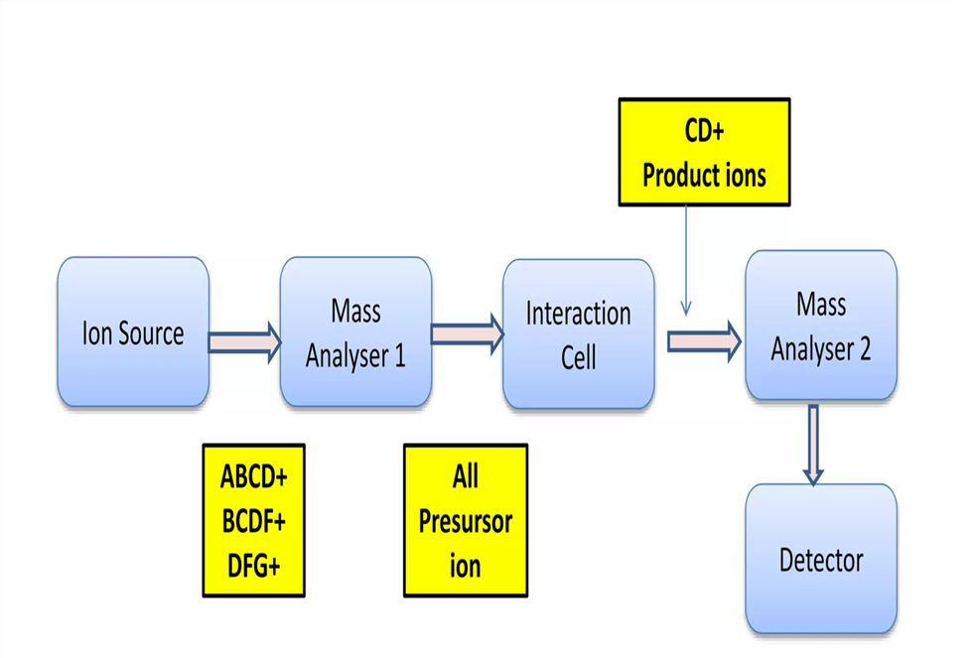
PRECURSOR ION SCAN(M2+ SPECIFIED)
Done to scan all possible precursor ions that decomposes to produce a specified product ion.
Gives information about which precursor ions produces a specific product ion.
In a mixture of compounds,those that gives the same product are identified by precursor ion spectrum
used to analyse specific classes of compounds.(Acyl carnitine Deficiency analysis)
.

Slide 52
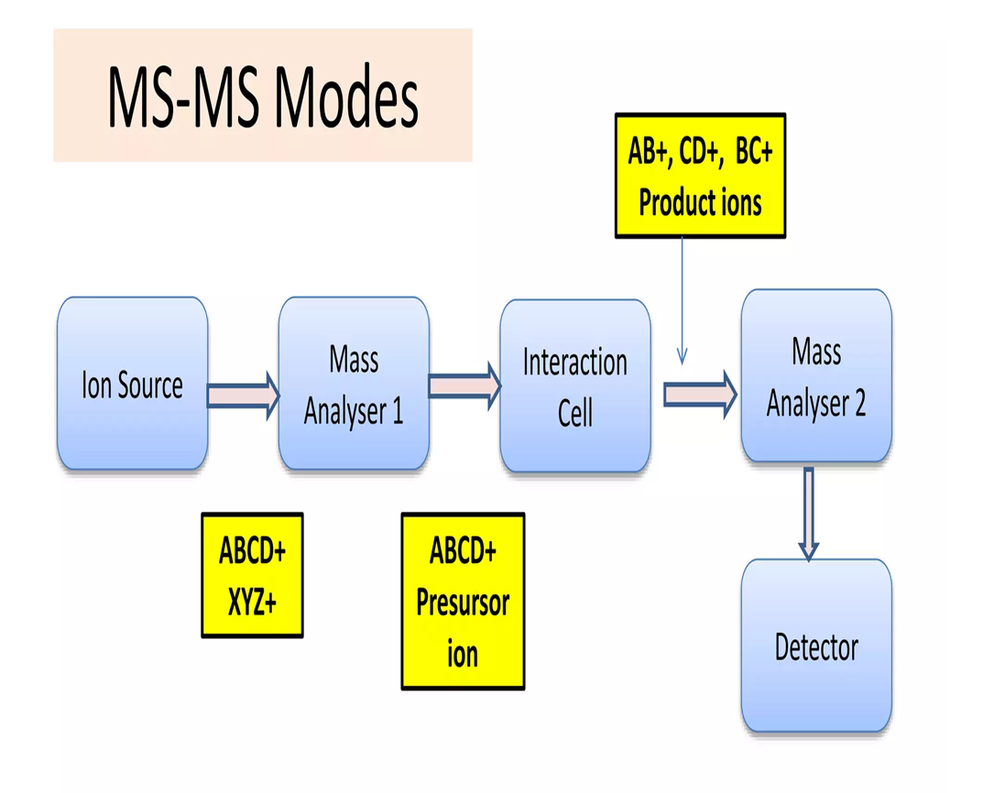
PRODUCT ION SCAN(M1+SPECIFIED)
Done to scan all product ions that result from the decomposition of a specified precursor ion.
Most common and well known MS/MS experiment.
Used to determine structurally significant fragment ions for a selected precursor ion

Slide 53
CONSTANT NEUTRAL LOSS SCAN(N SPECIFIED)
Done to look for all pairs of precursor ions and product ions that differ by a constant neutral loss.
Used to know a class of compounds that differ by constant neutral loss
peaks in constant neutral loss scan can be labeled by the precursor ion mass since we are interested in the identity of intact analyte molecules.

Slide 54
SELECTED REACTION MONITORING(SRM):-
Similar to selected ion monitoring for target compound identification.
In SRM,one specific set of product and precursor masses that are known to be characteristic of certain target compounds.
MULTIPLE REACTION MONITORING(MRM):-
This consists of a series of precursor/product ion pairs with the MS set to jump through the table of parent/product ion pairs in a cyclic fashion
used for quantitative analysis of a few specific target compounds

Slide 55
TYPES OF TMS
1. TANDEM IN TIME TMS -TRAPPING TYPE INSTRUMENTS
2.TANDEM IN SPACE TMS -BEAM TYPE INSTRUMENTS
Which is best???????

Slide 56
BEST-TANDEM IN TIME
because ions are held in one region of space,where parent ions are selected,dissociated and daughter ions analysed sequentially in time.

Slide 57
CLASSIFICATION OF TMS
TRAPPING TYPE
QUADRUPOLE ION TRAP
LINEAR ION TRAP
HYBRID MS
ION CYCLOTRON RESONANCE
MAGNETIC SECTOR
TRIPLEQUADRUPOLE
BEAM TYPE

Slide 58
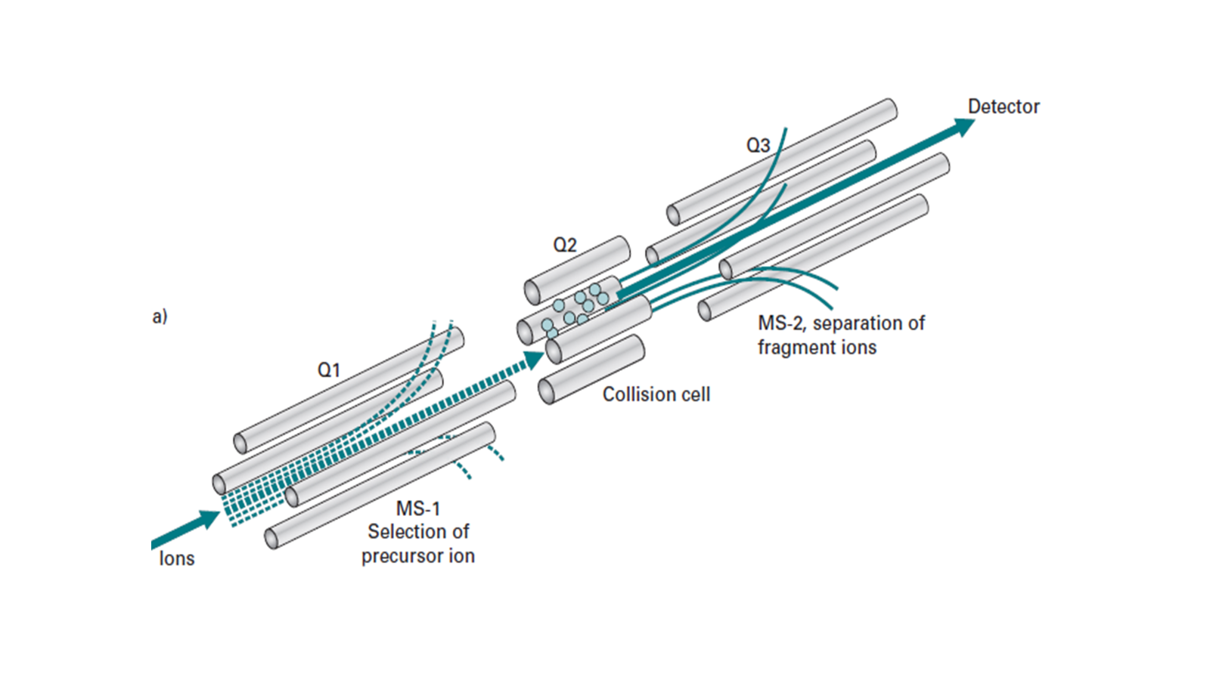
TRIPLE QUADRUPOLE MS
First quadrupole(Q1)functions as MS1
Second quadrupole (Q2)acts as collision cell
Third quadrupole (Q3)functions as MS2
Pressure in Q2 is raised so that ions traversing Q2 undergo several collisions leading to dissociation of precursor ions
Q2 is operated as RF ONLY Quadrupole.

Slide 59
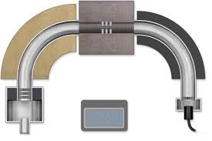
MAGNETIC SECTOR MS/MS
2 Magnetic sector instruments operated in tandem with a collision cell placed between 2 instruments
Permits high resolution selection of both precursor and product ions
Expensive

Slide 60
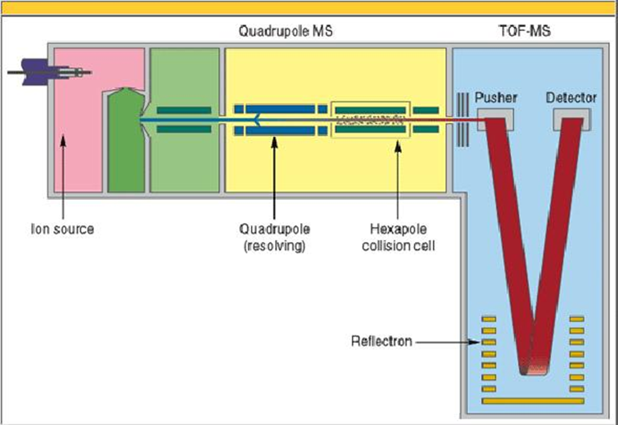
HYBRID MASS SPECTROMETER
Combination of 2 different types of MS in a tandem arrangement.
Combination of quadrupole for the first stage m/z selection and a TOF for second m/z analyzer.
Mainly used for proteomics research.

Slide 61
APPLICATIONS OF TANDEM MS
1)BIOTECHNOLOGY AND PHARMACEUTICALS
1)To determine the chemical structure of drugs and its metabolites.
2)Detection and quantification of impurities.
3)Analysis of liquid mixtures.
4)Finger printing.
2)CLINICAL TESTING AND TOXICOLGY.
Newborn screening,IEB,Cancer,Drug abuse etc.,

Slide 62
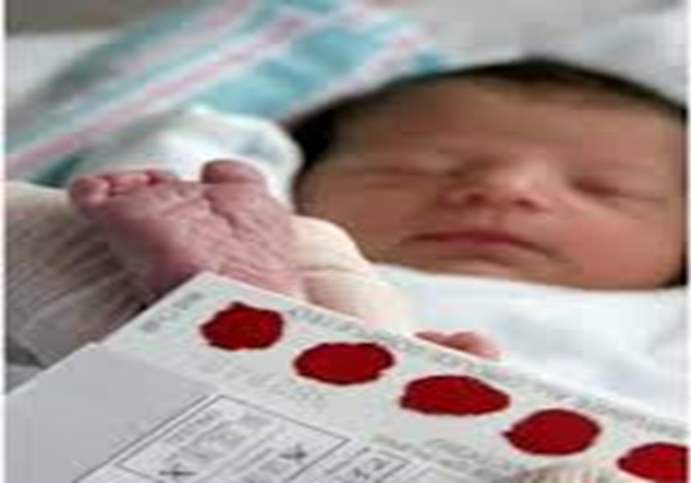
TANDEM MASS SPECTROMETRY IN A NEW BORN

Slide 63
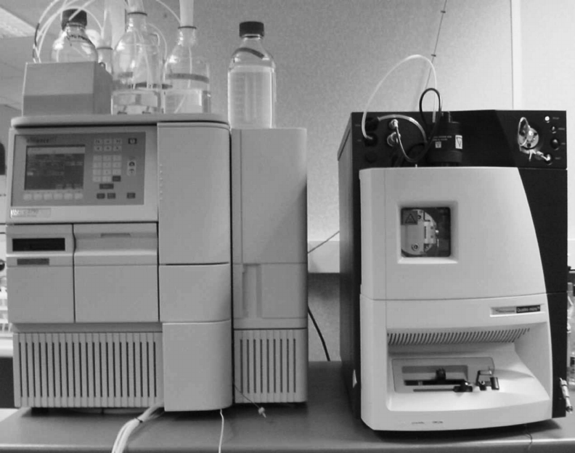
NEW BORN SCREENING: SPECIAL CHAMBER IN MS/MS CAUSES THE SUBSTANCES IN BLOOD TO SEPERATE AND MOVE
SMALLER LIGHT PARTICLES MOVE FASTER THAN LARGER HEAVIER SUBSTANCES
SUBSTANCES MOVE ACROSS A SPECIAL FILTER
COMPUTER RECORDS WHICH SUBSTANCES ARE PRESENT
COMPUTER ALSO MEASURES THE QUANTITY OF A PARTICULAR SUBSTANCE.

Slide 64
ADVENT OF TMS
BEFORE TMS TECHNOLOGY | WITH TMS
1)One disease-One test | Many diseases -Only one test
2)Many diseases-many tests-many samples | All tests performed on same sample.
 | New born screening easy

