Slide 1
VARIOUS METHOD OF GLUCOSE ESTIMATION , GTT AND PRINCIPAL OF CARBOHYDRATES CHEMISTRY TEST

Slide 2
Normal ranges :
[Reference: American Diabetes Association(ADA) ]
Random blood glucose test :
It is a blood sugar test taken from a non-fasting subject.
Normal range is 70-160 mg/dl.
Fasting blood glucose :
A determination of blood glucose level after an 8 hour period of fasting.
Normal range is 70 – 100 mg/dl.
Levels between 100 – 126 mg/dl are referred to as impaired fasting glucose or pre-diabetes.
Diabetes is typically diagnosed when fasting blood glucose levels are 126 mg/dl or higher.
Postprandial blood glucose test :
It is determination of the glucose in the blood after a meal.
Normal range is under 140mg/dl.
High value indicate diabetes.

Slide 3
Glycosylated hemoglobin :
hemoglobin to which glucose is bound.
Also known as glycohemoglobin or as hemoglobin A1C.
Tested for to monitor long-term control of diabetes mellitus.
Its level increase in of person with poorly controlled diabetes mellitus.
Since glucose stay attached to hemoglobin up to life of RBC (120 days ).
It reflect the average blood glucose level over past 3 month.

Slide 4
Ranges of glycosylated hemoglobin :
Normal range is between 4 to 5.7%.
Hemoglobin A1C between 5.7 to 6.4 % mean you have a greater change of getting of diabetes.
Level of 6.5% or higher means you have diabetes.

Slide 5
Enzymatic determination of glucose in blood
Glucose oxidase – peroxidase method (GOD POD method)
hexokinase method (HKS method)
Glucose dehydrogenase method (GDH method )

Slide 6
GOD POD METHOD
( glucose oxidase – peroxidase method )
PRINCIPLE:
Glucose + H₂O + O₂ GOD Gluconic acid + H₂O₂ 4 Amino Phenazone + Phenol + H₂O₂ POD
Quinonimine – Pink colour compound
Intensity is determined at on 505 nm filter.

Slide 7
Procedure :
 | TEST | STAN. | BLANK
1)Glucose reagent (ml) | 1.0 | 1.0 | 1.0
2)Serum(ml) | 0.01 | --- | ----
3)Glucose standard(ml) | --- | 0.01 | ----
4)Distilled water(ml) | --- | ---- | 0.01
Mix & keep it for incubation at 37 ͦC for 15 min or at room temperature for 30 min.
Measure the intensity of colour at 505 nm filter (Green filter).

Slide 8
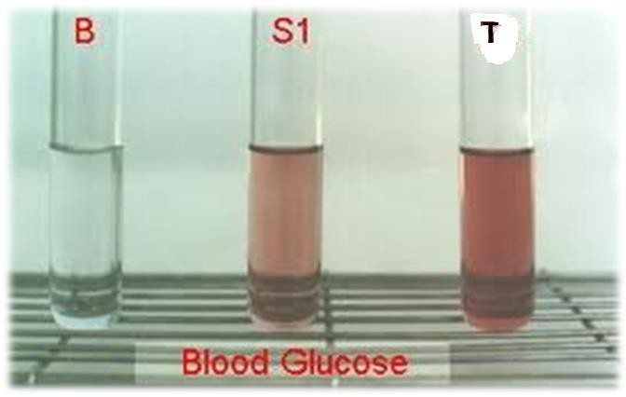

Slide 9
Calculation:
Concentration of Substance =
O.D. of Test-O.D. of Blank × Concentration of Std.
O.D. of Std.- O.D. of Blank
General Parameter:
Reaction type : End point
Standard Concentration : 100 mg/dl
Linearity is up to 500 mg/dl
If sample value is 500mg/dl ,dilute the sample 1:2 with distilled water & repeat assay.

Slide 10
ADVANTAGES :
It is specific for glucose estimation.
This method is sensitive, simple.
It is cheap method.
DISADVANTAGE:
This method show linearity only up to 500 mg/dl of glucose concentration.

Slide 11
Hexokinase method
PRINCIPLE:
Glucose +ATP ↔ Glucose 6 phosphate +ADP
Glucose 6 Phosphate + NAD ↔ 6- Phosphogluconate + NADH+H⁺
Conversion of NADH from NAD at 340nm increase in O.D. is measured at fix interval
Increase O.D. /min is directly conc. of glucose in the specimen = ∆ O.D.

Slide 12
PROCEDURE:
Pipette 1.0 ml Of Glucose Reagent in Cuvette
incubate ↓water bath at 37⁰ for 1 minute
add 10 μl of sample
↓mix well
read O.D./minute up to 3 minute
Repeat each steps by using Standard.
CALCULATION:
Plasma glucose = Delta O.D./min(test) × 100
Delta O.D./min(Std.)

Slide 13
ADVANTAGES :
It is most sensitive method.
Disadvantages :
This method show linearity only up to 500 mg/dl of glucose concentration.

Slide 14
GLUCOSE DEHYDROGENASE METHOD
(GDH Method)
PRINCIPLE:
GLUCOSE ↔ D-GLUCONO-δ-LACTONE NAD⁺↔NADH + H⁺
The appearance of NADH is measured at 340 nm.

Slide 15
Chemical method for determination of blood glucose
Ortho- toluidine method
Folin – vui method
Glucometer

Slide 16
Ortho-toluidine method
PRINCIPLE:
Glucose react with ortho-toluidin in hot acidic medium to form a Green color complex
Color intensity α Conc. Of Glucose
Measured in photometer at 620 nm to 660 nm.
It can measured other monosaccharide also.

Slide 17
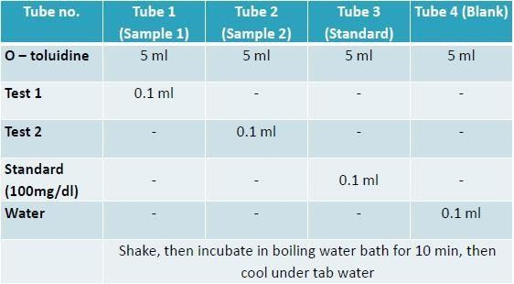
PROCEDURE:

Slide 18
Calculation :
The concentration of glucose in the standard solution is 100mg/100ml.
The concentration of glucose in urine is given by:
O.D. TEST
–––––––––––––– × 100 = mg Glucose /100ml blood
O.D. STANDARD

Slide 19
Disadvantages :
It is Non-Specific Method.
Time consuming method.
Ortho-toluidine is carcinogenic, so not utilized nowadays.

Slide 20
Folin - Vui Method
Principle :
When glucose or other reducing agent are treated with alkaline copper solution they reduce the copper with the result insoluble cuprous oxide is formed.
The cuprous oxide form is allowed to react with phospharomolybdate to form molybdenum blue colour complex which can be read at 420nm.

Slide 21
Procedure :
1 ml blood added in boiling tube contain 7 ml water+ 1 ml 10% sodium tungastate mix it + 1 ml of 2/3N H2SO4 with shaking.
Allowed to stand for 10 min.
Filtered it(This filtered is tungastic acid blood filtrate and it taken as a test sample).

Slide 22
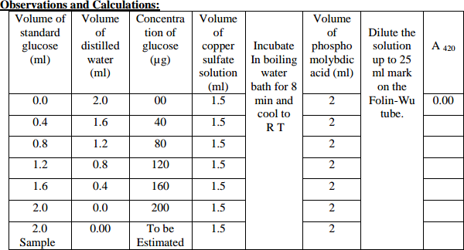

Slide 23
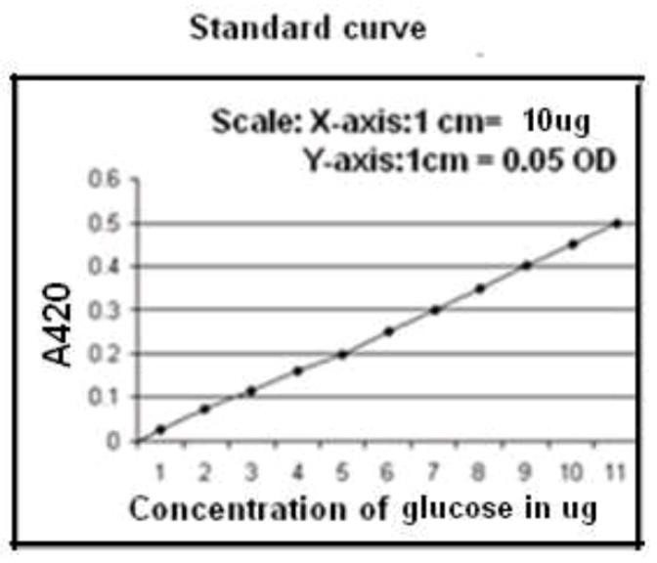
Plot the standard curve by taking concentration of glucose along X-axis and absorbance at 420 nm along
Y-axis.
From the standard curve calculate the concentration of glucose in the given sample.

Slide 24
Calculation :
Mg of glucose/100 ml of blood = mg of glucose in standard ×(OD of test/OD of standard) × 100/0.2

Slide 25
Disadvantages:
Time consuming method.
Non-specific method, also measure fructose.
•
•

Slide 26
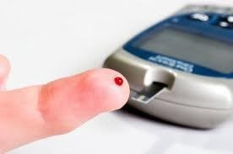
Glucometer
Blood is placed onto a test strip & insert into the glucometer to measure blood sugar level.
On each strip, there is about 10 layers, including a stiff plastic base plate and other layers containing chemicals or acting as spacer.
For instance there is a layer containing two electrodes (silver and other similar metals).
There also is a layer of a immobilized enzyme, glucose oxidase and another layer containing microcrystalline potassium ferricyanide.
The reaction interest between glucose and enzyme.

Slide 27
Principle:
Glucose
GOD
Glucuronic acid
Glucuronic acid + ferricynide
ferrocynide ē Current
The principle behind blood glucose meter is based on reactions that are analyzed by electrochemical sensor.
The glucose in the blood sample react with the glucose oxidase to form glucuronic acid which then reacts with ferricyanide to form ferrocyanide.
The electrode oxidizes the ferrocyanide, and this generate a current directly proportional to the glucose concentration.

Slide 28
Glucometer is only type of dry chemistry.
Currently many type of glucometer are available that give result
as
plasma equivalent
whole blood glucose
Glucose level in plasma is generally 10- 15% higher than whole
blood.
So it is important for patients to know whether it give result in “whole blood equivalent ˮ or “plasma equivalent ˮ.
Advantages:
Can do from capillary blood collection method.
Disadvantages:
It is coastly.
It gave slightly higher result than actual.

Slide 29
MEASUREMENT OF GLUCOSE IN URINE
For glucose estimation from urine is collected.
METHOD:
1.Qualitative 2.Quantitative
Semi- quantitative 1)QUALITATIVE METHOD:
It is determination by Benedict test

Slide 30
2) QUANTITATIVE MATHOD:
It Is Determination By Hexokinase & Glucose Dehydrogenase
3)SEMI QUANTITATIVE MATHOD:
It is determination by Glucose Oxidase strip test
E.g. Urine strip

Slide 31
Benedict's Test
This is a very simple and effective method of the amount of glucose in the urine
Principle:
Glucose(R-CHO)+ 2Cu⁺² +2H₂O→ Gluconic acid(R- COOH) +Cu₂O +4H⁺
Procedure:
5 ml of Benedict's reagent
↓
8 to 10 drops of urine
↓Boiling the mixture & cool down it
observe changes colour

Slide 32
Result & Interpretation on Benedict Test
Blue - sugar absent;
Green - 0.5 gm% sugar = +1
Yellow – 1.0 gm% sugar = +2
Orange - 1.5 gm% sugar = +3
Brick red – 2.0 % or more sugar = +4

Slide 33
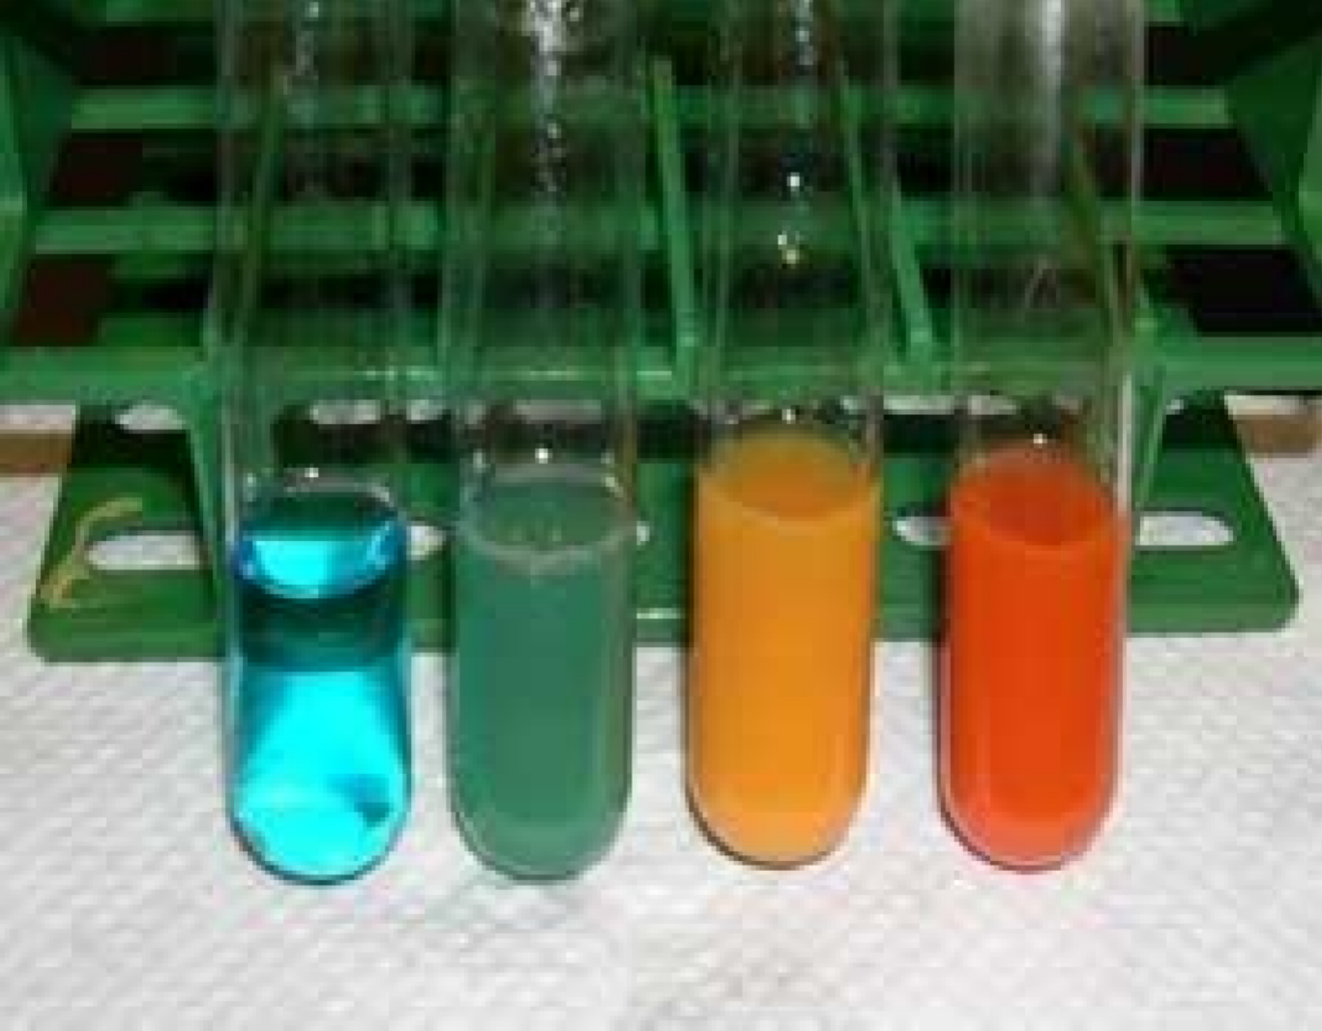
colour : gm% sugar :
grade : -
blue absent
green 0.5%
+1
orange 1.5%
+3
brick red 2.0%
+4

Slide 34
Significant of Benedict Test
Each reducing substance gives positive test
So Following substance can gives false positive test E.g. Vitamin – C, B-Complex vitamin, Salicylic acid

Slide 35
Glucose Oxidase Test or Diastix
Paper or plastic strips, called diastix .
A color-chart is provided with the strips.
Strip contain dye are O-toluidine, tetramethylbenzidine , potassium iodide, 4- amino phynazome, phenol.
The dye changes colour on coming in contact with the urine.
After 30 to 60 seconds the colour of the strip matched with the colours of the provided chart.

Slide 36
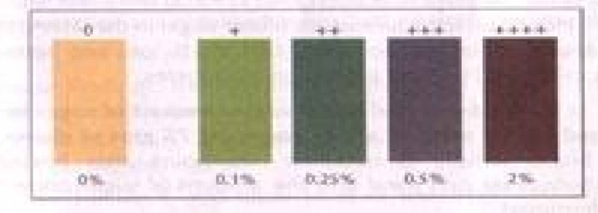
Oxidase Strip

Slide 37
GLUCOSE ESTIMATION IN CSF
CSF is a fluid that flows through and protects the subarachnoid space of the brain and spinal cord.
CSF fluid is mostly collected into plain vial and put it into a ice-pack & transport to laboratory for to analyze it immediately.
In CSF, bacteria & other cells are also present so analyzed immediately
It's obtained by lumbar puncture, L 3-L 4
In CSF, Glucose is estimation by GOD - POD method.
In CSF Contain 2/3 part of plasma glucose.

Slide 38
CLINICAL SIGNIFICANCE
Increased glucose : (hyper glycemia)
Diabetes mellitus
Adrenocortical hyper activity Decreased glucose: (hypo glycemia)
Bacterial infection
Hypo thyroidism
Hypo adrenalism

Slide 39
PRINCIPAL OF CARBOHYDRATE CHEMISTRY TEST

Slide 40
Tests:
Molisch′s test
Benedict′s test
Barfoed′s test
Seliwanhoff′s test
Inversion test
Iodine test

Slide 41
Molisch test
This test is specific for all carbohydrates. Monosaccharide gives a rapid positive test, Disaccharides and polysaccharides react slower.
Objective: To identify the carbohydrate from other macromolecules lipids and proteins.

Slide 42
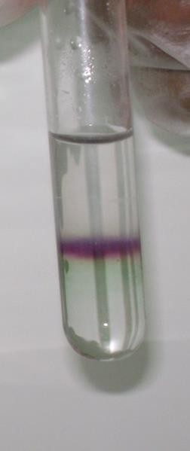
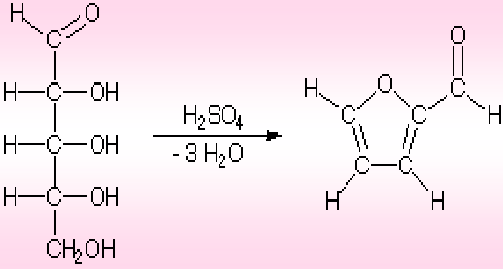
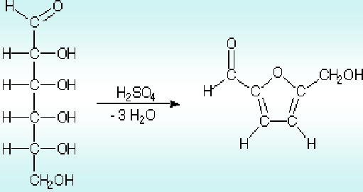
Principle:
The test reagent(H2SO4) dehydrates pentose to form furfural and dehydrates hexoses to form 5- hydroxymethyl furfural.
The furfural and 5- hydroxymethyl furfural further react with α-naphthol present in the test reagent to produce a purple product.
α-naphthol
Purple color
furfural
α-naphthol
Purpel color
5- hydroxymethyl furfural

Slide 43
Procedure :
2 ml of a sample solution
↓add
2 drops of the Molisch reagent ( α-napthol in 95% ethanol)
↓ add
2 ml of concentrated sulfuric acid
↓
violet ring appear
Tube | observation
1-gluccose | +
2-ribose | +
3-sucrose | +
4-starch | +

Slide 44
Benedict's test
Benedict's reagent is used as a test for the presence of reducing sugars.
All monosachharides are reducing sugars; they all have a free reactive carbonyl group.
Some disaccharides have exposed carbonyl groups and are also reducing sugars. Other disaccharides such as sucrose are non-reducing sugars and will not react with Benedict's solution.
Large polymers of glucose, such as starch, are not reducing sugars
Objective: To distinguish between the reducing and non- reducing sugars.

Slide 45
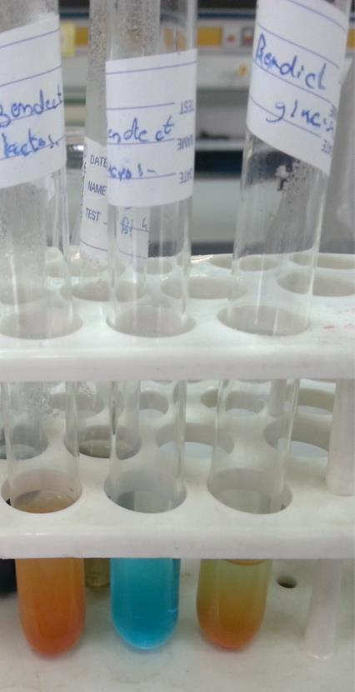
Principle:
The copper sulfate (CuSO4) present in Benedict's solution reacts with electrons from the aldehyde or ketone group of the reducing sugar in alkaline medium.
Reducing sugars are oxidized by the copper ion in solution to form a carboxylic acid and a reddish precipitate of copper oxide.
glucos e
sucros e
lactose
reddish precipitate of copper

Slide 46
Colour of precipitate give the idea about quantity of sugar present in the solution hence the test is semi-quantitative.
It can give false positive result because of non –glucose reducing substance.
Grade Color of Reaction Mixture Approximate Glucose concentration

Slide 47
Procedure :
ml of a sample solution
↓add
ml of Benedict's reagent
↓ heated in a boiling water bath for 5 minutes
formation of a reddish precipitate.
Tube | observation
1-glucose | +
2-sucrose | -
3-lactose | +

Slide 48
Barfoed’s Test
This test is performed to distinguish between
reducing monosaccharides, reducing
disaccharides and non reducing disaccharides.
Objective: To distinguish between mono- , di- and
poly saccharides.
Principle:
Barfoed’s test used copper (II) ions in a slightly
acidic medium
Reducing monosaccharides are oxidized by the
copper ion in solution to form a carboxylic acid and
a reddish precipitate of copper (I) oxide within
three minutes. Reducing disaccharides undergo
the same reaction, but do so at a slower rate.
The nonreducing sugars give negative result.

Slide 49
Barfoed’s reagent, cupric acetate in acetic acid , so in acidic medium , disacchride is a weaker reducing agent than monosacchride, so mono sacchride (1 to 2 minute) will reduce the copper in less time & disaccharide (7 to 12 minute)take time.

Slide 50
Procedure :
1 ml of a sample solution
↓ add
3 ml of Barfoed's reagent (a solution of cupric
acetate and acetic acid
↓
Heat mixture in a boiling water bath for 6 min.(after
the 3 min check the tubes)
↓
Reddish precipitate formed
Tube | observation
1-glucose | +
2-sucrose | -
3-lactose | -

Slide 51
Seliwanoff's Test
This test is used to distinguish between aldoses (like glucose) and ketoses (like fructose).
Objective: To distinguish between aldose and ketone sucrose.

Slide 52
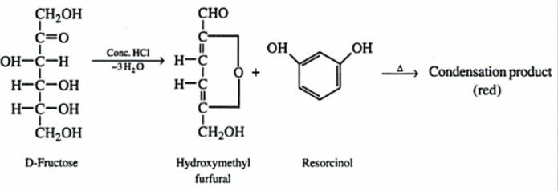
Principle:
Seliwanoff's Test uses 6M HCl as dehydrating agent and resorcinol as condensation reagent. The test reagent dehydrates ketohexoses to form 5- hydroxymethylfurfural. 5-hydroxymethylfurfural further condenses with resorcinol present in the test reagent to produce a cherry red product within two minutes. Aldohexoses react to form the same product, but do so more slowly giving yellow to faint pink color.

Slide 53
Procedure :
½ ml of a sample solution
↓add
2 ml of Seliwanoff's reagent
↓
heat mixture in a boiling water bath for 2ml
↓
colour develope
Tube | observation
1-glucose | -
2-fructose | +

Slide 54
Inversion test
Principle:
D- Glucose + D-fructose
[α]D = 52.5° [α]D= -92.4°
Sucrose + H2O
[α]D = + 66.5°
Sucrose is dextrorotatory.
The optical rotation change from dextrorotatory to laevorotatory on hydrolysis , since fructose causes a much greater laevorotation than the dextrorotation
caused by glucose.
This is known as inversion.
The resultant hydrolysate is called invert sugar, which is more sweeter than sucrose.

Slide 55
Procedure :
5ml of OS
↓
2 drop of conc. HCl
↓boil for 2 min. & cool down
5 drop of 40% NAOH(alkaline)
↓
perform benedict & seliwanoff test
↓
observe colour reaction

Slide 56
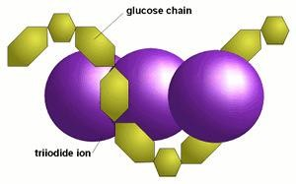
Iodine test:
Principle:
Iodine binds starch to give blue colored complex. Shorter chain gives a red color.
Longer chain give more intense color reaction.

Slide 57
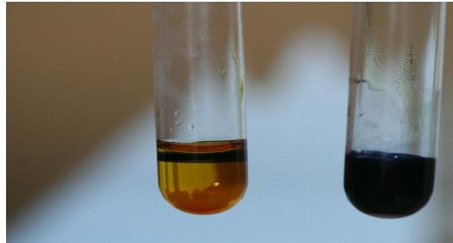
Procedure :
ml of OS
↓
drop of iodine solution
↓mix colour develop (blue ,violet )

Slide 58
THANK YOU

