Slide 1
EQAS evaluation
Dr. kr Gopala krishnan 3rd Year Resident Doctor, Biochemistry Department, Government Medical College, Bhavnagar.

Slide 2
Terminology
Percentage Deviation Score (%Dev)
RM% Dev
ORM% Dev
SDI
RMSDI
ORMSDI
TS
RMTS
ORMTS

Slide 3
Target scoring system <40 - Unacceptable 41 - 50 Need for improvement 51 - 70 Acceptable 71 - 100 Good 101 - 120 Excellent TDPA-set so that only 10% laboratories achieve TS less than 50.

Slide 4
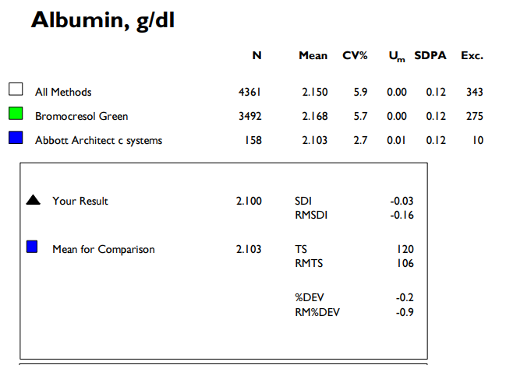
Text section

Slide 6
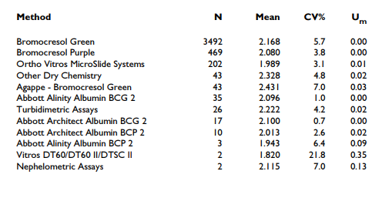
Text section

Slide 7
Graph of SD vs Sample number

Slide 8
Graph showing % Deviation vs Concentration

Slide 9
Graph showing % Deviation vs. Concentration

Slide 10
Graph showing % Deviation vs. Concentration

Slide 11
Graph showing % Deviation vs sample number

Slide 12
Graph of Target score vs Sample number

Slide 13
Acceptable criteria for performance
Target Score > 50
SDI < ±2
% Deviation within the “acceptable limits” set.

Slide 14
THANK YOU

Slide 15
%Deviation = participant’s result - mean for comparison x 100 mean for comparison

Slide 16
SDI
SDI= lab mean- mean for comparison
SDPA
SDPA= CVPA X mean for comparison
100
CVPA= TDPA/1.64

