Slide 1
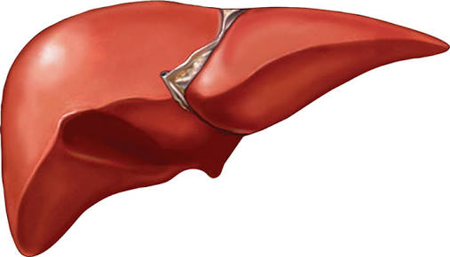
Liver enzymes
Dr. Sapna Patel
Biochemistry Resident
GMC, Bhavnagar

Slide 2
USES
Screening of liver dysfunction
To recognize Pattern of liver disease
To Assess Prognosis of patient
Follow up of disease
To evaluate the response to therapy

Slide 5
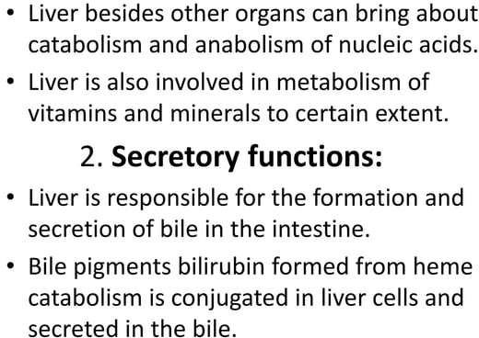

Slide 6
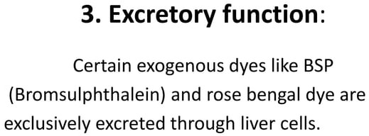

Slide 8
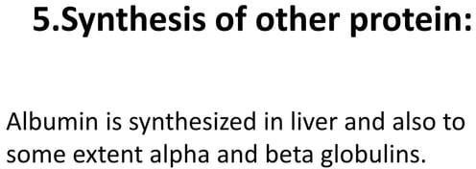

Slide 10
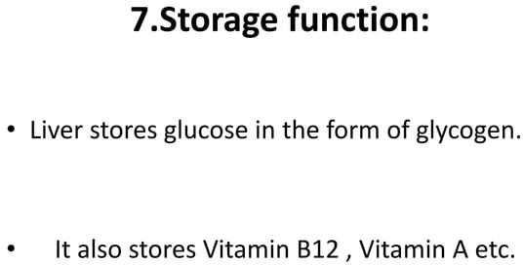

Slide 11
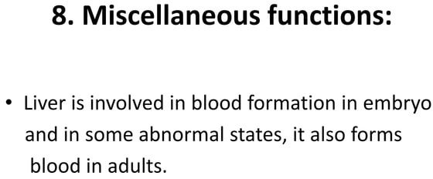

Slide 13
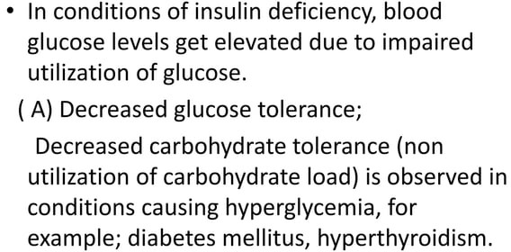

Slide 14
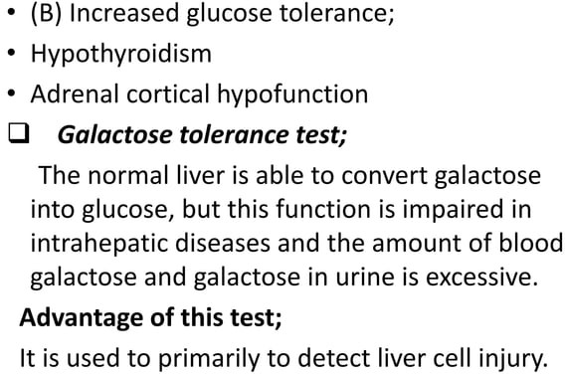

Slide 16
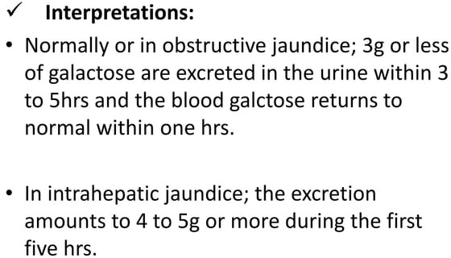

Slide 17
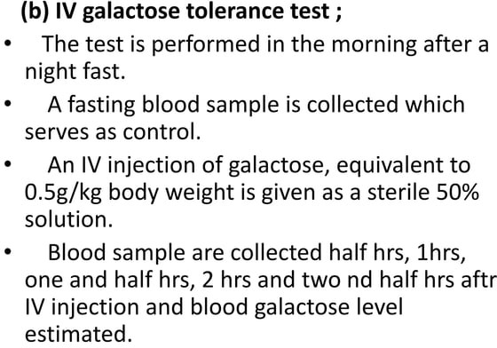

Slide 18
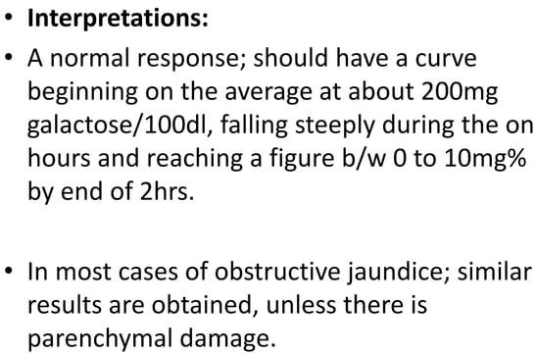

Slide 20
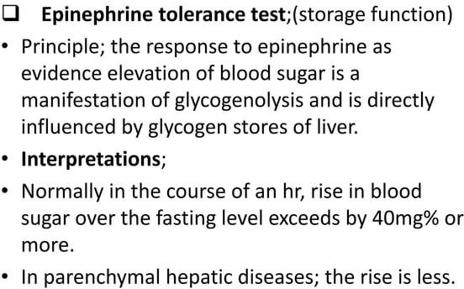

Slide 22
Total Protein PRINCIPAL
Method: Biuret
Normal Range
Serum Protein: 6-8 g/dl
Serum Albumin:3.5-5.5 g/dl

Slide 23
Total Protein & Albumin
Both decrease in Hepato-cellular disease.
Because it is synthesized & store into liver.
It may found decrease in following disease:
Malnutrition
Chronic disease
Nephrotic syndrome
Inflammatory bowel disease
Chronic infection
Tuberculosis

Slide 24
Albumin Principal
Method: Bromocresol Green (BCG)
Albumin present in serum binds specifically with bromocresol green at pH 4.1 to form green colored complex, intensity of which can be measured colorimetrically by using 640 nm (or a red filter)
Proteins react with cupric ions in alkaline medium to form a violet colored complex. The intensity of the color produced is directly proportional to proteins present in the specimen and can be measured on a photometer at 530 nm (or by using a green filter).

Slide 26
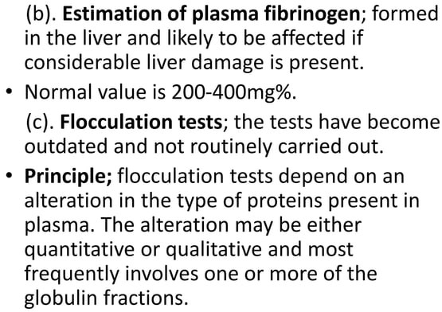

Slide 27
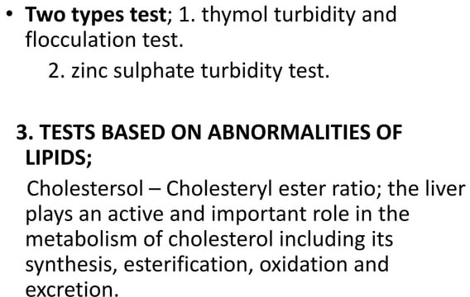

Slide 29
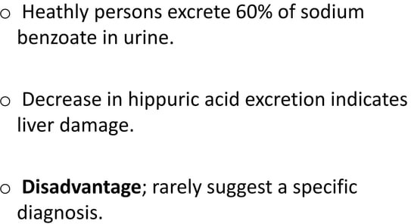

Slide 30
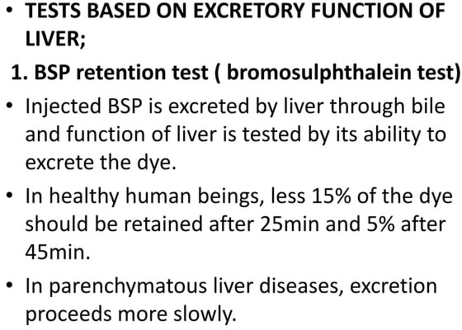

Slide 32
Liver Enzyme include:
SGPT (ALT-Alkaline Transaminase)
SGOT (AST-Aspartate Transaminase)
GGT (Gamma Glutamyl transferase)
ALP (Alkaline Phosphatase)
5’ nucleotides
LDH (Lactate Dehydrate)

Slide 33
Other test include:
Bilirubin
Total Protein, Serum Albumin, Serum Globulin
PT/BT /CT (Prothombin, Bleeding, Clotting Time)
Blood ammonia
AFP (Alfa feto protein)
Ceruloplasmin
Leucine aminopeptidase
Alpha - 1 antitrypsin
Procollagen III peptide
Cholesterol
Glycoprotein

Slide 34
SGPT(ALT)
Serum Glutamic Pyruvate Transaminase (SGPT)
Alanine aminotransferase (ALT)
Method: L- Alanine LDH UV Kinetic (IFCC kinetic)
Measuring the rate of decrease in absorbance of NADH at 340 nm due to the oxidation of NADH to NAD.
L-Alanine + α-ketoglutarate ^{ALT} Pyruvate+ L-glutamate
Pyruvate+NADH+H LDH Lactate +NAD+

Slide 35
Significance
Enzyme present in hepatocytes .
Significantly elevated levels of ALT (SGPT) often suggest the existence of other medical problems such as viral hepatitis, liver damage.
So ALT is commonly used as a way of screening for liver problems.
Alanine transaminase (ALT) – Male: 13-35 U/L
– Female: 10-30 U/L

Slide 36
SGOT (AST) Principal
Method: L- Aspartate LDH UV Kinetic
SGOT (AST) catalyzes the transfer of amino group between L-Aspartate and α Ketoglutarate to form Oxaloacetate and Glutamate.
The Oxaloacetate formed reacts with NADH in the presence of Malate Dehydrogenase to form NAD.
The rate of oxidation of NADH to NAD is measured as a decrease in absorbance which is proportional to the SGOT (AST) activity in the sample.
L-Aspartate + α Ketoglutarate SGOT Oxaloacetate +L-Glutamate
Oxaloacetate + NADH + H+ MDH Malate + NAD+

Slide 37
Significance
The AST is a cellular enzyme is found in highes concentration in heart muscle, The cells of the liver & the cells of the skeletal muscle .
The blood SGOT levels are thus elevated with liver damage or insult to the heart.
Some medication can also raise SGOT level.
Normal Range:- 10-40 U/L

Slide 38
Interference From ALT & AST:
When a cell is damaged, it leaks this enzyme into the blood, where it is measured.
Very high values(300-1000 U/L)
Acute Viral hepatitis/ toxic hepatitis.(ALT>AST)
Paracetamol (acetaminophen) overdose.
infectious mononucleosis
Moderate high values(100-300 U/L)
Alcoholic Liver disease
Autoimmune hepatitis
Wilson's disease
Non Alcoholic hepatitis
Minor high values(<100U/L)
Non Alcoholic steatohepatitis (NASH)
Chronic Viral hepatitis

Slide 39
Clinical significance of AST/ALT
Normal AST/ALT ratio is 0.8
AST/ALT ratio >2 seen in
Alcoholic Liver disease
Cirrhosis
Non Alcoholic steatohepatitis (NASH)
Liver metastasis
MI
Erythromycin treatment
AST/ALT ratio decreased seen in
Acute Viral hepatitis/ toxic hepatitis
Extra hepatic obstruction

Slide 40
GGT(Gamma Glutamyl Transaminase)
In Body , it is use for synthesis of glutathione.
Has 11 iso-enzymes.
Seen in liver, kidney, pancreas, Intestinal cell & prostate gland
Highest increases in intra or post hepatic biliary obstruction
Higher and more persistent increases than ALP (Alkaline Phosphatase)

Slide 41
GGT Significance
Normal value : 10 – 30 IU/L
It is microsomal enzyme. Its activity is induced by alcohol, Phenobarbitone and rifampicin.
So it is clinically important for diagnosis of alcohol abuse. GGT level in alcoholics roughly parallels the alcohol intake.
Although reasonably specific to the liver and a more sensitive marker for cholestatic damage than ALP.
Also increased in Pancreatic diseases, renal diseases, COPD.
↑ serum GGT activity sometimes following MI or congestive cardiac failure.

Slide 42
GGT PRINCIPAL
Method: Carboxy Substrate Method
GGT catalyzes the transfer of amino group between L- γ-Glutamyl-3-carboxy-4 nitroanilide and Glycylglycine to form L- γ-Glutamylglycylglycine and 5-amino-2- nitrobenzoate.
The rate of formation of 5-amino-2-nitrobenzoate is measured as an increase in absorbance which is proportional to the GGT acitivity in the sample.
L- γ-Glutamyl 3-carboxy 4-nitroanilide + Glycylglycine GGT
L- γ-Glutamyl glycylglycine+ 5-Amino-2- nitrobenzoate.

Slide 43
Alkaline Phosphatase
Widely distributed, high concentrations in liver, bone, intestines, gall bladder, spleen, placenta and kidney.
The main sources of serum ALP is Hepatobiliary tree and bones.
Elevated levels during healing of fractures , active growth and during the 3rd trimester of pregnancy.
↑↑ serum ALP activity in liver disease is mainly due to Cholestasis.
Normal value : 40 – 125 IU/L

Slide 44
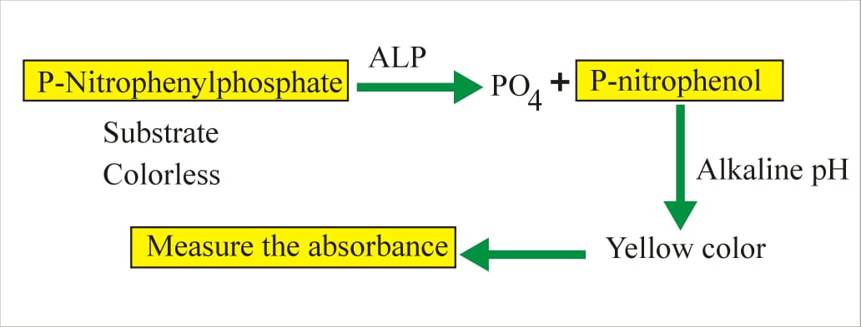
Reaction:

Slide 45
Interference
Mild elevations (<500 IU/L)
Viral hepatitis
Alcoholic cirrhosis
Infiltrative liver disease like lymphoma, sarcoidosis
Moderate elevation (500 – 1000 IU/L)
Cholecystitic
Gall bladder stone
Severely elevation (>1500 IU/L)
Osteomalacia
Osteoporosis
Ricket
Osteosarcoma
Bone tumour
Paget's disease

Slide 46
Isoenzymes of ALP
Alpha – 1 ALP (10%)
In biliary canaliculi epithelium, increased in obstructive jaundice
Alpha – 2 heat labile ALP (25%)
In hepatic cells
Alpha – 2 heat stable ALP (1%)
In placental cell so found in normal pregnancy
Regan Isoenzymes/carcinopla cental enzyme = Carcinoma of lung, liver & gut
Pre – beta ALP (50%)
Bone disease
Gamma – ALP (10%)
Intestinal cells
Leukocyte ALP
Decrease in chronic myeloid leukemia
Increase in lymphoma

Slide 47
5’ – Nucleotidase/Nucleotide Phosphatase
Ecto – enzyme - enzyme present on cell membrane
Normal value : 2 – 10 IU/L
Moderate increase in hepatitis
Very high in biliary obstruction
Value does not affected in any type of bone diseases.

Slide 48
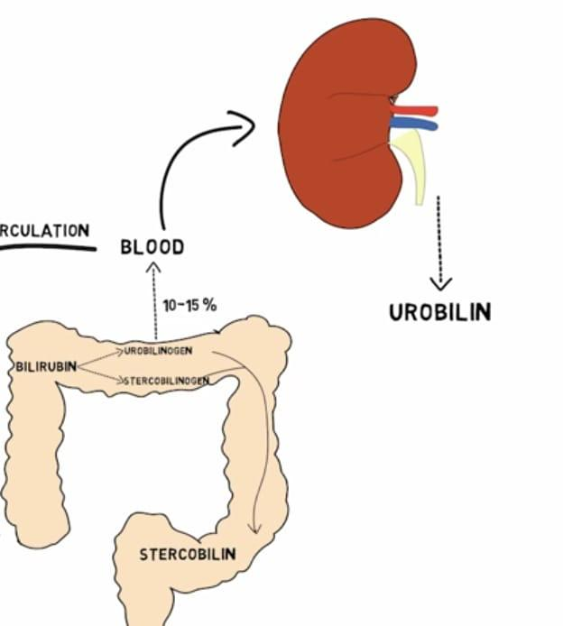
Bilirubin Pathway

Slide 54
Different between Unconjugated & Conjugated Bilirubin
 | UNCONJUGATED | CONJUGATED
In water | Insoluble | Soluble
In alcohol | Soluble | Soluble
Normal | <1.2 | <0.4
In bile | Absent | Present
In Urine | Always absent | Normally absent
Diffusion into tissues | Diffuses-yellow colour | Doesn’t diffuse
Van den bergh | Indirect + | Direct +

Slide 56
Type & Cause of Jaundice
Pre-hepatic Jaundice
Neonatal (Physiological) Jaundice
Malaria
G 6 PD deficiency
Thalassaemia
Sickle cell disease
Mis-match Blood Transfusion
Auto-immune
Intra-Hepatic Jaundice
Acute Viral hepatitis
Alcohol Cirrhosis
Cirrhosis of Liver
Primray Biliary Cirrhosis,
Haemochromatosis
Wilson Disease
Alpha-1 antitrypsin deficiency
Drug induce – Quinine Group, NSAID, Chemotherapeutic drugs
Post Hepatic Jaundice
Gall Bladder - Common Bile Duct - Pancreatic duct Stone
Gall Bladder - Hepatic – Pancreatic – Duodenal Carcinoma

Slide 57
PHYSIOLOGIC JAUNDICE OF THE NEWBORN

Slide 58
PHOTOTHERAPY

Slide 59
Features | Pre-hepatic Heamolytic |  | Hepatic Hepatocellular | Post-hepatic Obstructive
Blood Examination
TB | ↑↑ |  | ↑↑ | ↑↑
DB | Normal |  | ↑ | ↑↑
IB | ↑↑ |  | ↑ | Normal
ALT | Normal |  | ↑ ↑ | Normal
ALP | Normal |  | Normal / ↑ | ↑ ↑
Urine Examination
Bile Pigment |  | Normal | Normal / ↑ |  | ↑ ↑
Urobillinogen |  | ↑ ↑ | Normal / Absent |  | Absent
Bile Salt |  | Normal | Normal / ↑ |  | ↑ ↑
Stool Examination |  | Normal | Normal |  | Clay Colour
Specific Investigation |  | Haemoglobin, LDH | Liver Function Test |  | USG Abdomen

Slide 60
Bilirubin PRINCIPAL
Method: Diazo Reaction
Bilirubin glucuronide +diazonium salt azodye (tan or pink to viotel)

Slide 61
Van den bergh Test :Direct & Indirect Bilirubin
Method: Diazo Reaction
This is specific reaction to identify the increase in serum bilirubin level.
Normal serum gives a negative Van den Bergh reaction.
sulfanilic acid + sodium nitrate Diazotized
Diazotized sulfanilic acid + bilirubin Azobilirubin (purple color).

Slide 62
Van den bergh Test :Direct & Indirect Bilirubin

Slide 63
Prothombin time Principal
Method: Capillary tube method
When preformed tissue thromboplastin and calcium chloride are added to citrated plasma, the plasma clots.
The time taken for the clot to appear is called Prothrombin time (PT).
Prothrombin time (PT) is a blood test that measures how long it takes blood to clot.
Normal Range
11 to 16 second

Slide 64
Interferance
Another measure of hepatic synthetic function is the prothrombin time.
Prothrombin time is affected by proteins synthesized by the liver.
Thus, in patients who have prolonged prothrombin times, liver disease may be present.
Since a prolonged PT is not a specific test for liver disease, confirmation of other abnormal liver tests is essential.

Slide 65
Diseases such as malnutrition, in which decreased vitamin K ingestion is present, may result in a prolonged PT time.
An indirect test of hepatic synthetic function includes administration of vitamin K (10mg) subcutaneously over three days.
Several days later, the prothrombin time may be measured. If the prothrombin time becomes normal, then hepatic synthetic function is intact.
This test does not indicate that there is no liver disease, but is suggestive that malnutrition may coexist with (or without) liver disease.

Slide 66
Bledding Time
Determination of bleeding time helps to detect vascular defect & platelet disorder.
Prolonged bleeding time is generally absociated thrombocytopenia.
Principle:- A 1mm deep prick made on ear lobe or finger of the patient the length of time required for bleeding to cease is record.
Normal Range:- 1-5 minutes

Slide 67
Clotting Time
Principle:- Blood is collected in capillary tube after a finger prick & the stop watch is started. The formation of fibrin string is noted by breaking the capillary tube at regular interval, The time is noted at the first appearance of the fibrin string.
This method is generally useful in severe clotting disorders.
Normal Range:- 4-9 min.

Slide 68
Procedure
Sterilize the finger top with spirit and given a deep prick to get free flow of blood. Start the stop watch as soon as blood starts coming out. Fill a thin capillary tube (it will be filled by capillary action by just applying the tip on the blood drop) with blood. After every 30 seconds, break a small portion of the capillary tube till a thin line of unbroken coagulam is seen between the broken ends. Stop the stop watch and note the time. This is CLOTTING TIME.

Slide 69
Blood Ammonia
Ammonia is a by product of amino acid catabolism.
Ammonia is used as a potential marker of hepatic encephaophathy, but it is not a good test for liver function.
High annonia levels have been found with near normal liver function and vice versa.
Liver converts blood ammonia into urea and muscles use it in transmination reaction to produce glutamate or alanine etc.
Pateints with advanced liver diseases usually also have muscle wasting which then also contributes, to hyperammonemia.

Slide 70
Liver Biopsy
Liver biopsy is oftern the last test used to arrive at a final diagnosis of liver disease.
It is indicated in chronic cases of liver diseases characterized by unexplained clinical findings pointing to liver disease.

Slide 71
Hepatic neoplasm markers
Alpha fetoprotein (AFP): primary hepatocellular carcinoma
Carcinoembryonic antigen (CEA): increased CEA: liver metastatic carcinoma or other carcinomas of the gastrointestinal system
Abnormal prothrombin (APT): increased APT primary hepatocellular carcinoma

Slide 72
THANK YOU

