Slide 2
TANDEM MASS SPECTROMETER
SYNOPSIS
DEFINITION
PRINCIPLE
INSTRUMENTATION
ION ACTIVATION METHODS
MS/MS EXPERIMENTS
TYPES OF TMS ANALYSERS
APPLICATIONS

Slide 3
TANDEM MASS SPECTROMETER (MS/MS)
DEFINITION
Uses 2 MASS SPECTROMETERS in a single instrument.
ONE MASS SPECTROMETER purifies the analyte ion from the mixture using a magnetic field.
the other MASS SPECTROMETER analyses fragments of the analyte ion for identification and quantification induced by collision with an inert gases like argon or helium.

Slide 4
PRINCIPLE OF TMS
combines 2 mass spectrometers MS1andMS2.
first mass spectrometer - select a single(precursor)mass that is characteristics of a given analyte in a mixture.
The mass selected ions pass through a region where they are activated in a way that causes them to fall a part to produce fragment(product)ions. This is usually done by colliding the ions with a neutral gas in a process called collisional activation(CA)or collision induced dissociation(CID).The second mass spectrometer is used to separate fragments ions according to mass.The resulting MS/MS spectrum consist only of product ions from the selected precursor.chemical back ground and other mixture components are absent.

Slide 5
INSTRUMENTATION OF TMS

Slide 6
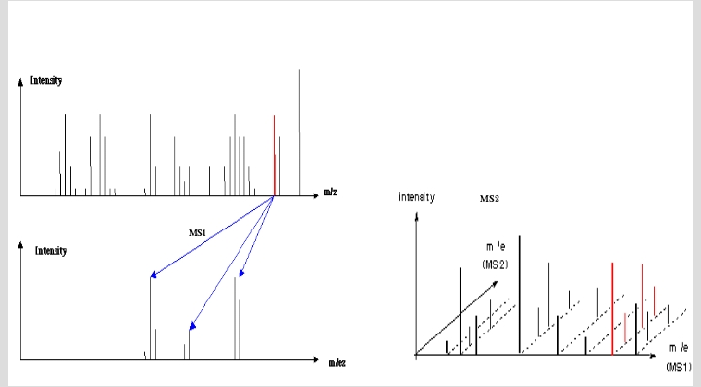

Slide 7
ION ACTIVATION METHODS
Mainly done to increase the internal energy of ions so that chemical bonds will break and fragment ions will be formed.

Slide 8
MS/MS EXPERIMENTS
Consider a precursor ion as, M1+ that decomposes to produce a product ion,M2+,and a neutral loss,N
M1+ M2+ + N
1)PRECURSOR ION SCAN
2)PRODUCT ION SCAN
3)CONSTANT NEUTRAL LOSS SCAN
4)SELECTED REACTION MONITORING.
5)MULTIPLE REACTION MONITORING.

Slide 9
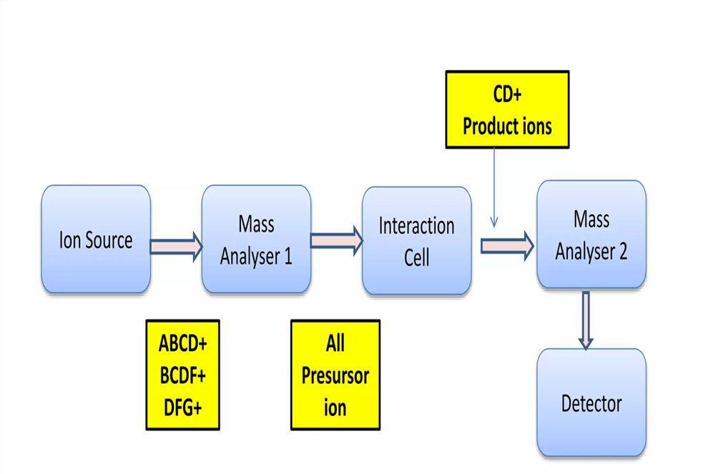
PRECURSOR ION SCAN(M2+ SPECIFIED)
Done to scan all possible precursor ions that decomposes to produce a specified product ion.
Gives information about which precursor ions produces a specific product ion.
In a mixture of compounds,those that gives the same product are identified by precursor ion spectrum
used to analyse specific classes of compounds.(Acyl carnitine Deficiency analysis)
.

Slide 10
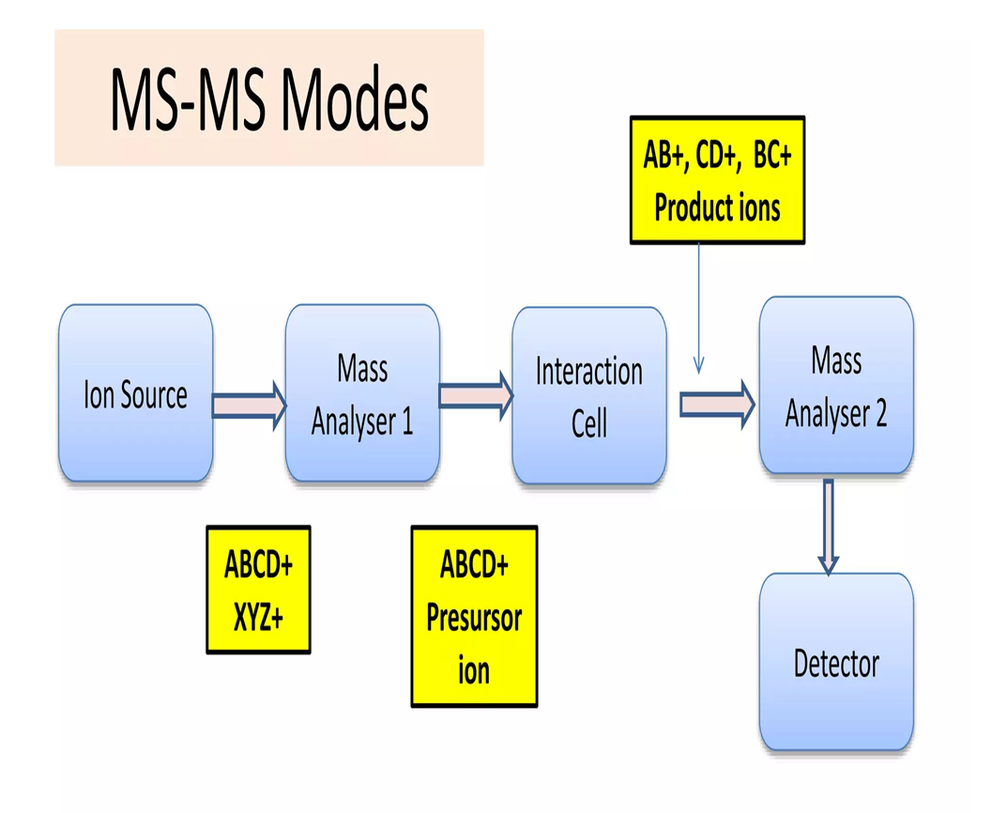
PRODUCT ION SCAN(M1+SPECIFIED)
Done to scan all product ions that result from the decomposition of a specified precursor ion.
Most common and well known MS/MS experiment.
Used to determine structurally significant fragment ions for a selected precursor ion

Slide 11
CONSTANT NEUTRAL LOSS SCAN(N SPECIFIED)
Done to look for all pairs of precursor ions and product ions that differ by a constant neutral loss.
Used to know a class of compounds that differ by constant neutral loss
peaks in constant neutral loss scan can be labeled by the precursor ion mass since we are interested in the identity of intact analyte molecules.

Slide 12
SELECTED REACTION MONITORING(SRM):-
Similar to selected ion monitoring for target compound identification.
In SRM,one specific set of product and precursor masses that are known to be characteristic of certain target compounds.
MULTIPLE REACTION MONITORING(MRM):-
This consists of a series of precursor/product ion pairs with the MS set to jump through the table of parent/product ion pairs in a cyclic fashion
used for quantitative analysis of a few specific target compounds

Slide 13
TYPES OF TMS
1. TANDEM IN TIME TMS -TRAPPING TYPE INSTRUMENTS
2.TANDEM IN SPACE TMS -BEAM TYPE INSTRUMENTS
Which is best???????

Slide 14
BEST-TANDEM IN TIME
because ions are held in one region of space,where parent ions are selected,dissociated and daughter ions analysed sequentially in time.

Slide 15
CLASSIFICATION OF TMS
TRAPPING TYPE
QUADRUPOLE ION TRAP
LINEAR ION TRAP
HYBRID MS
ION CYCLOTRON RESONANCE
MAGNETIC SECTOR
TRIPLEQUADRUPOLE
BEAM TYPE

Slide 16
APPLICATIONS OF TANDEM MS
1)BIOTECHNOLOGY AND PHARMACEUTICALS
1)To determine the chemical structure of drugs and its metabolites.
2)Detection and quantification of impurities.
3)Analysis of liquid mixtures.
4)Finger printing.
2)CLINICAL TESTING AND TOXICOLGY.
Newborn screening,IEB,Cancer,Drug abuse etc.,

Slide 17
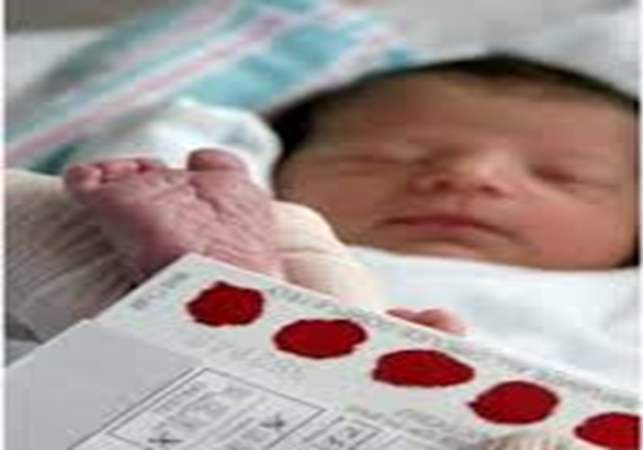
TANDEM MASS SPECTROMETRY IN A NEW BORN

Slide 18
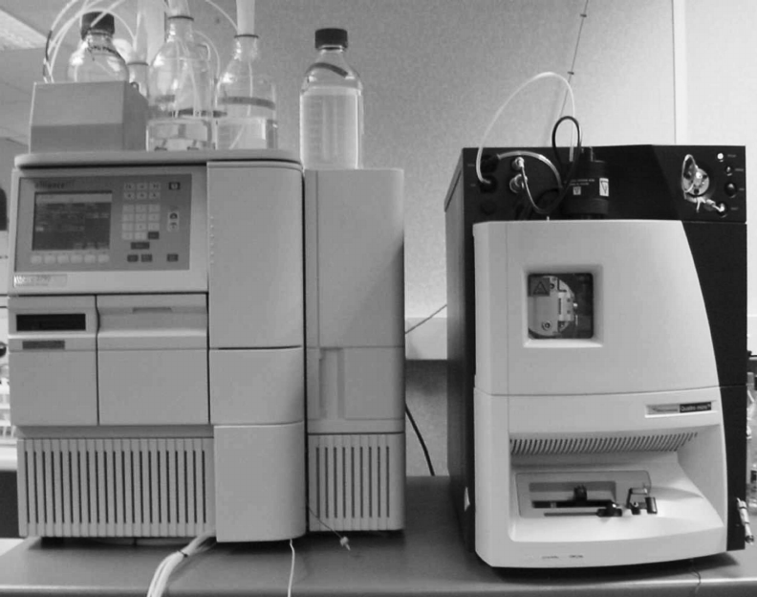
NEW BORN SCREENING: SPECIAL CHAMBER IN MS/MS CAUSES THE SUBSTANCES IN BLOOD TO SEPERATE AND MOVE
SMALLER LIGHT PARTICLES MOVE FASTER THAN LARGER HEAVIER SUBSTANCES
SUBSTANCES MOVE ACROSS A SPECIAL FILTER
COMPUTER RECORDS WHICH SUBSTANCES ARE PRESENT
COMPUTER ALSO MEASURES THE QUANTITY OF A PARTICULAR SUBSTANCE.

Slide 19
ADVENT OF TMS
BEFORE TMS TECHNOLOGY | WITH TMS
1)One disease-One test | Many diseases -Only one test
2)Many diseases-many tests-many samples | All tests performed on same sample.
 | New born screening easy

Slide 20
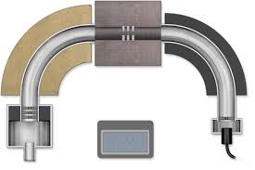
MAGNETIC SECTOR MS/MS
2 Magnetic sector instruments operated in tandem with a collision cell placed between 2 instruments
Permits high resolution selection of both precursor and product ions
Expensive

Slide 21
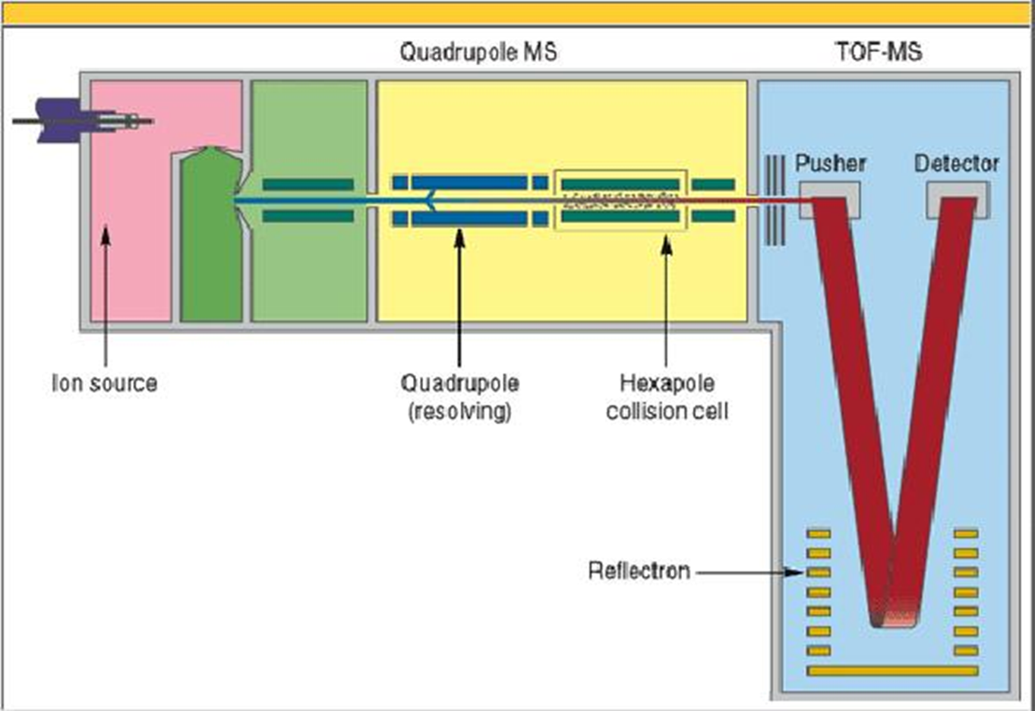
HYBRID MASS SPECTROMETER
Combination of 2 different types of MS in a tandem arrangement.
Combination of quadrupole for the first stage m/z selection and a TOF for second m/z analyzer.
Mainly used for proteomics research.

Slide 22
APPLICATIONS OF TANDEM MS
1)BIOTECHNOLOGY AND PHARMACEUTICALS
1)To determine the chemical structure of drugs and its metabolites.
2)Detection and quantification of impurities.
3)Analysis of liquid mixtures.
4)Finger printing.
2)CLINICAL TESTING AND TOXICOLGY.
Newborn screening,IEB,Cancer,Drug abuse etc.,

